Slide 1
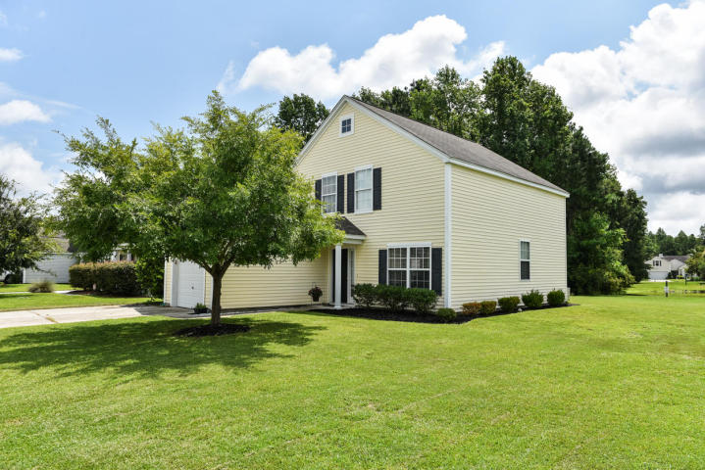
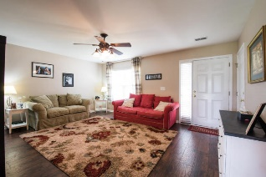
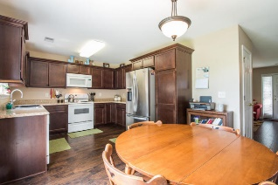
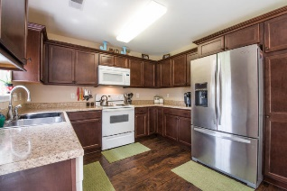
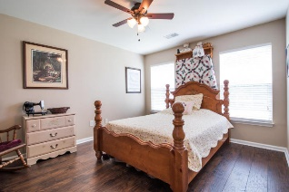
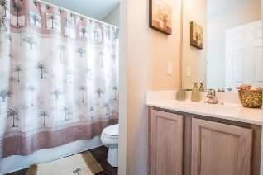
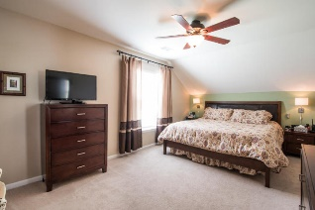
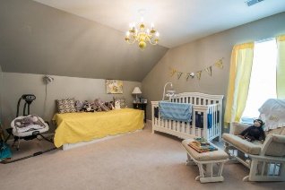
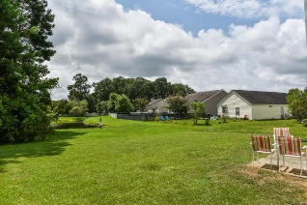
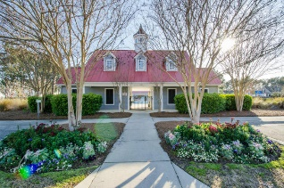
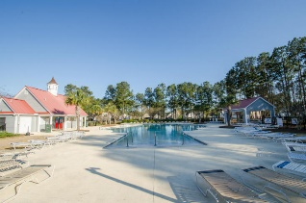


1228 Shadow Mist Lane
The Peninsula - Charleston, SC 29492 - MLS# 16021095 - $250,000
Fantastic Pond Site Opportunity! Just Reduced!
Charming home located off Clements Ferry Road in the desirable neighborhood The Peninsula features the convenience of dual masters - one downstairs and one up. Owner just installed beautiful wood floors throughout the bright open eat-in kitchen, powder room and spacious family room. Continue upstairs to another large master bedroom with walk-in closet and full bath as well as 2 more good sized bedrooms. Situated on a small pond and wooded area, this home is perfect for outdoor lifestyle and entertaining family and friends. It's only a very short walk to the play park or enjoy cooling off in the neighborhood pool at the end of the day. The Peninsula is conveniently located to the new elementary school which is opening this Fall, Mt. Pleasant, Daniel Island and also Highway 526 - only a short drive to Boeing, Charleston International Airport, shopping and restaurants. Don't miss this opportunity to own a wonderful home and enjoy Lowcountry living at its finest!
Peggy Leete
Office - (843) 884-1622
Cell - (843) 532-7923
pleete@carolinaone.com
www.peggyleetehomes.com
Carolina One Real Estate
628 Long Point Rd
Mt Pleasant, SC 29464

