Slide 1
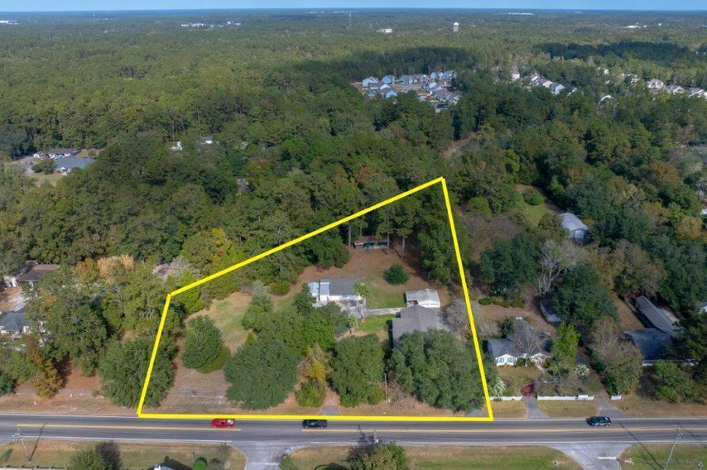
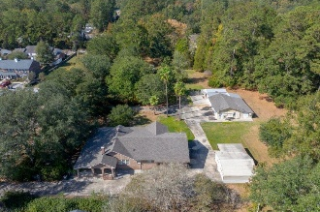
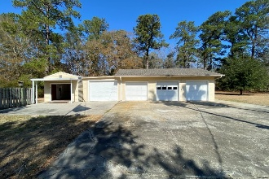
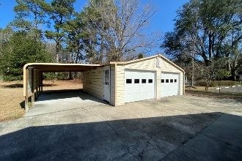
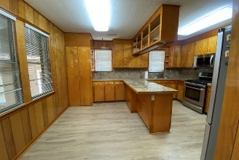
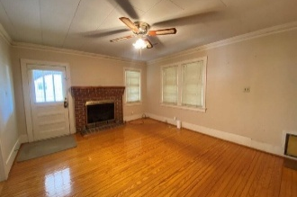


2.25 Acre Live/Work Opportunity
$15,000 Agent Bonus
with ratified contract by 4/15/18
1229 Central Avenue
Summerville, SC 29483
MLS# 24021083
$875,000
$12,100 Under
Recent Appraised Value
Perfect opportunity live and work at the same place. Home is very comfortable. Spacious recreation room leads to kitchen-breakfast room. generous layout of wood kitchen cabinets. Top of the line appliances (double door fridge, gas stove, microwave, dishwasher). Tile counter tops with breakfast bar plus room for your kitchen table. Dining room has excellent natural light and can accommodate spacious table and lots of room for buffet and China cabinetry. Nice opening to main living space with Fireplace. From outside your quest can enter this room from the side porch. Center Hall with antique pot belly style stove (present owner only uses the modern central HVAC) This center hall connects hall bath and 2 bedrooms( one of bedroom is was used as an office) Both rooms are very spacious One of the bedrooms can open to the hallway and the Primary bedroom. The primary bedroom is massive, plenty of room for a big sitting area plus a full bath and walk-in closet. From this room you can access a large sunporch (over 300 sqft This is not reflected in the sqft for the house) ) that area does have separate zone and return for the heat and air. This has several sliding glass doors on the outside wall that offer a fantastic view of your acreage. Laundry is in a separate room off the recreation room. Washer and Dryer can convey. Gas water heater is in this room along with storage shelving. Above the rec room is a partially finished attic that is more storage than anyone can imagine ever being needed. There is easy access to that lighted area by a pull down stairway. Property features 4 garage bays for wood working or any storage needs and behind this 4 car building is a back room that can accommodate so much more work space and storage. It runs behind the 4 car bays. There is running water in the 1st bay and open attic space above the 4 bays. There is a 5th bay in this line of buildings but it is a metal building. All 5 bays have electric garage doors. These 5 areas are on a separate electric meter from the house. For your cars there is another free standing 2 car garage. which is located closer to the residence. There is a whole house generator and dwelling is mostly crawl space except the rec room and laundry room are on slab. Electric gates are on 2 separate driveways to add additional privacy. Fencing is in place. Come see this beautiful land with great trees and massive native shrubbery.
Candace Pratt
843-696-5508
candace@prattandco.com
www.prattandco.com
RE/MAX Southern Shores
9209 University Blvd, Charleston, SC 29406

