Slide 1
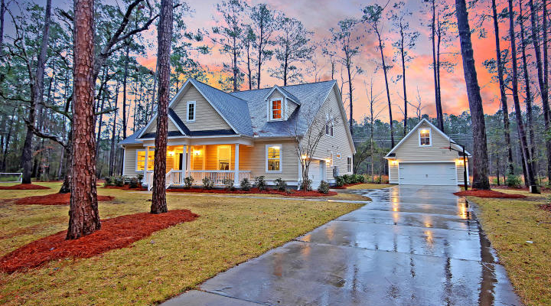

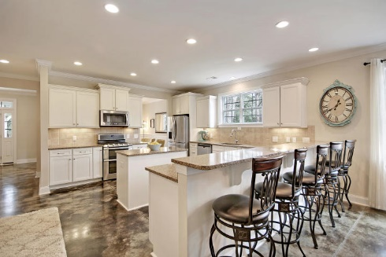

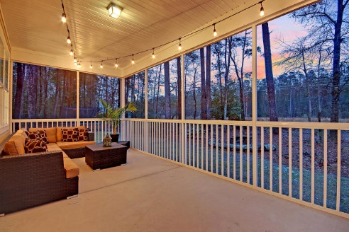
Price Reduced
Price Reduced
For Quick Sale
Open House Saturday 12-3
122 Ashley River Drive
Mateeba Estates ~ Summerville, SC 29485 ~ MLS# 20005366 ~ $499,000
Nestled on one acre of land, this custom built stunner has been impeccably maintained and is move in ready! You will feel like you are stepping into a design magazine when you walk through the front door! From professionally finished concrete floors to beautiful iron banisters and high end moldings, every detail was thought of in this gorgeous dream home in Summerville. The large custom kitchen is perfect for entertaining and flows effortlessly into the main living areas. With quartz countertops, tile backsplash, large center island, and tons of storage, you will look forward to cooking and entertaining. The master bedroom is located on the first floor and is a sanctuary with coffered ceilings and an extra sitting area, perfect for relaxing after a long day. You will find three more bedrooms on the second floor, including a second master featuring beautiful custom barn doors. True to Lowcountry fashion, the large screened back porch is inviting to sit and enjoy the nature that surrounds you. This beautiful, peaceful neighborhood backs up to the Ashley River with a private boat landing within walking distance to the home.
Additional features include:
Top of the line dual-fuel variable speed HVAC system with WiFi-connected Thermostats
HERS rating of 64 (meaning 36% more energy efficient than the typical home)
Upgraded 400 Amp electrical service
Moen Motionsense touch-free kitchen faucet
Tranquil lot on one acre of land.
House is wired for generator power.
Easy distance to downtown Summerville and Charleston.
Zoned for Dorchester 2 schools, including Ashley Ridge High School.
Beautiful screened porch overlooking the woods behind.
Detached double garage with workbench and tons of shelving for storage. Second floor of garage features and finished bonus room, perfect for an office or media suite!
Book your showing today!
Katie Wishneff kwishneff@mattoneillteam.com 843-870-8784

