Slide 1
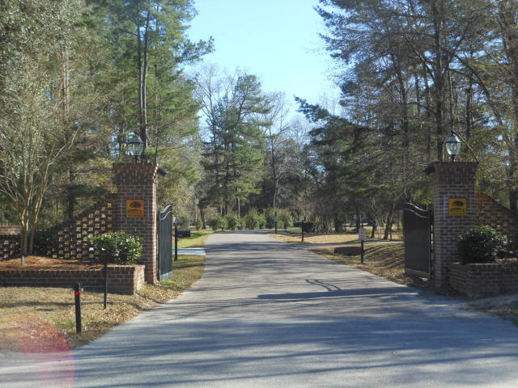
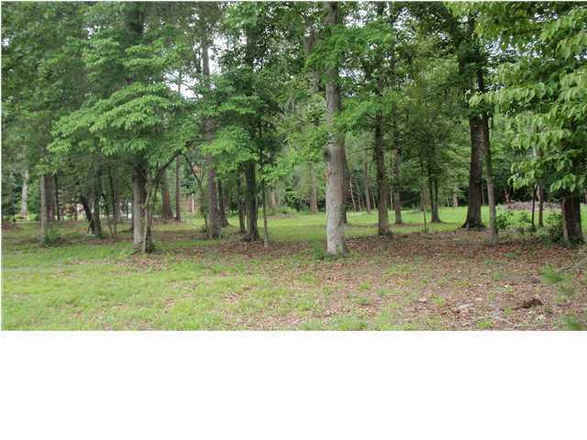
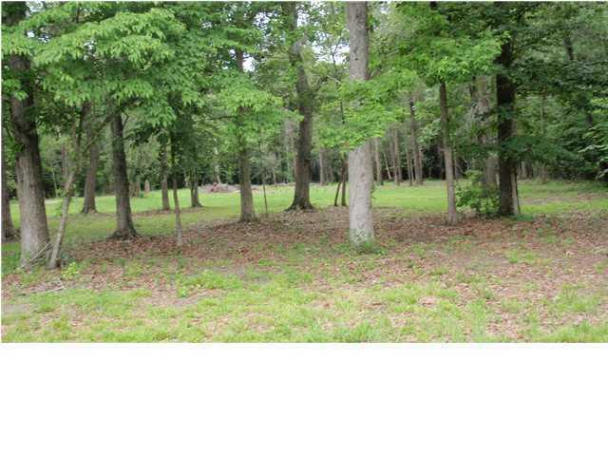
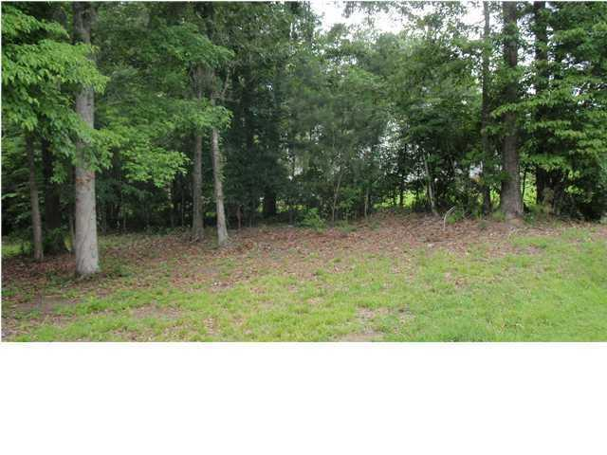
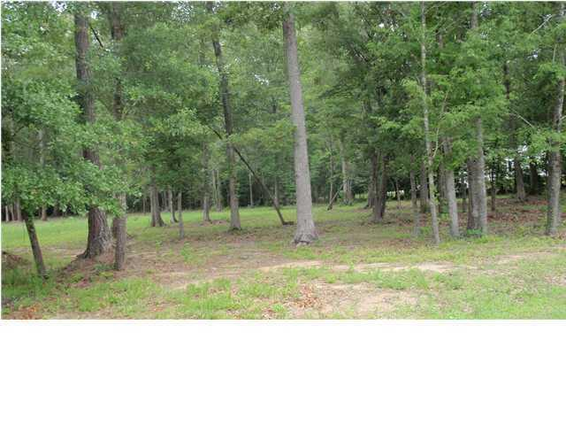
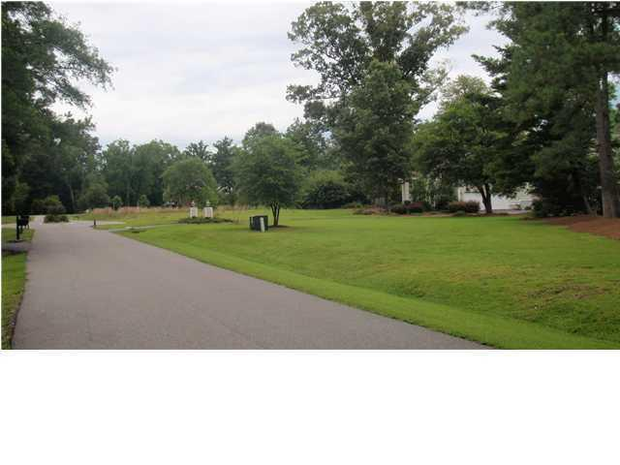
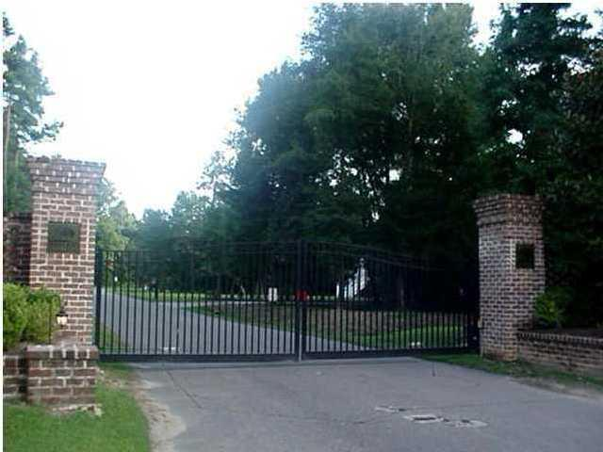

122 Boyle Way Boyle Plantation Summerville, SC 29485 MLS# 16000769 $109,900 2.98 Acres
Ready for your dream home!
This is an almost 3 acre building lot located in a beautiful gated community just down the road from Ashley Ride High School. The lot has been surveyed and septic permit and well approval has already been completed. This beautiful treed lot has been cleared enough to build your dream custom home.
Boyle Plantation is a small private gated community with relatively large lots and custom homes. Located in the award winning Dorchester 2 school district this is a perfect lot to build your dream home with plenty of space between your neighbors and yet close to town.
Bill Milo
Mobile: 843-412-0052
Bill@southernshoresre.com
Southern Shores Real Estate
1050 St. Andrews Blvd
Charleston, SC 29407

