Slide 1
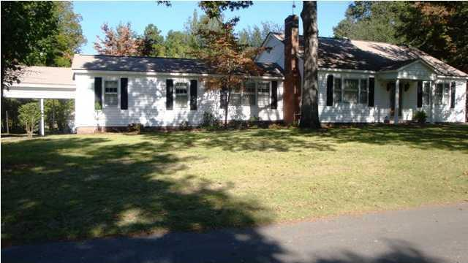
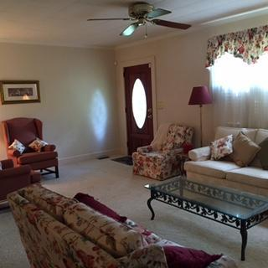
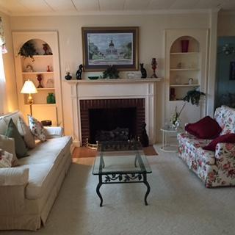
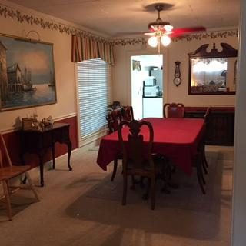
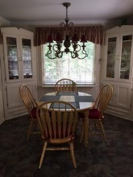
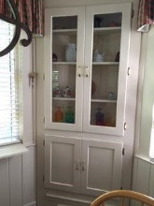
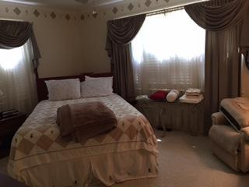
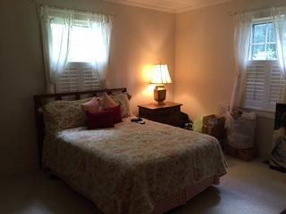
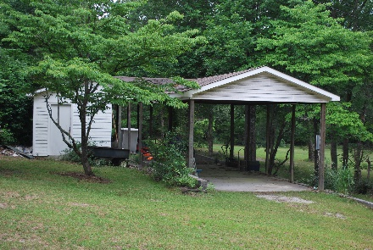
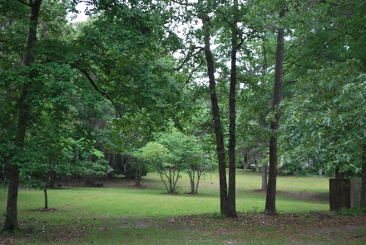
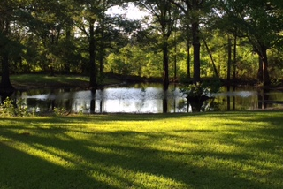
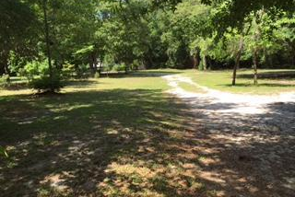

5 acres in the heart of Eutawville!
122 Delta Drive
Eutawville, SC 29048 | MLS# 16012074 | $215,000
3 Beds | 3 Baths | 2,207 Square Feet
Unique property in the middle of Eutawville that has everything you could want!
Property is 5.4 acres which includes a small pond, deer that are frequent visitors, and plenty of land to do whatever your heart desires!
Carla C Davis
Mobile - (843) 437-4873
gaweber@tds.net
AgentOwned Premiere Group
141 A N. Main Street
Summerville, SC 29483

