Slide 1
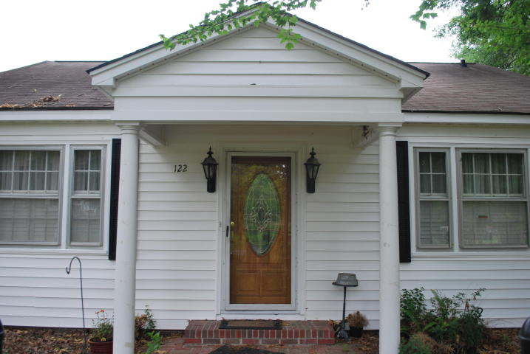
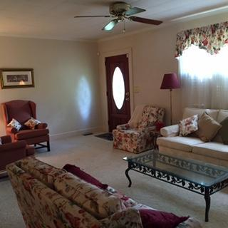
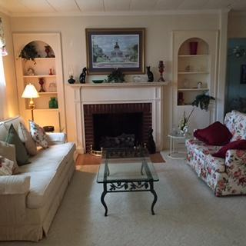
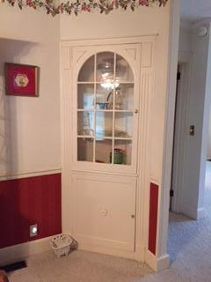
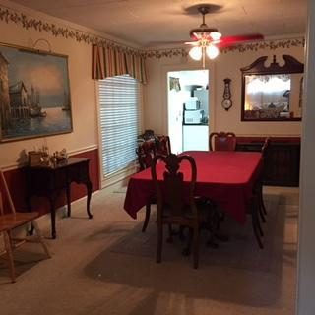
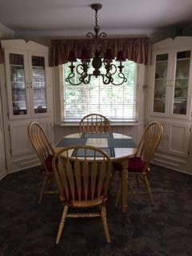
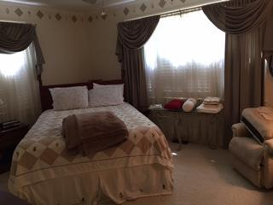
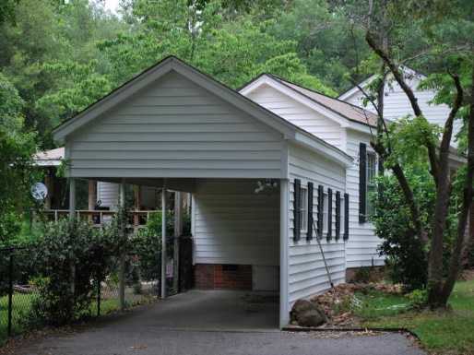
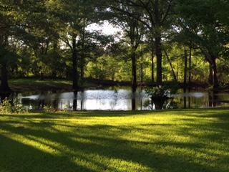
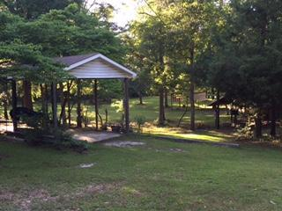
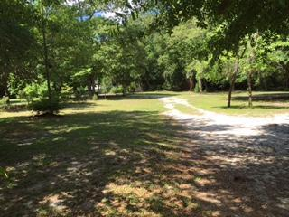

122 Delta Drive
Eutawville, SC 29048 MLS# 16012074 $249,900
3 Beds 3 Baths 2,207 Square Feet
Unique property in the middle of Eutawville that has everything you could want!
Property is 5.4 acres which includes a small pond, deer that are frequent visitors, and plenty of land to do whatever your heart desires!
If you prefer more land there is an adjacent parcel that consists of one more acre see MLS # 16012209
Carla C Davis
Mobile - (843) 437-4873
gaweber@tds.net
AgentOwned Premiere Group
141 A N. Main Street
Summerville, SC 29483

