Slide 1
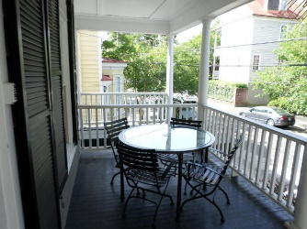
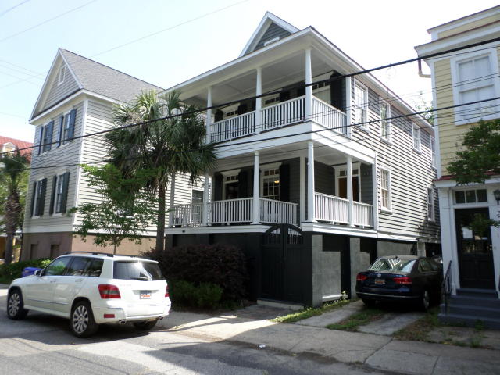
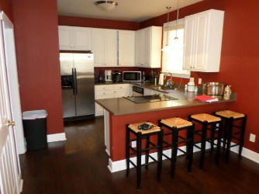
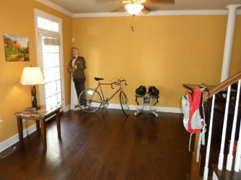
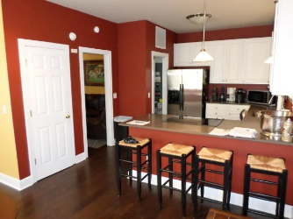
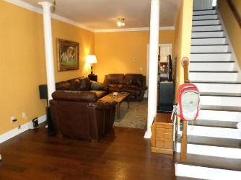
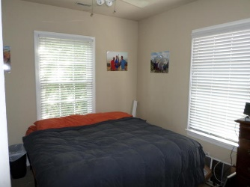
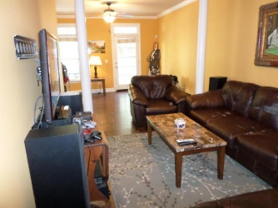
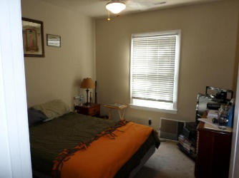
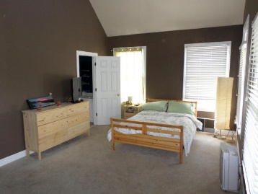
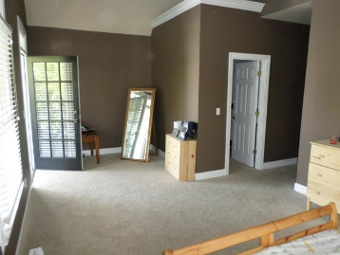
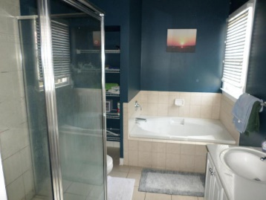
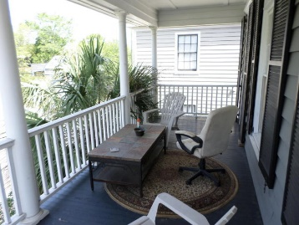
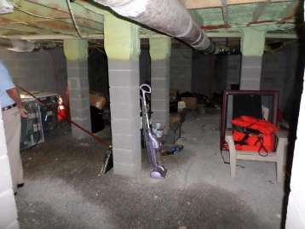

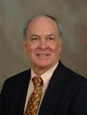
Convenient to College & MUSC
Just Reduced!
122 Smith Street
Radcliffeborough - Charleston - MLS# 15016651 - $630,000
122 Smith St presents an opportunity to own an elevated Charleston single house as a private residence or as an investment for rental income. Conveniently located and in proximity to the College of Charleston. MUSC, Roper Hospital and upper King St., this home was built in 2002 and offers off street parking. As one enters the house, a spacious formal living and dining room are featured with wood floors and crown molding. A spacious porch off the living room is great for entertaining. The kitchen features a large pantry, breakfast area and stainless appliances. All three BR's are located upstairs and are carpeted. The master bath has a garden tub and separate shower. Off the MBR is another porch. A private walled area in the rear of the house has many options. Storage area under house.
Carey Budds
843-475-1505
cbudds@eratidesrealty.com
Jerry Wise
843-442-7633
jwise@eratidesrealty.com
ERA Wilder Realty, 125-F Wappoo Creek Dr, Charleston, SC 29412

