Slide 1
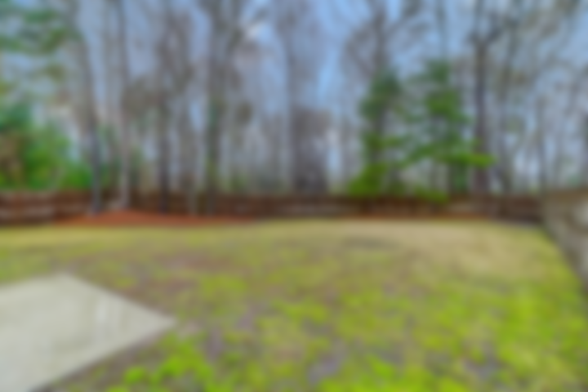
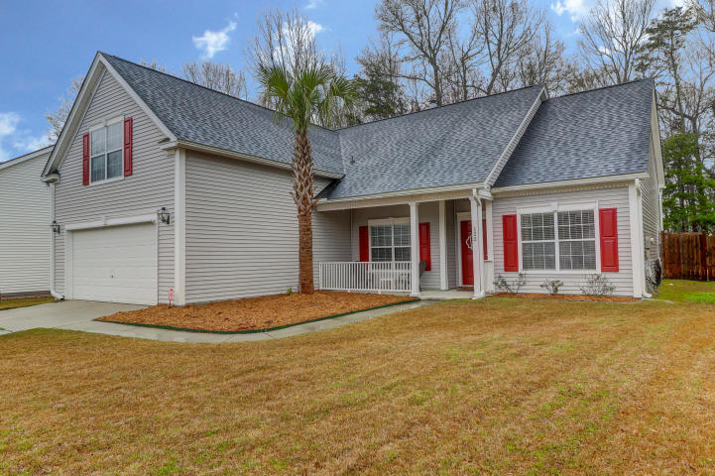
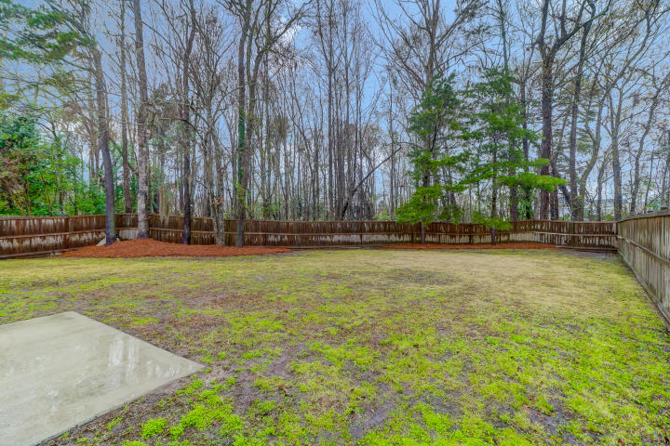
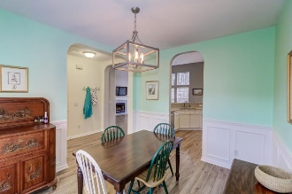
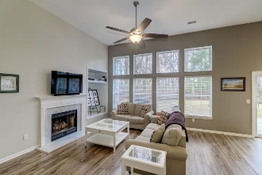
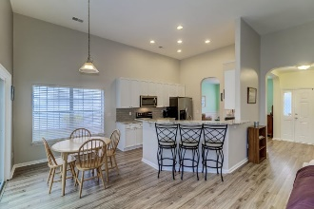
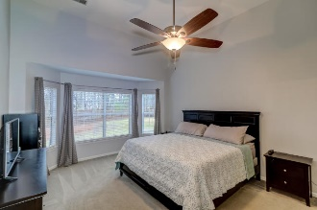
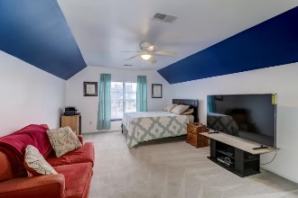


Updated And Like New Home In Grand Oaks
122 Sugar Magnolia Way
Grand Oaks Plantation • Charleston, SC 29414 • MLS# 20006510 • $335,000
Welcome into this updated bright and open home! Kitchen has been completely updated, white cabinets, stainless steel appliances including double oven electric range, quartzite countertops, tile backsplash, with lots of storage and pantry, high ceilings and opens into the great room with floor to ceiling windows that provide lots of natural light. All new flooring throughout main living area and bathrooms. King size Owner suite offers high ceilings, updated bath with separate floor to ceiling tiled shower, soaker tub, dual vanity with lots of storage, large custom-built walk-in closet. New roof in 2016. Updated 16 seer HVAC split unit with Wi-Fi control installed in 2016. Relax and entertain on your back patio and enjoy your privacy fenced in large lot that backs up to a wooded buffer for extra privacy! You'll love the location of this neighborhood. It's perfect for all walks of life. The entrance to the neighborhood has a Harris Teeter and will feature other shops and restaurants within walking or golf cart distance. You can also explore the tree-lined trails this great community provides or visit the Rec Center just around the corner, or the neighborhood pool and play area down the street. *The information herein is furnished to the best of the Listing Agent's knowledge. All information herewith is subject to verification by the purchaser and their agent. Listing Agent assumes no responsibility for correctness thereof, nor warrant the accuracy of the information or the condition of the property. If square footage is important - measure! Buyer to verify schools and any and all information deemed important.*
Christina Garvin
(843) 270-7667 | cgarvin63@gmail.com
Elaine Brabham and Associates, LLC • 1890 Sam Rittenberg Boulevard, Suite 217 • Charleston, SC 29407

