Slide 1
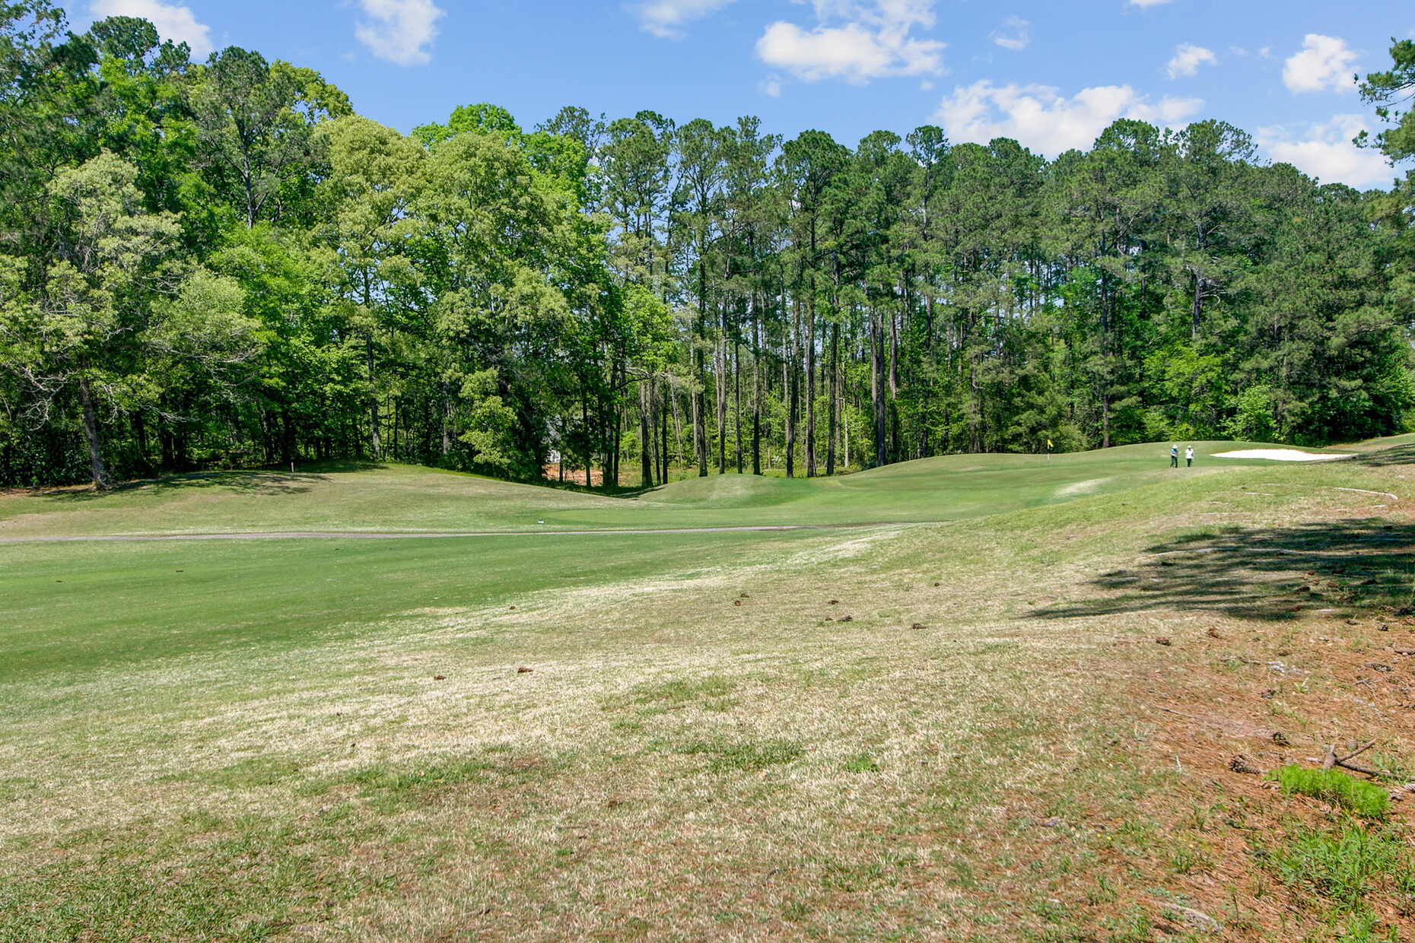


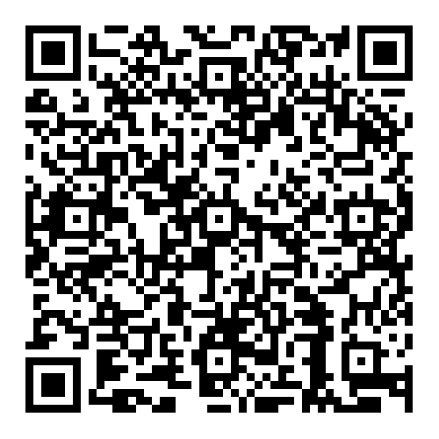

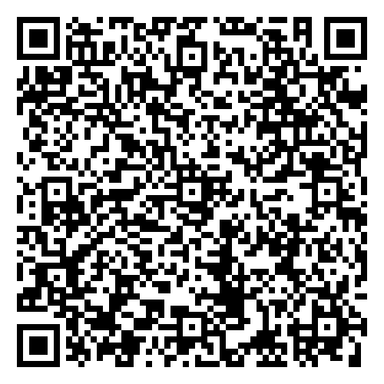


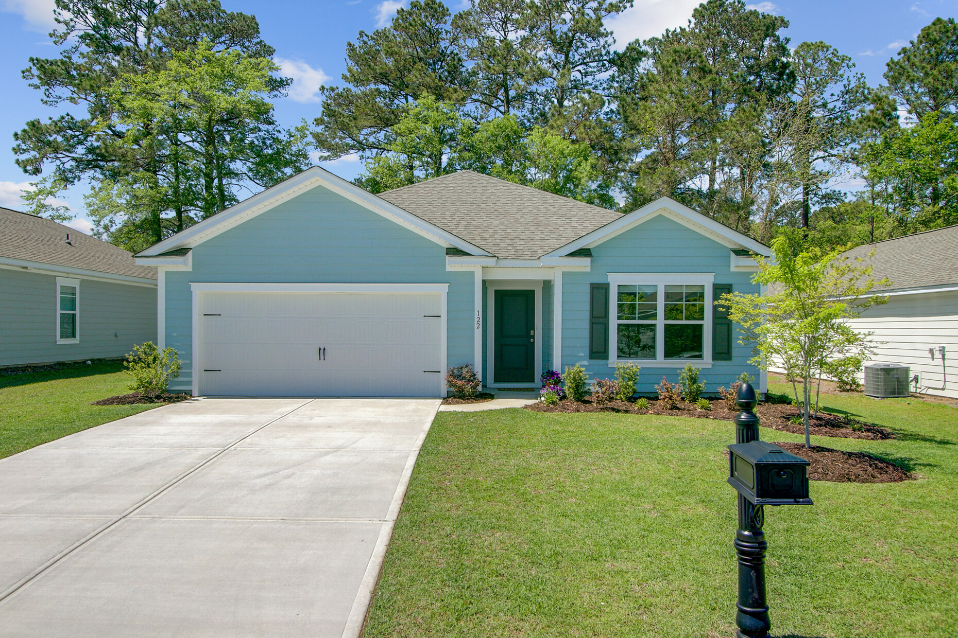
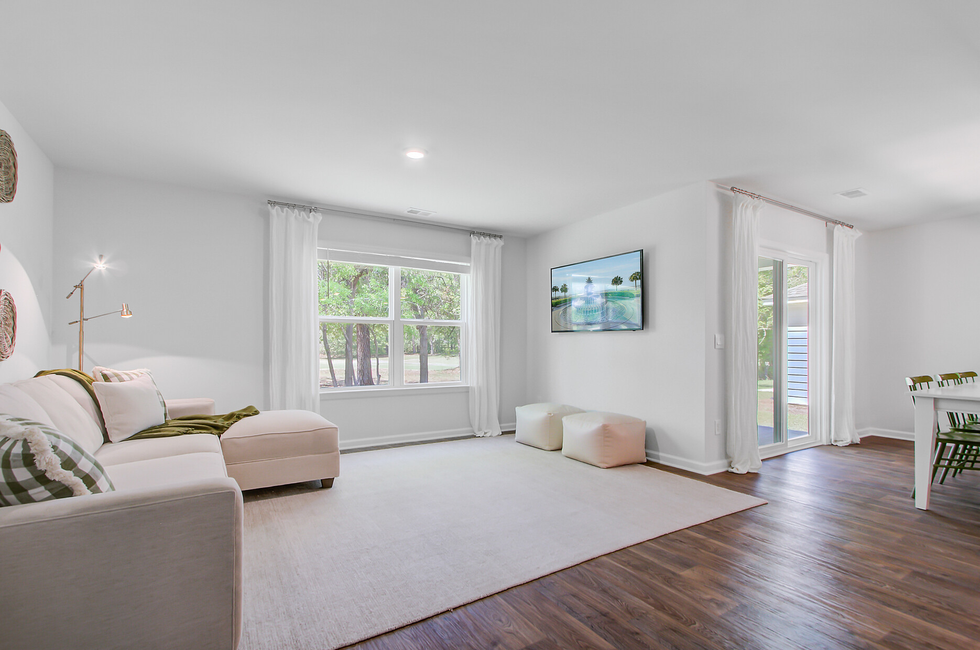
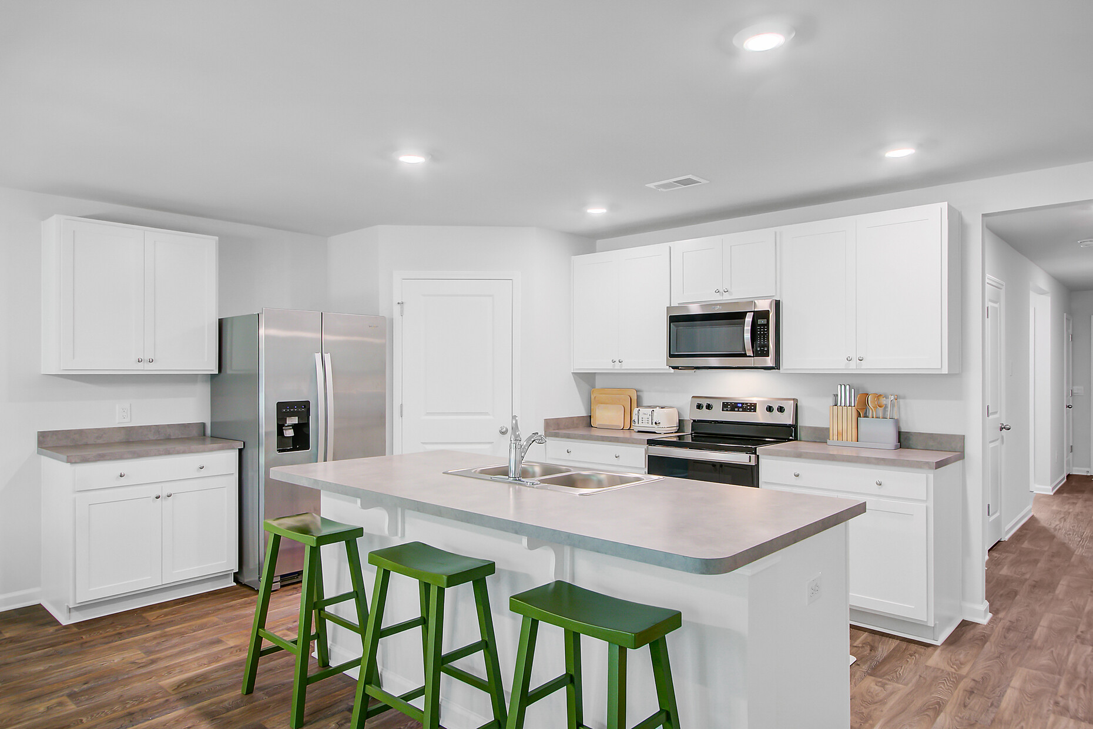
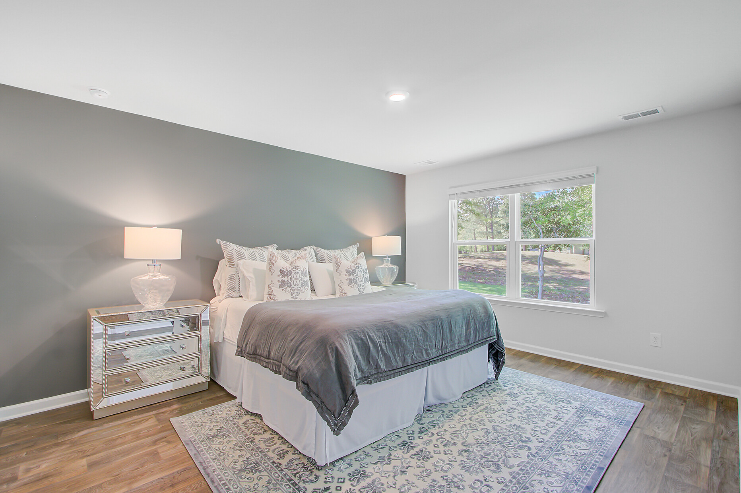
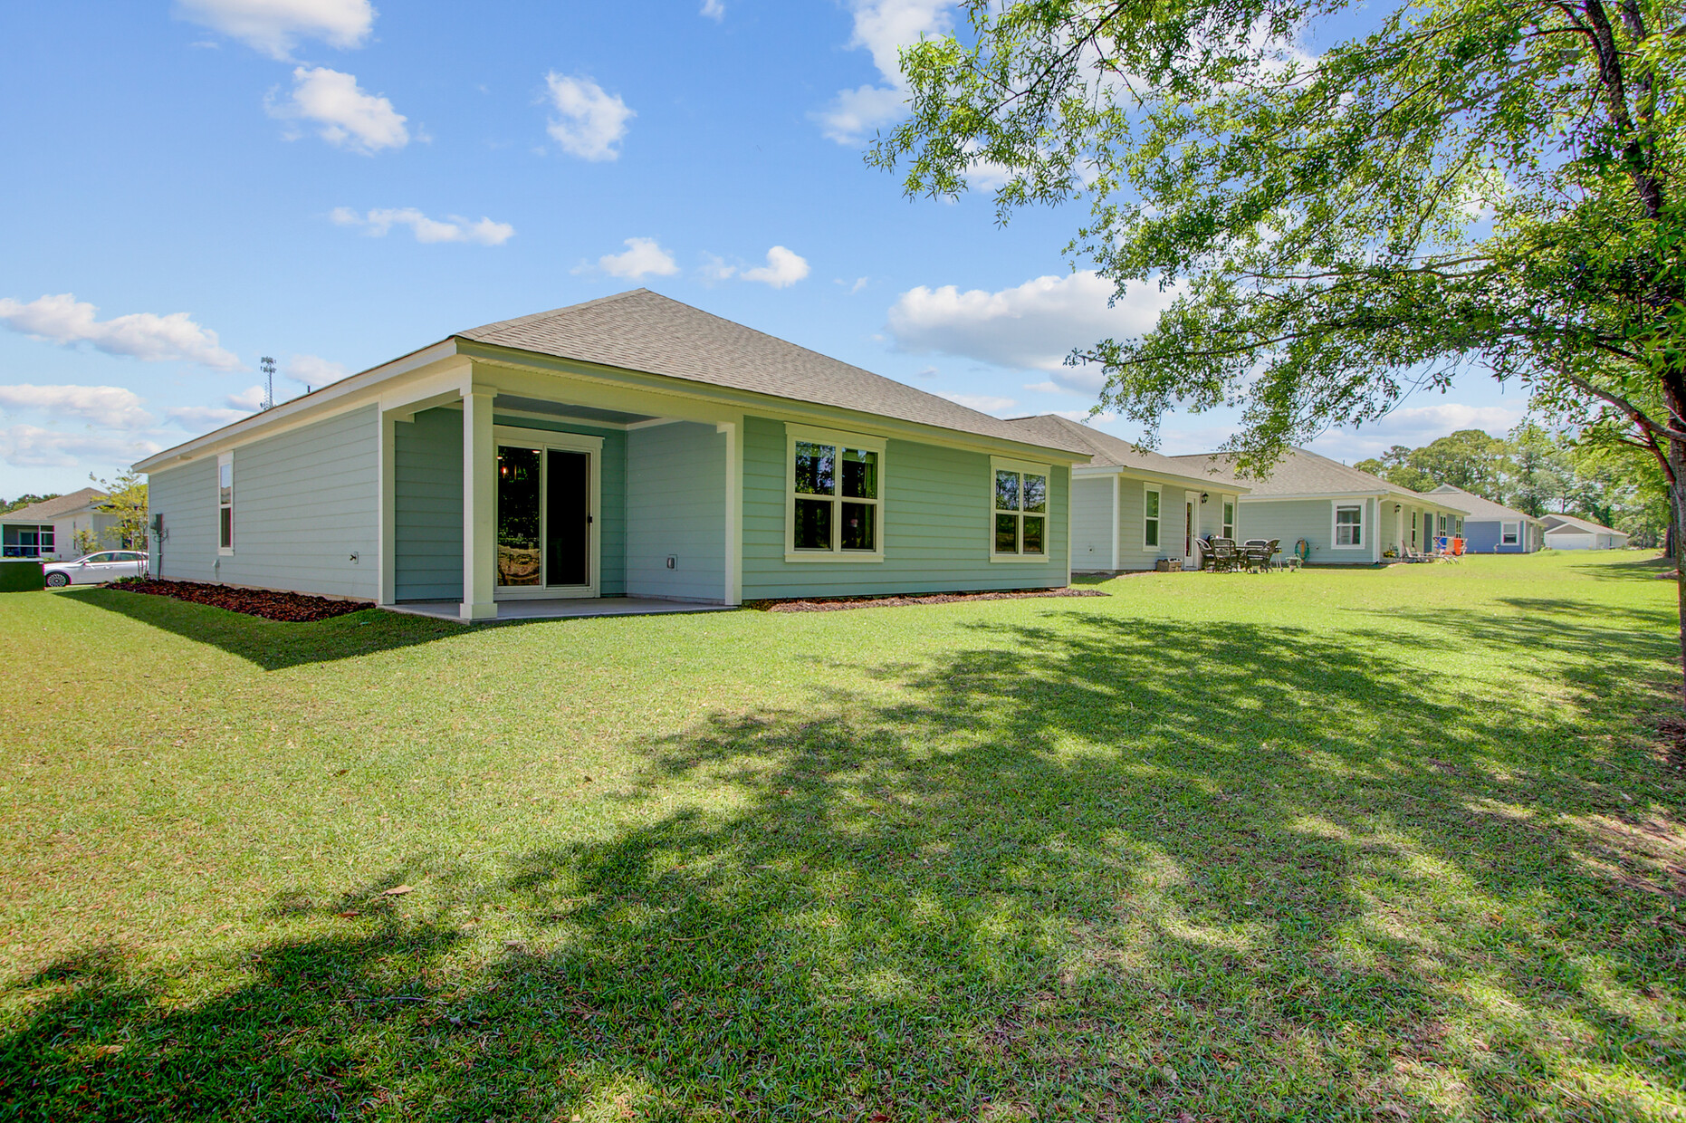


Move-in Ready with Golf Course Views!
Video Tour
Virtual
Tour
122 Congaree Court
Center Pointe | Santee, SC 29142 | MLS# 25009895 | $299,900
SPECIAL OPPORTUNITY!
THIS HOME HAS AN ASSUMABLE MORTGAGE AT 4.5% INTEREST RATE
This nearly-new 4BR/2BA home offers peaceful fairway views from a quiet cul-de-sac near Lake Marion. Enjoy stylish upgrades, a bright open layout, and added storage throughout. Still under builder warranty and full of charm—schedule your private tour today before it’s gone!
Ellen O'Neil
Broker/Owner, ABR, e-PRO, CNE
Charleston Realtor of Distinction
843-300-8530
www.EllenONeilProperties.com

