Slide 1
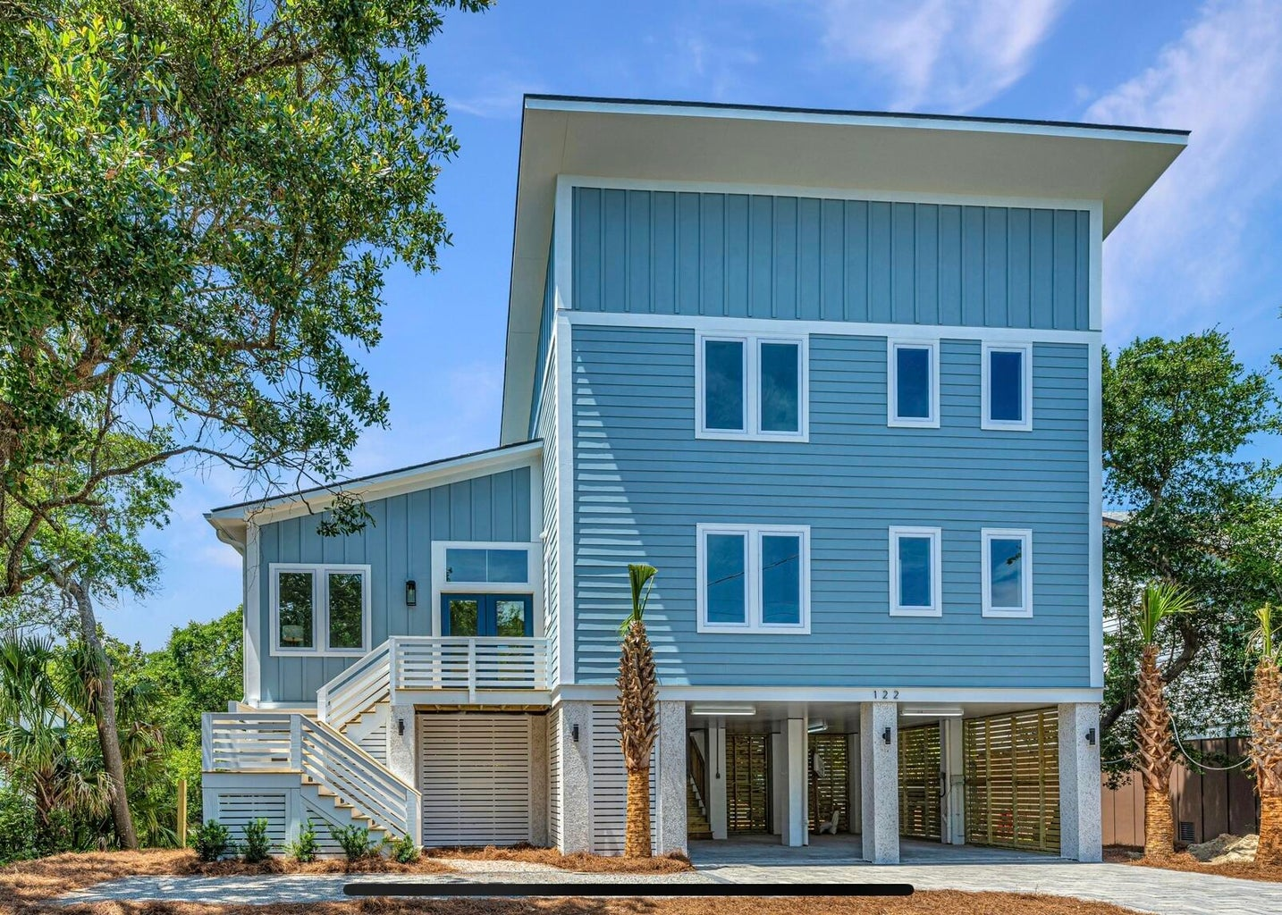
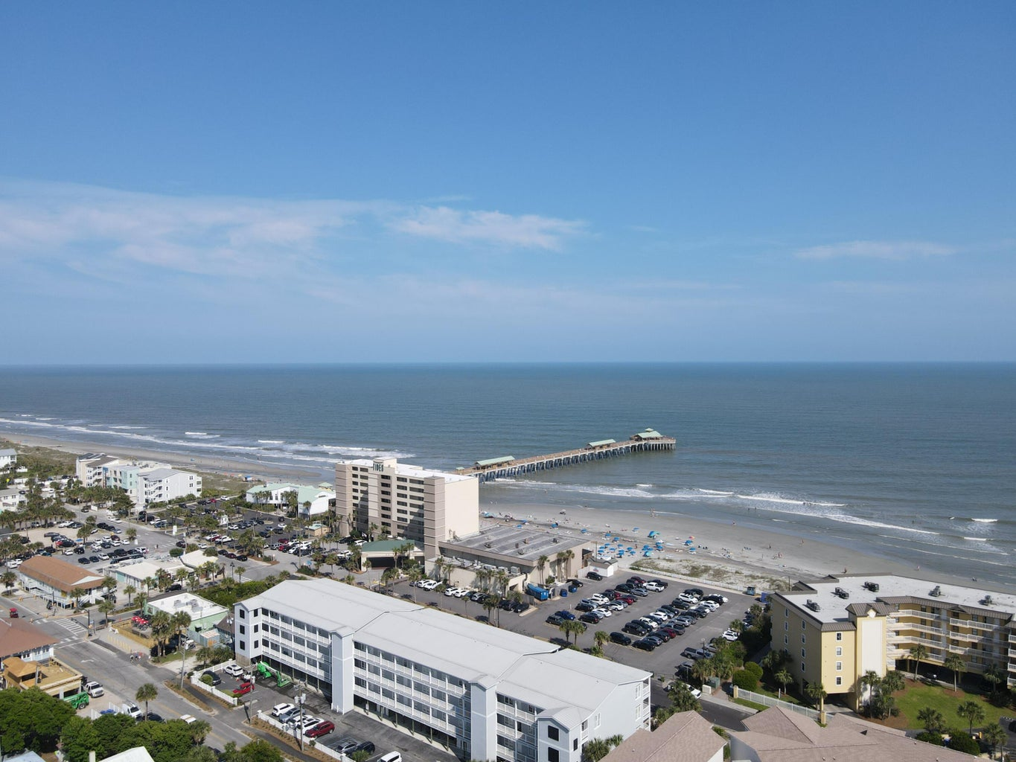
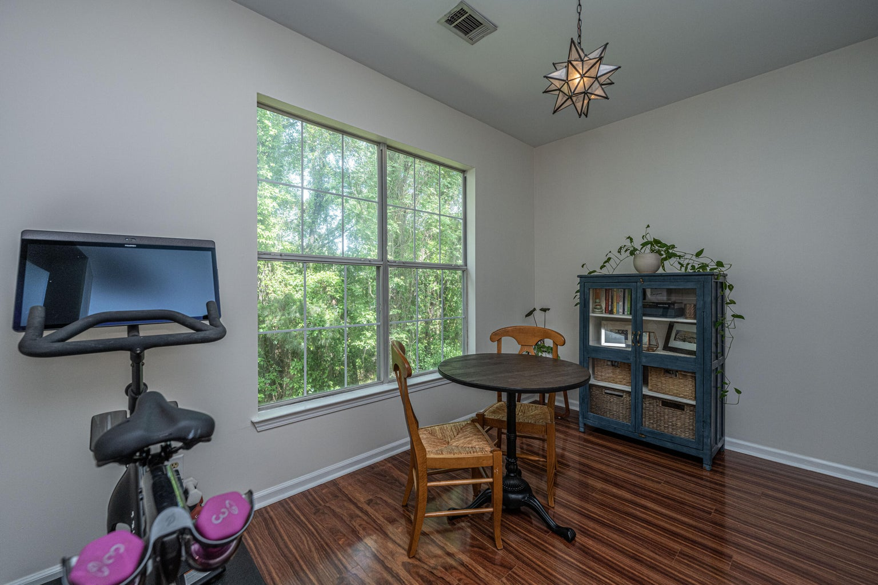
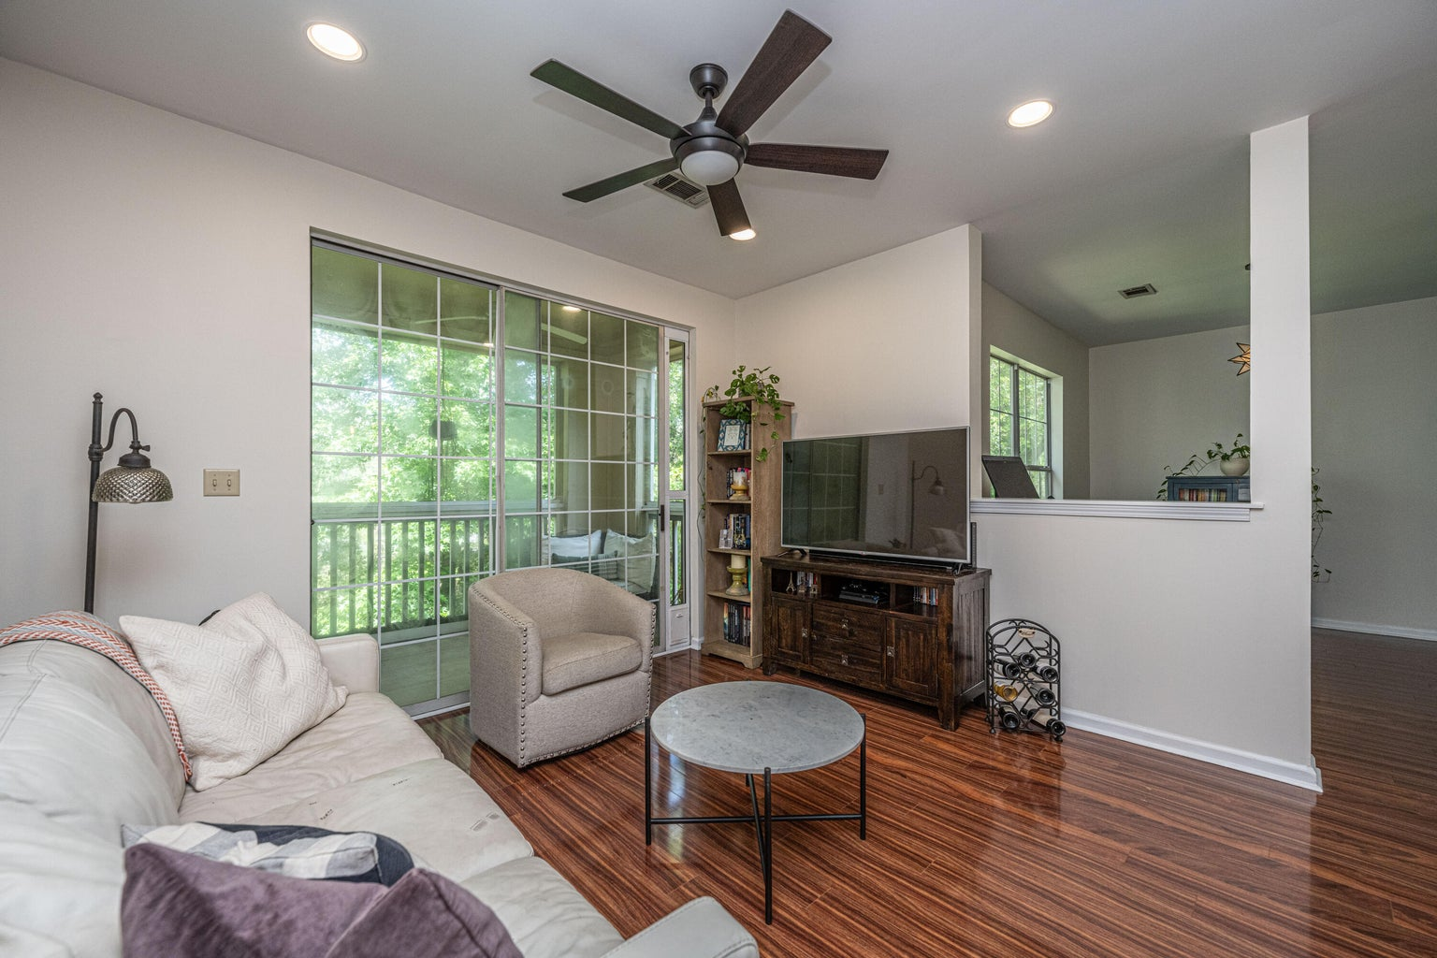
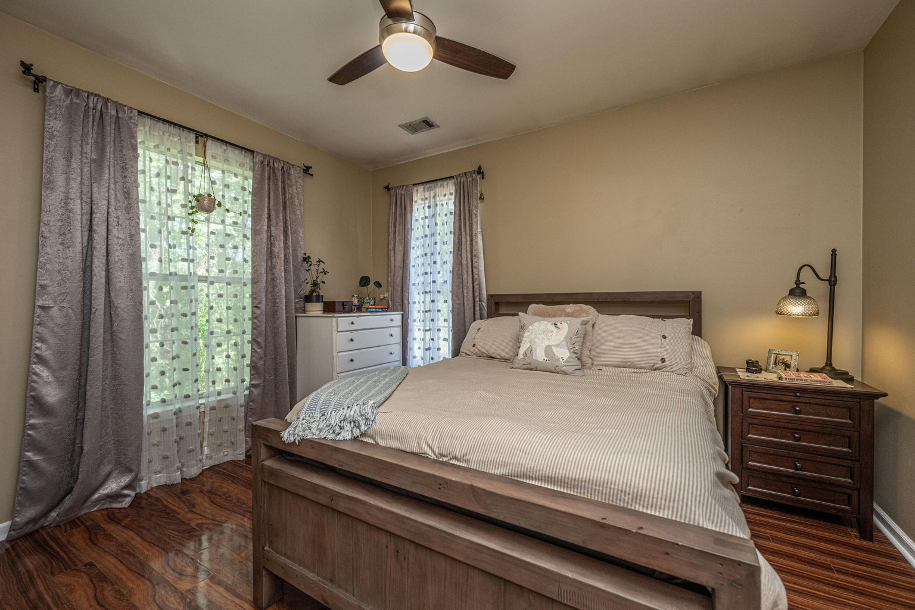
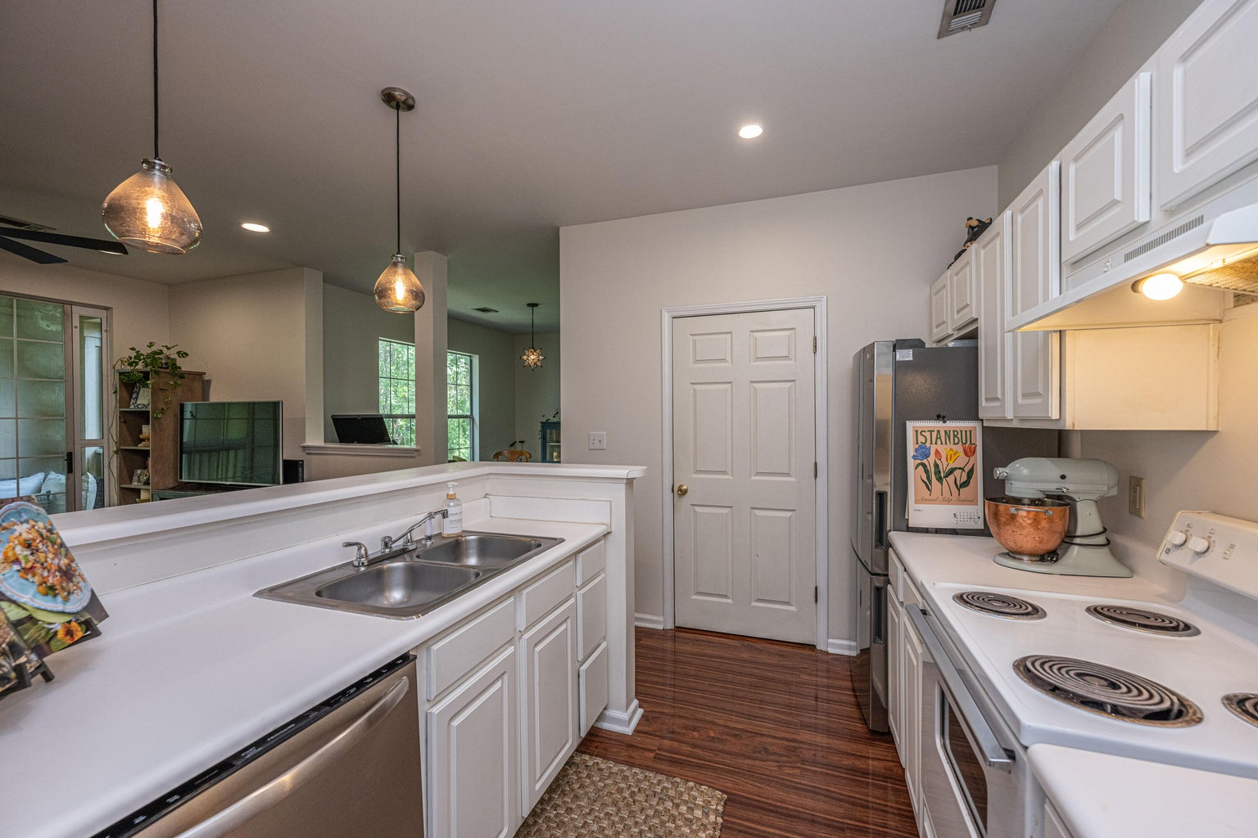



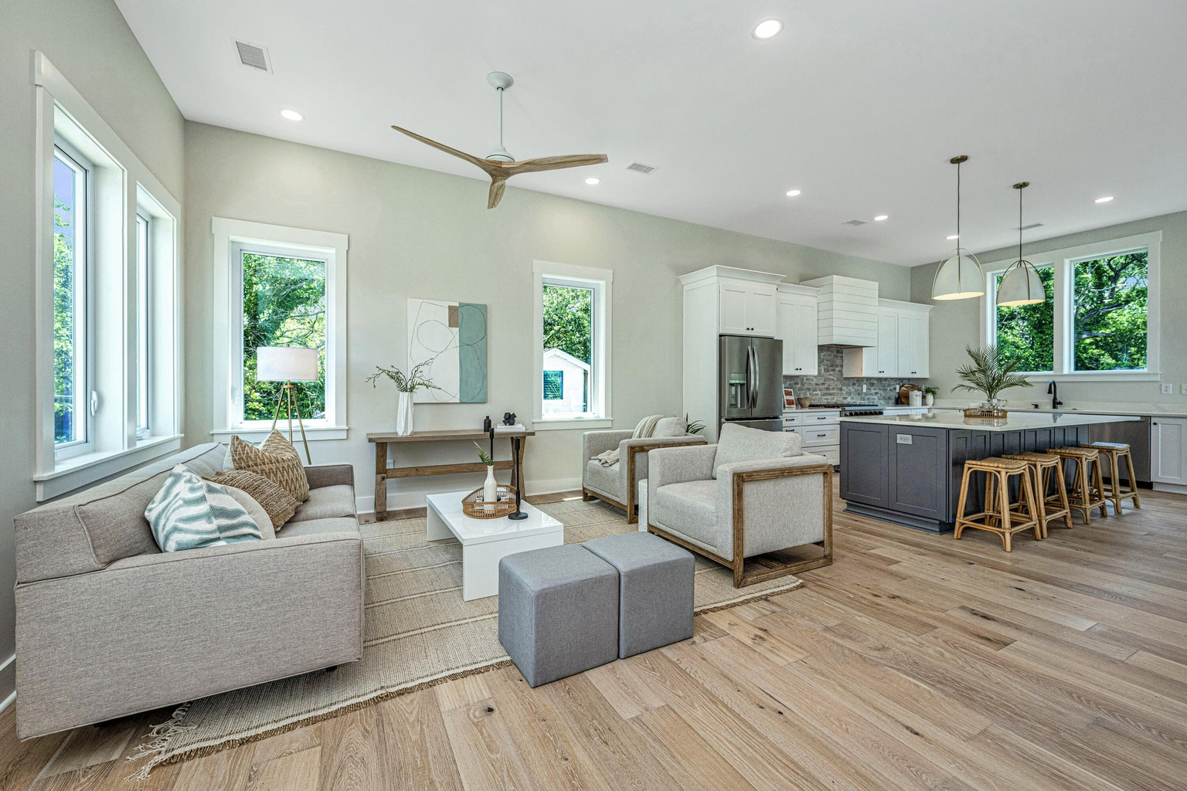
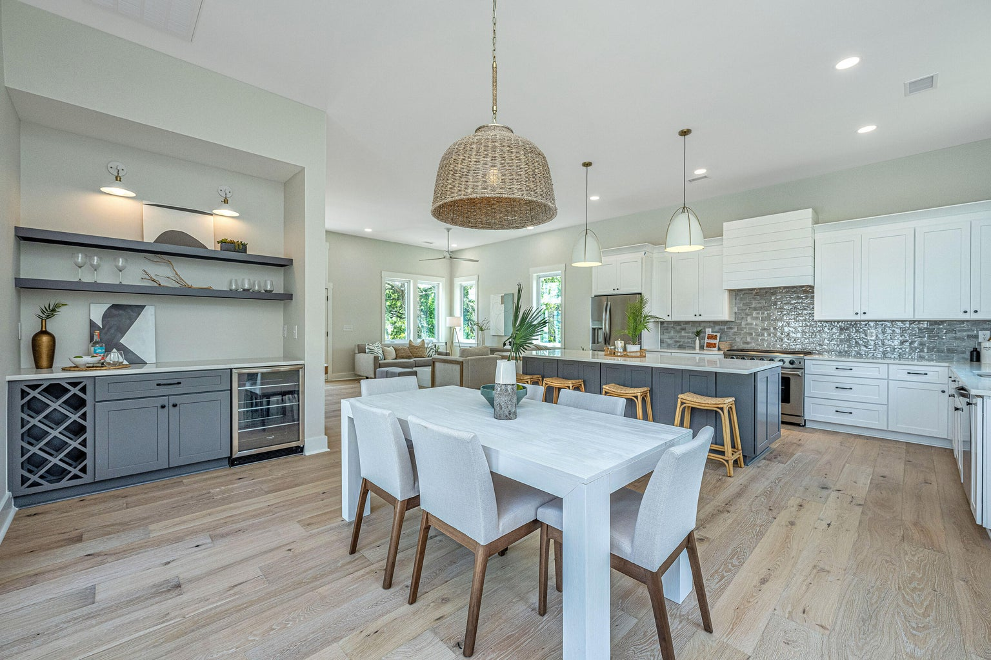
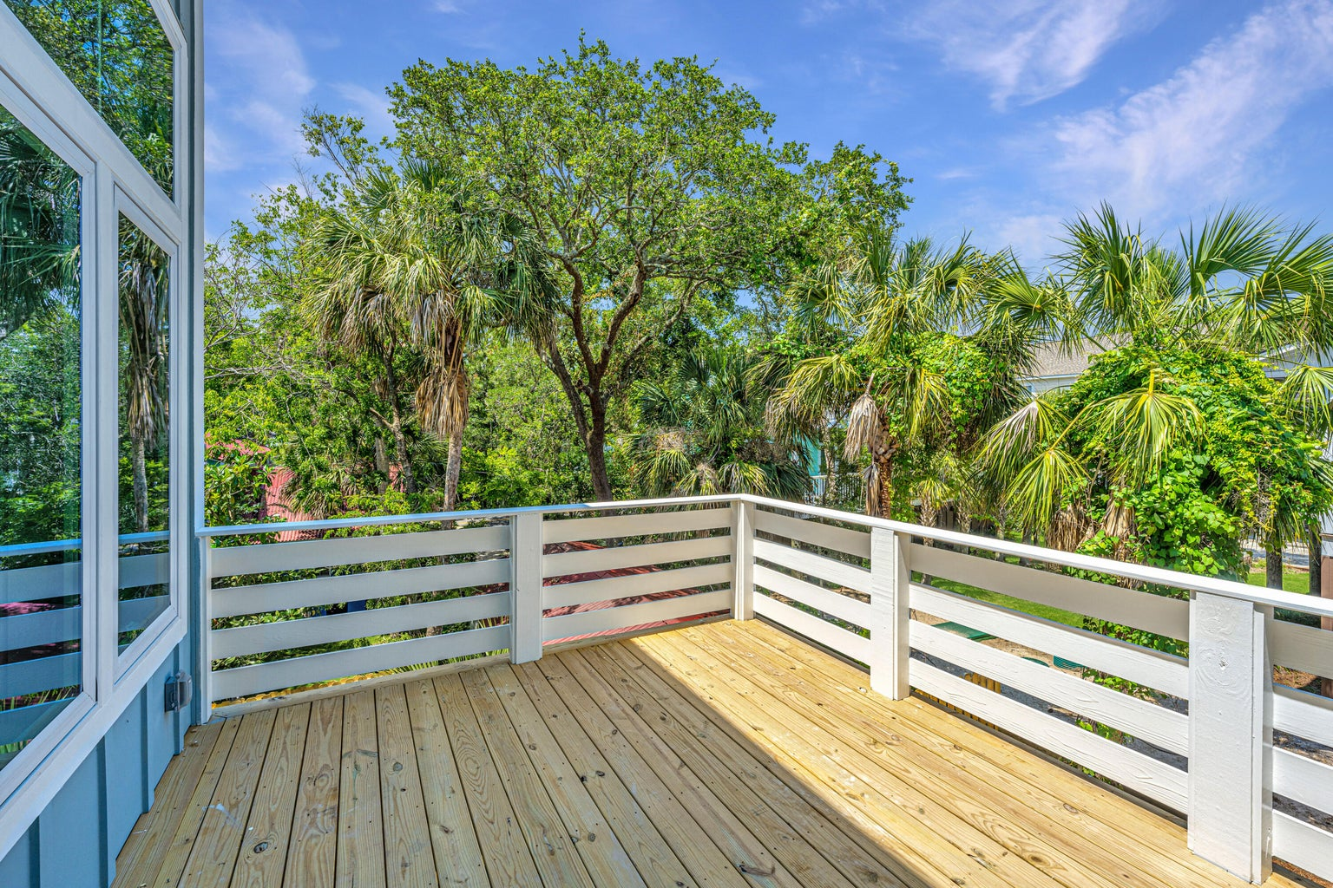


Modern Beach-Style Home ~ Steps to the Beach
122 W Cooper Avenue
Folly Beach, SC 29439 | MLS# 23011815 | $1,725,000
Beach style meets a modern flair with this newly-built home two blocks from the beach and less than two blocks from Center Street's restaurants, bars, and shopping on Folly Beach! This elevated home offers the ''wow'' factor immediately upon entering through the double glass doors to a massive, open living, kitchen, and dining space with 11 ft ceilings and oversized windows that bring in an abundance of natural light. The custom, gourmet kitchen features a gas stove, soft-close designer cabinetry, and endless counterspace including an oversized island. The dining area features a built-in bar and wine cooler. Each floor has two bedrooms, with the primary suite and deck access on the main floor. The primary suite includes a spacious bathroom with elegant finishes, a glassed-in tile shower, dual vanity, and a large walk-in closet. This is also a RARE opportunity to have a fenced backyard space on the island!
2 Blocks from Beach
2 Blks to Center St
Modern Design
4BR/3Bath
Elevated Home
Luxury Finishes
4
3
1,844
2 Blocks from Beach
2 Blocks to Center St
Modern Design
4BR/3Bath
Elevated Home
Luxury Finishes
Virtual Tour: https://my.matterport.com/show/?m=ZXsGvknU8zA
Seth Stisher
843-270-2902
seth@sethrealty.com

