Slide 1
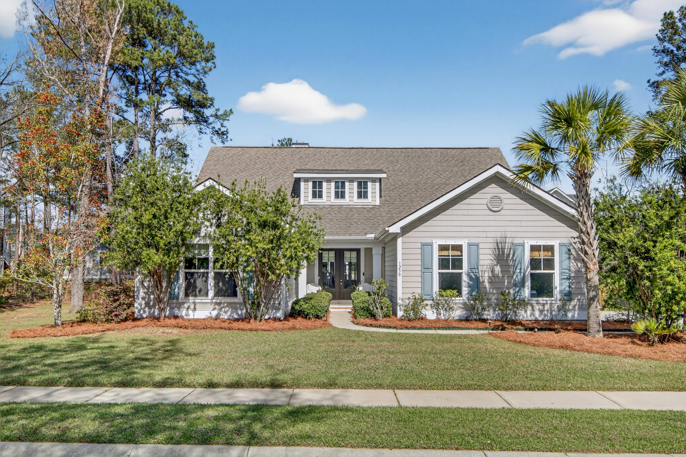
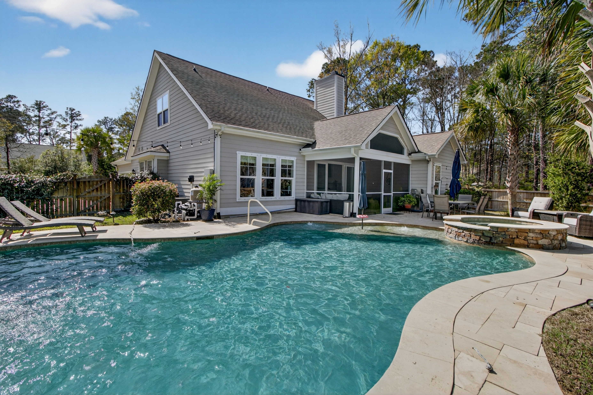
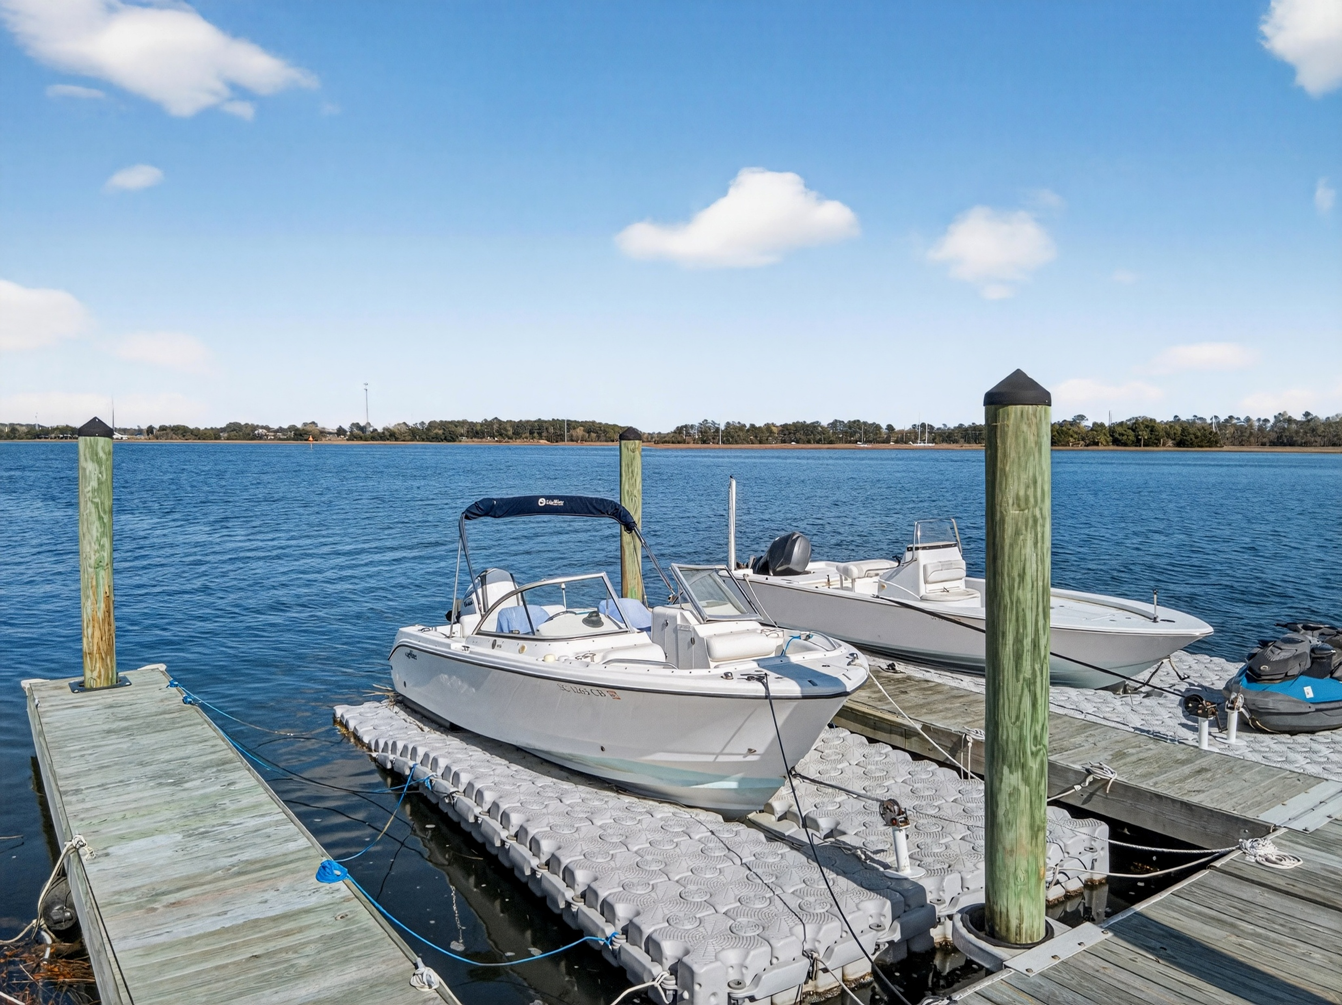
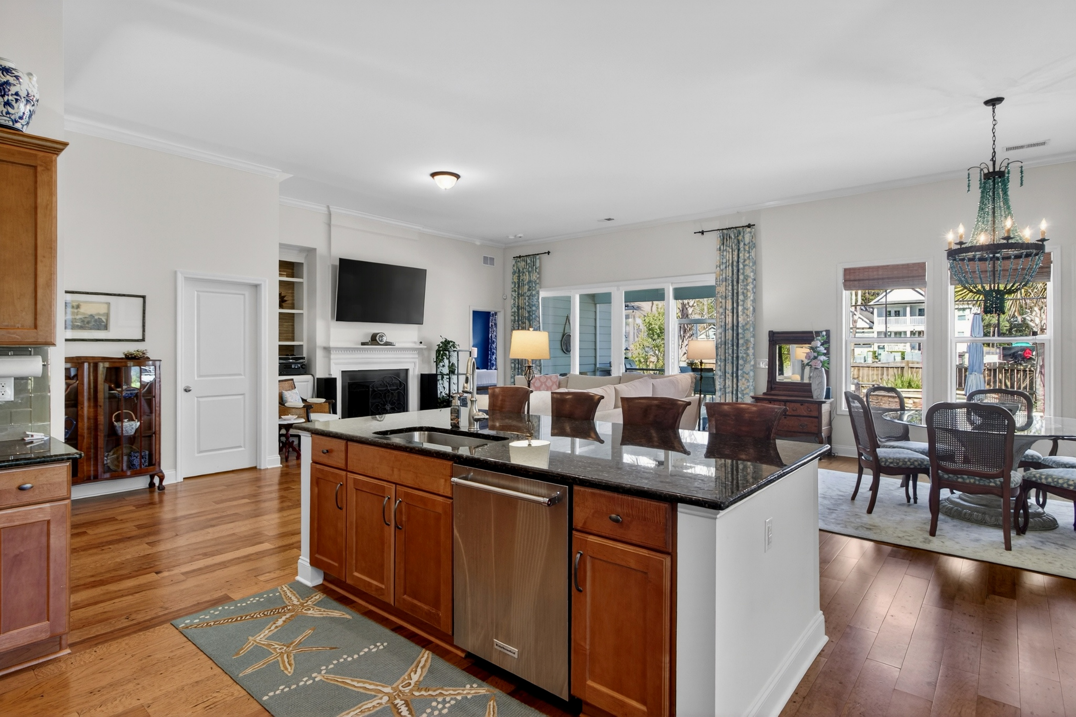
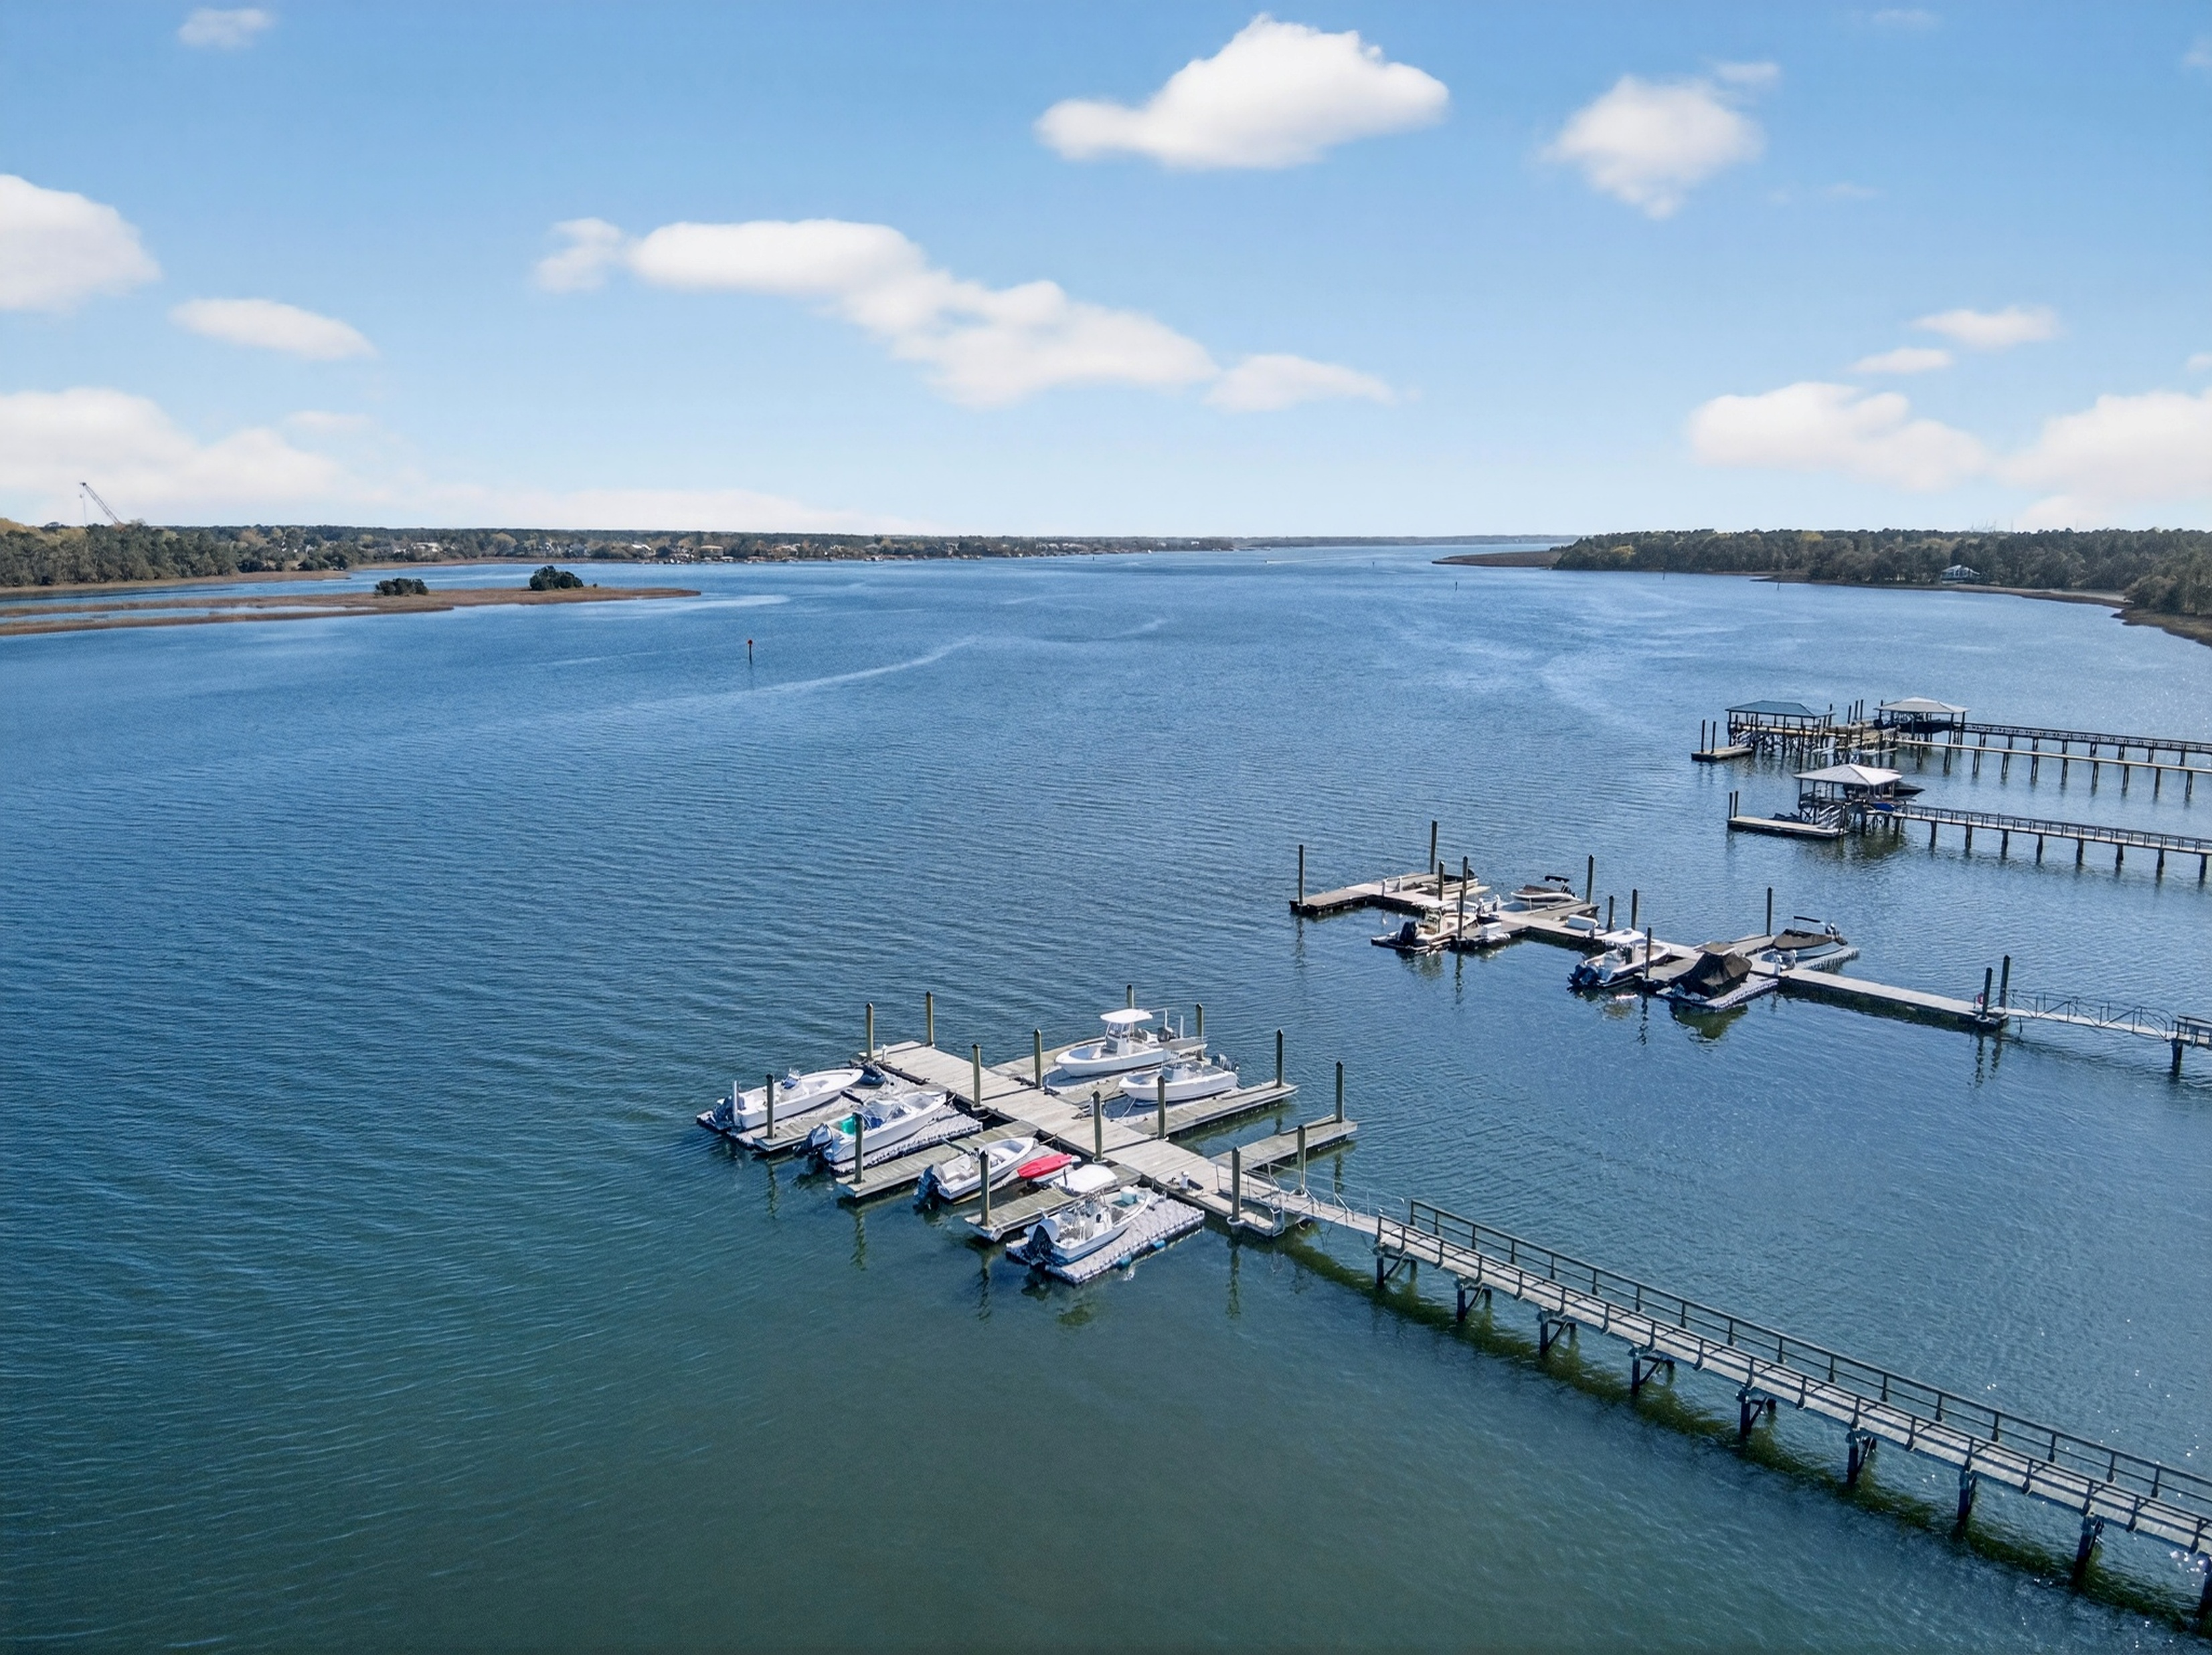

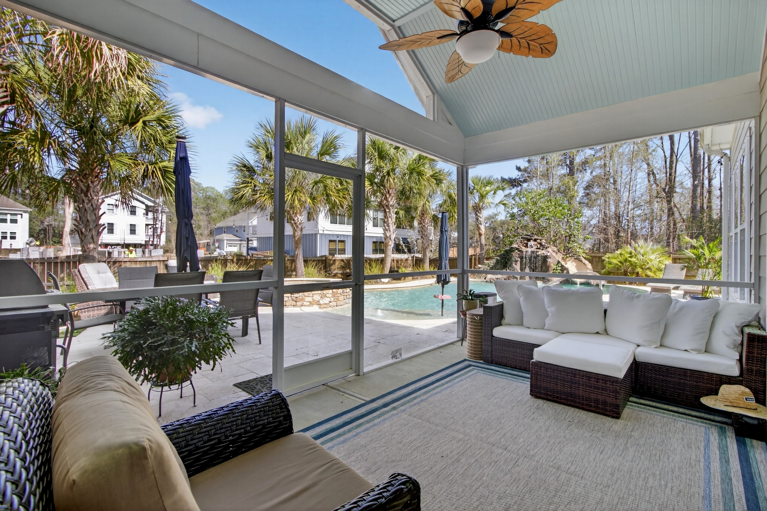




NEW LISTING + OPEN HOUSE
Saturday 1-3 PM
Rendering with Garage
Apartment Bath
Property Site
Video Tour
1230 River Walk Court
River Club Estates
Charleston, SC 29492
MLS# 26007398 | $1,495,000
Storybook
Apartment Bedroom
Do you have buyers who want a boat slip in deep water
and a home with an inground pool?
All this for 1,500,000!
Primary suite is on the main level
Rare Wando River Opportunity!
5BD | 3.5BA | 3,033 Sq Ft on a 0.69-acre wooded lot in River Club Estates. Enjoy a deeded deep-water boat slip, private community dock, and an incredible backyard oasis with gunite pool, spa, and rock slide. Spacious open floor plan with primary suite on the main level and room for everyone. Located near Point Hope with easy access to Mt. Pleasant, Daniel Island, beaches, and the airport.
Tour this special property today.
Property Site | Video Tour
Ellen O'Neil
Broker/Owner, ABR, e-PRO, CNE
Charleston Realtor of Distinction
843-300-8530
www.EllenONeilProperties.com

