Slide 1
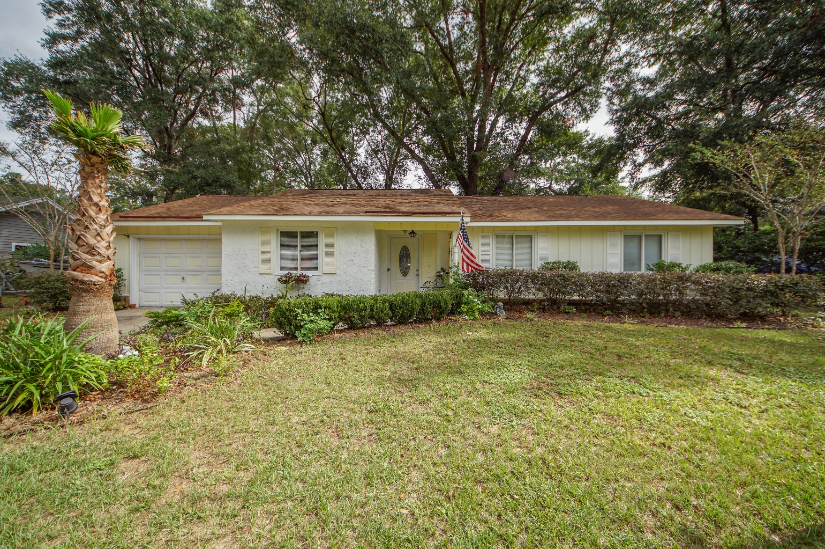
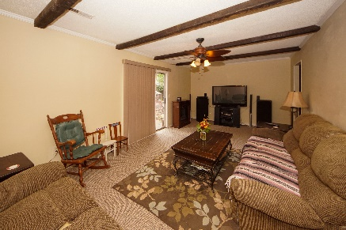
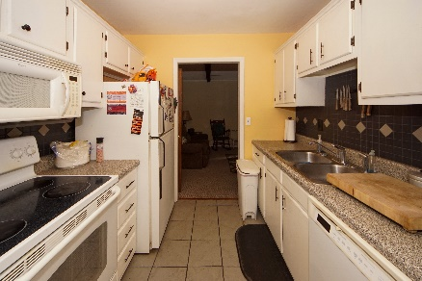
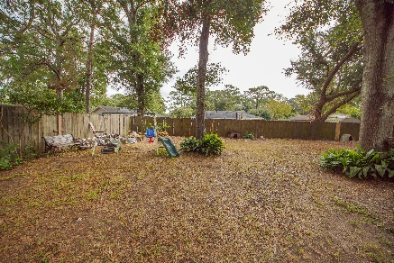


1232 Chicorie Way Quail Run :: Charleston, SC 29412 MLS# 19028785 :: $275,000 3 Bed / 2 Bath
New Price!!
Great Location!
Own a home in Quail Run in James Island!
Lots of potential in this 3 bedroom home with separate dining, kitchen and family room.
New roof 2015. This home sits on a .30 acre and we are motivated to sell!
Desirable location close to Folly Beach!!!!
Connie White, Broker
843-532-3356
connie@chrepros.com · conniewhiterealestate.com
Charleston Homes · 597 Old Mt. Holly Road · Suite 301 · Goose Creek, SC 29445

