Slide 1
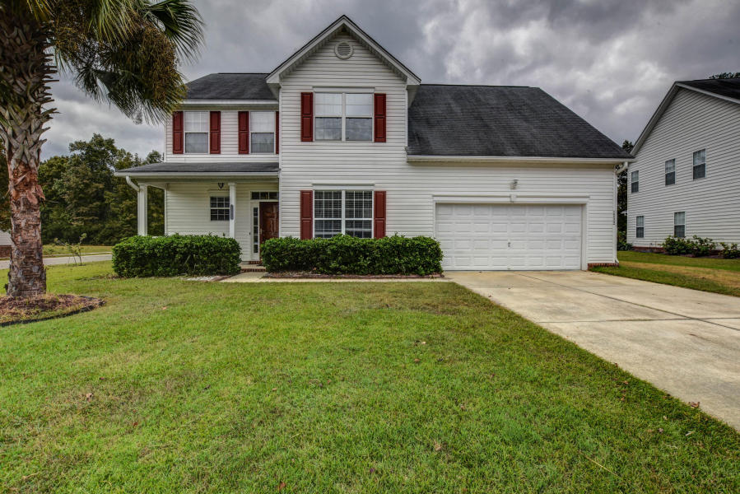
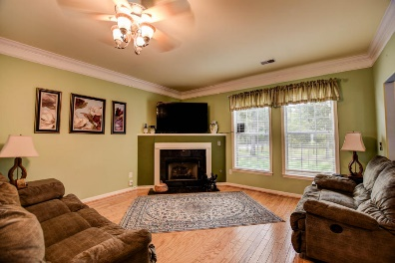
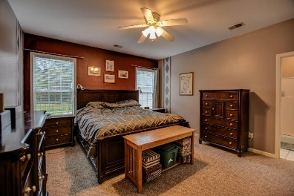
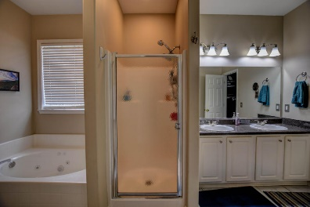
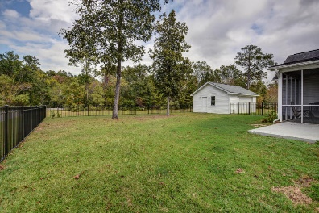


Wonderful Home
…Easy Living
1232 Creek Stone Way
Tanner Plantation · Hanahan · MLS# 16028583 · $309,900
4 Bedrooms · 2.5 baths · 2,572 sqft
Come see this lovely home in popular Tanner Plantation. Upon entering the home you are greeted by a formal dining room, which is currently being used as a flex space, and an open family room with gas fireplace. The kitchen has solid surface counters and an eat in area. The master bedroom is located downstairs and the master bath consists of shower, jetted tub, dual sinks and dual closets. The half bath and laundry room finish up the downstairs. Arriving upstairs you are greeted by a large loft, 2 bedrooms and a FROG, or 4th bedroom. There is another full bath, with access from one of the bedrooms and the hallway. Sitting on a corner lot and backing up to a pond the home has a great setting. An additional garage/storage space is in the back.
Motivated Seller, Bring all offers!
Rochelle Rennert
(843) 847-9694
rynoroch@gmail.com
www.RochelleSellsCharleston.com
AgentOwned Premiere Group
100 Crowfield Blvd
Goose Creek, SC 29445
Real Estate ● Mortgage
Insurance ● Business Brokerage

