Slide 1
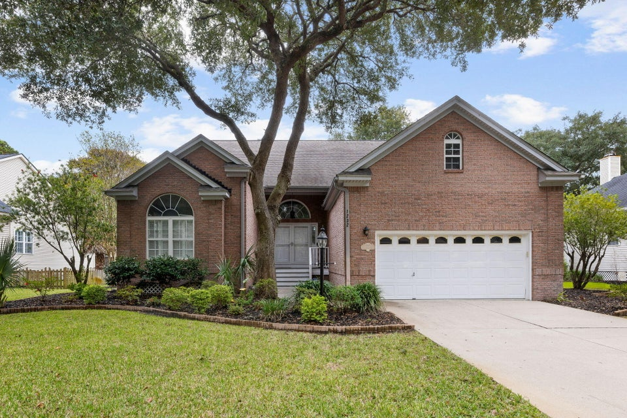
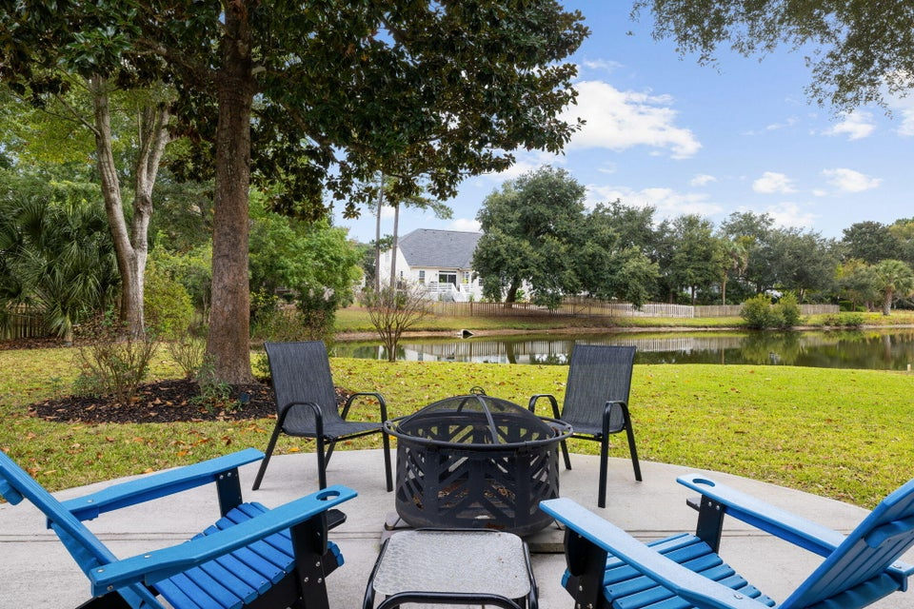
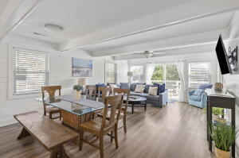
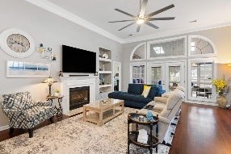
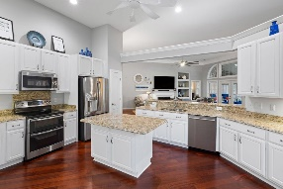
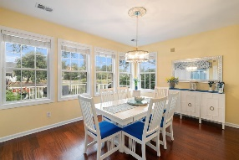
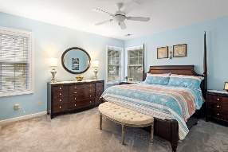
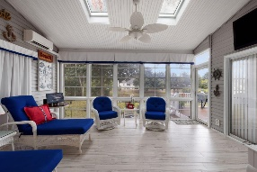
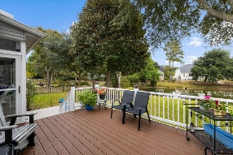
1232 Palmetto Peninsula Drive
Seaside Farms | Mount Pleasant, SC 29464 | MLS# 24028287 | $1,100,000
Darrell Creek Elevated Home With Elevator & Salt Pool
Seaside Farms Mt Pleasant-- One story living!
Beautifully updated and meticulously-maintained single-level home in the beloved Seaside Farms neighborhood. This location cannot be beat. Easy walk to the neighborhood pool; play park; Harris Teeter; and ''Downtown Seaside'' shopping and dining! Enter the home through the double front doors into the foyer. Note the abundance of natural light, beautiful hardwood floors, crown molding, and custom light fixtures that continue throughout the main areas. Off of the foyer, to the left, is a small hallway that connects two guest bedrooms and an updated shared full bath. Straight ahead you'll find the open concept kitchen/dining/living areas. The kitchen features granite counter tops, white cabinetry, stainless steel appliances, an island, breakfast bar, and eat-in area.
The eat-in area overlooks the back deck and fenced-in yard through a wall of windows and accesses the sunroom via a sliding glass door. An open double doorway connects the separate dining room to the eat-in kitchen and living areas. The family room features a gas fireplace and built-in shelving. French doors, with large windows on either side and a transom above, lead from the family room to the sunroom, which overlooks the back deck, yard, and serene pond beyond. A vestibule off of the family room leads to the primary suite with direct access to the sunroom. The beautifully updated primary bathroom features a custom double vanity with custom mirrors, lighting, and plumbing fixtures; tile flooring; and a large tile shower with built-in shelves and frameless glass surround.
Improvements the current owners have made throughout their ownership include the following: replaced roof; replaced hot water heater; replaced all landscaping; added hardwood floors in kitchen, dining room, family room; replaced carpet in the primary bedroom and added LVP flooring in the two guest bedrooms; added a sunroom with tile floors; added HVAC system in sunroom; replaced HVAC system throughout the entire house; added a side deck; added a cement patio; remodeled both bathrooms with all new tile, granite counter tops, vanities, lighting, and plumbing fixtures; replaced all fans and fixtures in kitchen, dining room, living room; remodeled kitchen with all new granite counter tops, cabinets, appliances, lighting, and plumbing fixtures; added plantation shutters in kitchen, dining room, front bedroom, and front door; and replaced sealing of the crawl space.
The "downtown" area of Seaside Farms has numerous shops, restaurants, and offices. The neighborhood has a strong sense of community and is located just off of the IOP Connector -- about three miles to the beach! Also a quick drive to Towne Center and I-526 and 15 to 20 minutes to downtown Charleston!
Andrea Rogers
843-532-3010 | andrearogers1@gmail.com | www.andrearogersrealtor.com
AgentOwned Preferred Group | 1400-G Palm Blvd | Isle Of Palms, SC 29451

