Slide 1
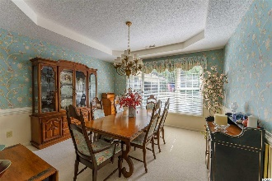
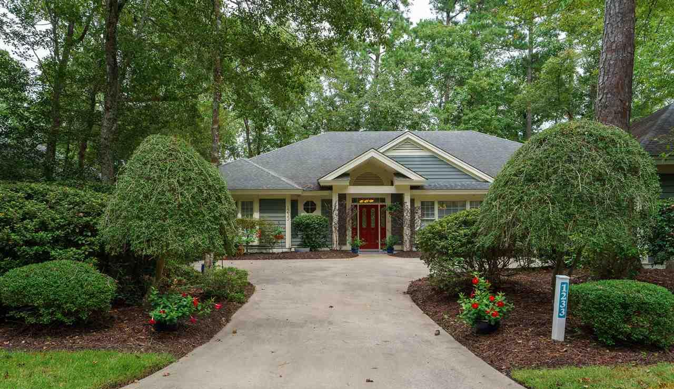
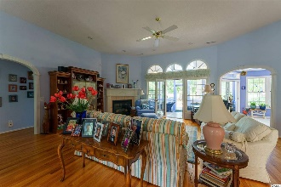
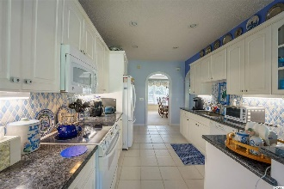
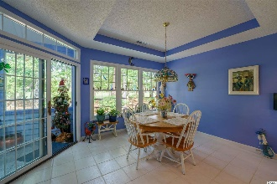
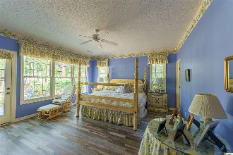
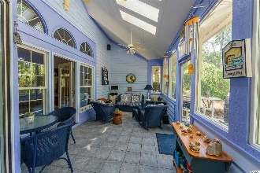
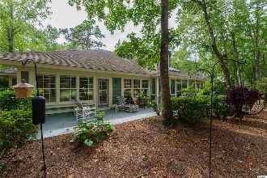
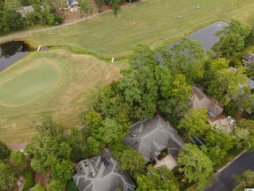
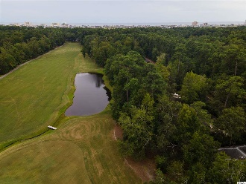


The Epitome Of Easy Beach/Golf Living
1233 Pine Valley Rd
Tidewater Plantation ~ North Myrtle Beach ~ MLS# 2019577
The epitome of easy beach-golf living, this BIG, custom-built traditional-ranch treasure is quite a rare find! Moreover, with the proven value of Tidewater, this unique golf-course home is appealing for a permanent residence or vacation home and is priced as an excellent investment property. Homes in the Plantation have low HOAs and city taxes with amazing amenities. Tidewater Plantation Resort boasts a world-class golf course, is minutes from the beach, shopping, medical services, schools, entertainment, dining & access to major highways. Those rich amenities include owners' oceanfront beach cabana with open/screened porches, bathrooms, showers & kitchen on the wide white-sand Cherry Grove Beach, named the 11th best in the nation. Residents have a private beach access entrance and plentiful beach parking. In Tidewater, residents enjoy the use of several pools/hot tubs. Other amenities are driving range, golf shop, clubhouse with bar/dining & event facilities, clay- and hard-surface tennis courts, pickle ball court, fitness center, bocce/horseshoe courts & amenity center. Tidewater is manned, gated & has a gated, monitored storage yard for boats, jet skis, etc. The resort reflects the luxury & comfort of a fine upscale beach/golf lifestyle. And, in Tidewater, BIG value often comes in likewise very Big packages, such as this unforgettable nearly 3,000 heated-square-foot 4- bedroom, 2 1/2-bath appealing single-level rambler with a note-worthy spacious flex-floor-plan, oversized fourth bedroom used as an office with separate outside entrance and to the garage, three-season Snuggery porch overlooking the golf course and private split-bedroom guest wing with jack-n-jill en suite. Yet it lives comfortably like a cozy cottage with tons of cabinet space, unbelievable storage & lots and lots of closets, including walk-ins in every bedroom, two in the master! A generous front driveway leads to the BIG two-car garage with, yes, more storage. The front of the home has much curb-appeal and overlooks a lovely, mature landscape of pretty flowering plants and indigenous foliage that surrounds the entire house as well. A wide, welcoming entry foyer looks out contiguously inside to the golf course via the windows in the living room and enclosed rear-porch, bathed in light also from coveted skylights. Formal dining is to the right and the living/great room straight ahead, adjoining the kitchen further to the right, along with the master/en suite, utility room and fourth bedroom/office. This living area is the heart of the home and boasts a warming, BIG gas fireplace. The spacious formal dining space has a tray ceiling and is easily accessed from the kitchen, also with a tray ceiling, and is nearby the guest bath for entertaining. The kitchen has well-planned functionality; charming cabinetry with pot shelves & walk-in pantry; and is family-sized with breakfast nook, used as an additional family gathering area, offering another nice view of and access to outside living areas and to the golf course. The two roomy guest bedrooms and bath are well separate and to the left. Guests enjoy not only space and BIG walk-in closets but huge windows with more views and cheerful natural lighting. They may never want to leave! Terrific traffic patterns throughout! Look for the many interesting architectural details, also throughout, & the gorgeous colonial-inspired doorway arches. This unique custom-design reflects preplanning by a thoughtful original owner who chose to construct a quality dream home for the generations in popular North Myrtle Beach, a Top-10 Beach Town in the U.S., named the safest city in South Carolina, and in Tidewater Plantation Resort. Tidewater is on a tree-lined road to oceanfront Anne Tilghman Boyce Coastal Reserve, a nature conservancy. Tidewater itself is on an elevated peninsula of live oaks and southern pines between the ICW and the Cherry Grove Inlet to the Atlantic Ocean. Real- & face-time virtual home and area tours available.
Deborah Collins
843-424-9013
dctidewater@yahoo.com
Connie Ross-Karl
702-306-2643
conniesross@aol.com
NEW WAY PROPERTIES MYRTLE BEACH

