Slide 1
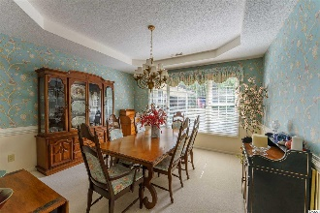
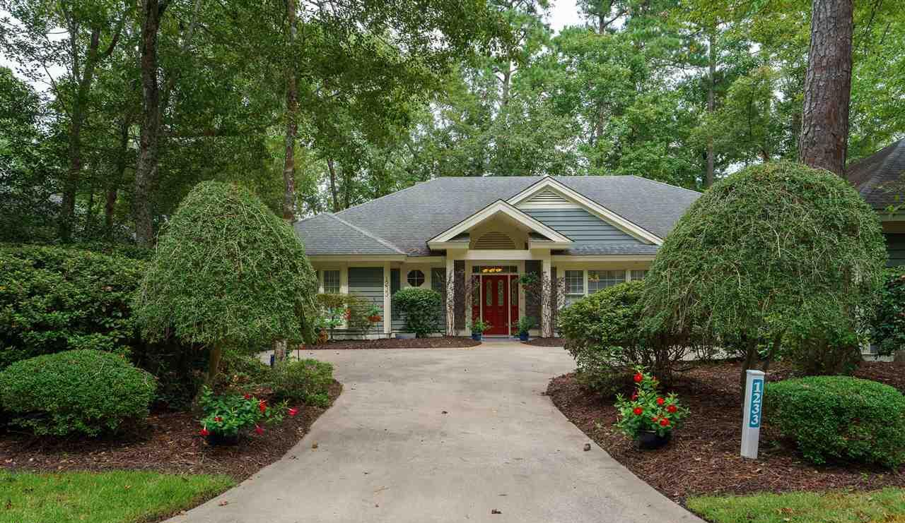
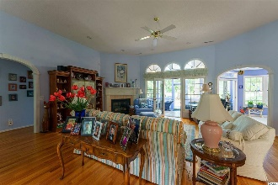
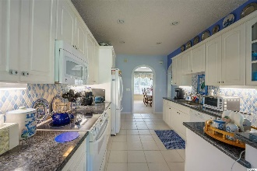
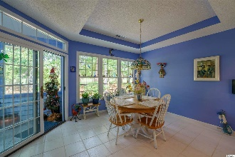
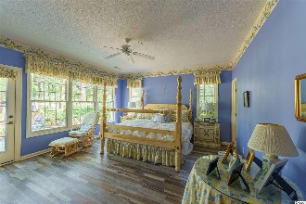
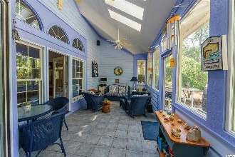
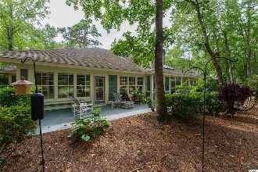
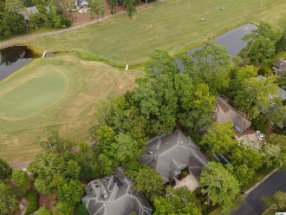
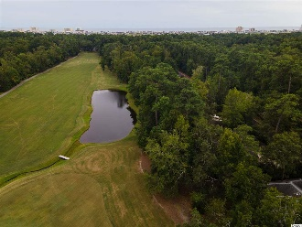


Features & Upgrades
1233 Pine Valley Rd.
Tidewater Plantation Resort | Popular North Myrtle Beach SC 29582
Location: Wonderful to watch the golfers putting! Home is located near the green on the #6 hole of Tidewater Plantation Golf Course but not on the cart path: 90 ft. of frontage on the golf course and 90 ft. of frontage on Pine Valley Rd. Lot 83 is rectangular with both sides measuring 140 ft. The large lot enjoys 12,197 sq. ft. and is .28-acre.
Inside:
Big space flex space with stairs going up to the huge attic / plenty of opportunity for even more living space as well! (Two-level storage attic completely floored with a full
staircase.)
A large mid-stairway shelf perfect for seasonal displays.
4th bedroom or office with built-in cabinets & shelves, and including extra outside direct-entry door.
More:
Mounted TV VCR perfect to watch from the Jacuzzi tub in master bath will convey.
2 huge walk-in closets in the master bathroom, walk-in closet in every well-planned bedroom.
All bedrooms oversized!
Seasonless, Carolina Room, “Snuggery,” back porch is picture-perfect for watching those golfers putting. Portable air conditioner in Snuggery - will convey.
Epoxy finish on the patio is easy to keep clean with a hose down.
Built-in kitchen cabinet wine rack. Pot shelves.
Large closet in the laundry room which has a pocket door.
Master bedroom has an access patio door.
All windows have shades.
The Living/Great Room has floor outlets with remote controls.
Walk-in pantry.
Planned cabinetry for all kitchen uses.
Tray ceilings in kitchen & front dining room.
Pull-out shelving in the kitchen. Kitchen has granite countertops and farm sink / provides instant boiling water.
5 architecturally designed detail walkway arches. Wide and welcoming foyer, entry hallway with half-bath & coat closet.
Large backyard patio. Beautiful snuggery with skylights, picture windows, and screen door right off the spacious living room & bright kitchen.
Entry hall and linen closets.
I/2 bath off entry, perfect for entertaining.
Large patio off back of home, accessed form Carolina room and master bedroom.
HOA maintains the front lawn grassy area.
Propane services heat, hot water heater, fireplace, stove in Carolina room and outdoor grill.
Beautiful curb appeal and mature landscaping.
One owner home shows beautifully!
Deborah Collins
843-424-9013
dctidewater@yahoo.com
Connie Ross-Karl
702-306-2643
conniesross@aol.com
NEW WAY PROPERTIES MYRTLE BEACH

