Slide 1
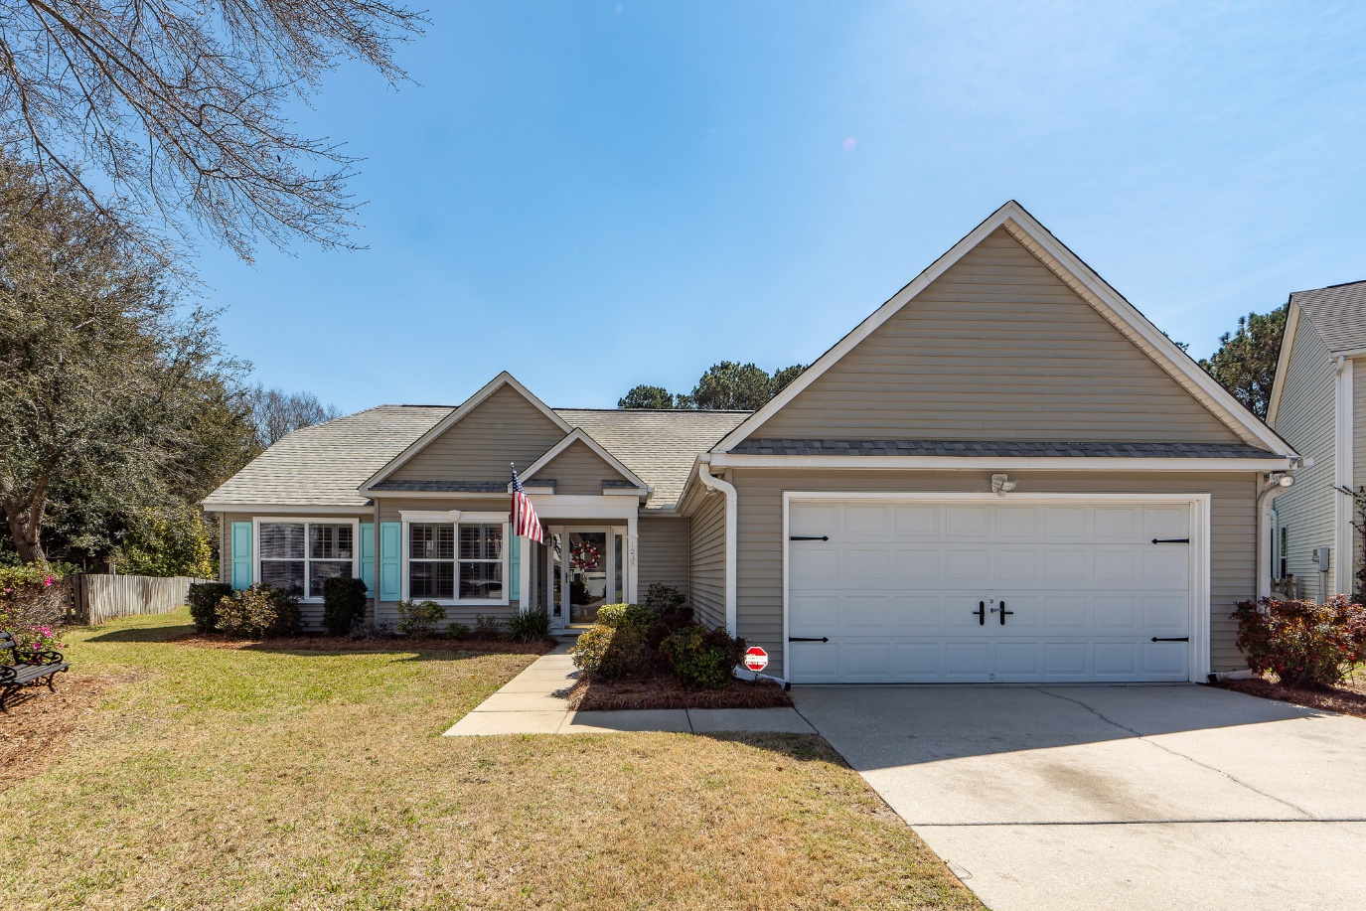
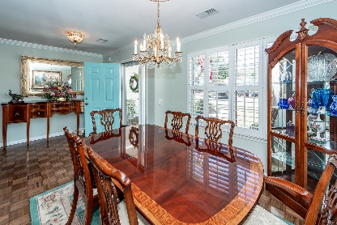
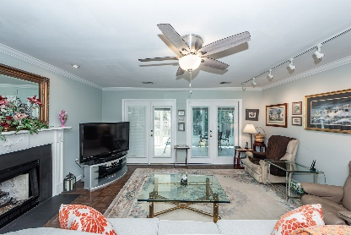
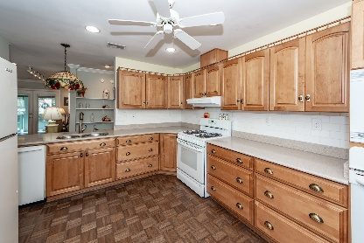
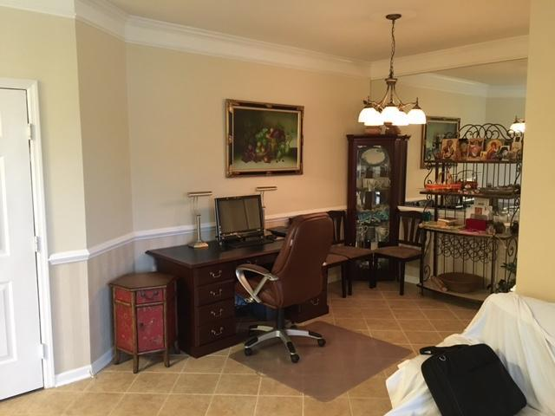
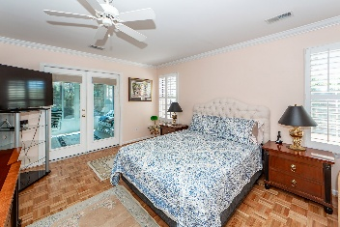
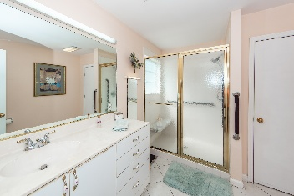
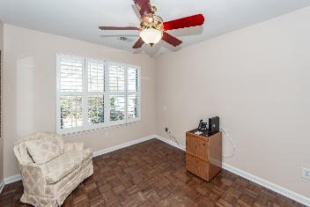
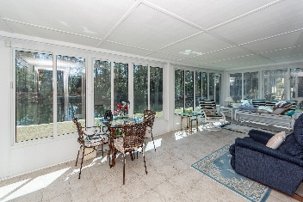
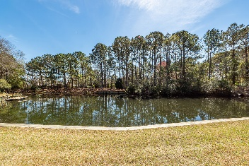



Agent Open House | Wednesday, 4/30 from 11-1 $100 Gift Card, Good Food, Beverages, and a Chance to Preview a Great Home!
1233 Bridgeport Drive
Waters Edge | Mount Pleasant, SC 29466 | MLS# 25007595 | $799,000
Charming One-Story Home with Pond Views & Prime Location This beautifully maintained one-story home on a cul-de-sac offers 1,700+ sq. ft. of inviting living space, featuring classic moulding, parquet floors, and stylish plantation shutters throughout most of the home. The living room/dining room combination with a gas fireplace provides a spacious, open feel—perfect for entertaining or everyday comfort. The well-appointed kitchen is a chef's dream, complete with Silestone countertops, a built-in microwave, a spacious pantry, and a unique dual-oven setup—one gas, one electric. A standout feature of this home is the large sunporch, offering breathtaking views of a beautiful pond.
The primary suite enjoys direct access to the sunporch, along with a walk-in closet, ceiling fan, and a large stand-up shower for added luxury. Additional highlights include tile flooring in the bathrooms, a convenient two-car garage, and an unbeatable location...just 10 minutes to the beaches and shopping and only 2 minutes from historic downtown Charleston.
Don't miss this rare opportunity to own a home that combines charm, comfort, and an exceptional location!
VIRTUAL TOUR
Cheryll Woods-Flowers
843-442-2219
cflowers@woodsflowers.com
www.woodsflowers.com
Coldwell Banker Residential Brokerage | 1127 Queensborough Blvd | Suite 103 | Mt Pleasant, SC 29464

