Slide 1
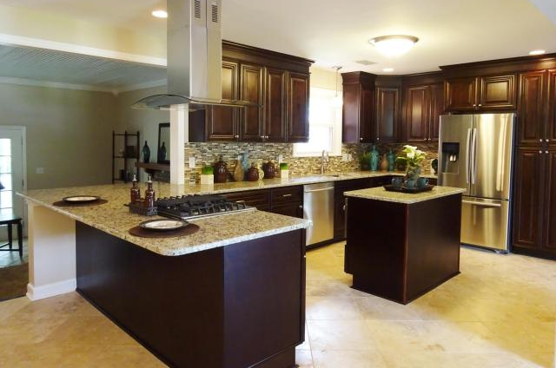
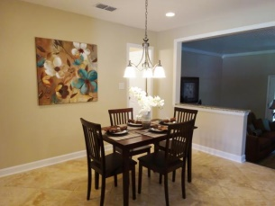
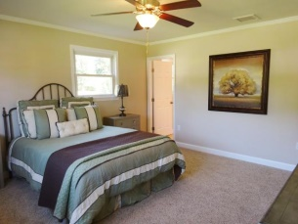
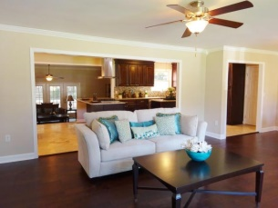
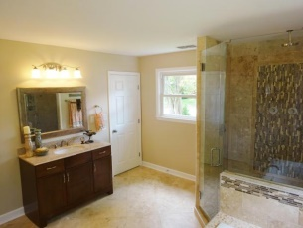
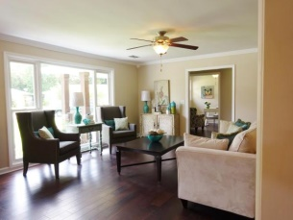
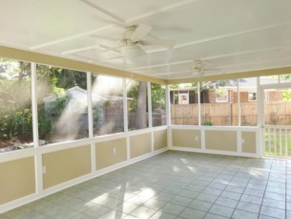
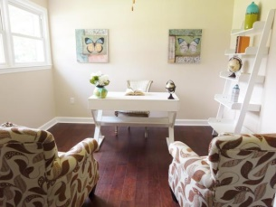
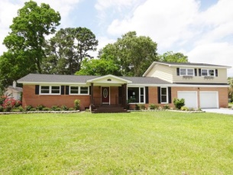

Just Renovated!
1235 Camelot Dr
Lenevar
Charleston MLS# 15013611
$389,900
Welcome to your newly renovated state of the art home!!This home has been completely renovated with some of the best upgrades on the Market! New Arch. shingles, Windows, Dual HVAC's, Custom kitchen and baths, Hardwood floors, Travertine tile, Granite, and so much more! As soon as you walk into this home you will love the open floor plan and gourmet kitchen that makes this house an entertainers dream! This kitchen is equipped with a Samsung SS appliance package complete with a gas range perfect for cooking demonstrations! The downstairs also features a beautiful spa retreat master suite, fully equipped with his and her vanities, large walk-in shower with rain shower head and body sprays, in addition to the large Jacuzzi tub! This house has everything you could want! A MUST SEE!!
Karrie Britton
M - (843) 478-9638
design_elements@msn.com

