Slide 1
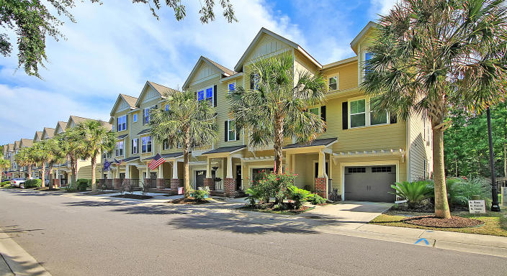

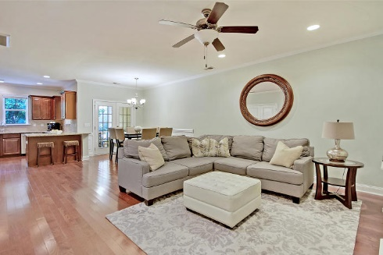
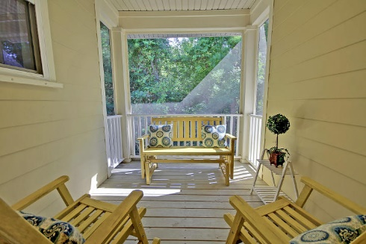
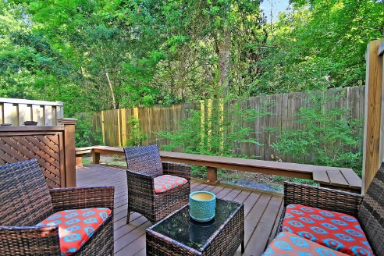
Convenient Location
Close to Everything
Price Reduced
For Quick Sale
Open House Saturday 12-3
1237 Dingle Road
Royal Palms ~ Mount Pleasant, SC 29466 ~ MLS# 20013588 ~ $336,500
Terrific townhome living conveniently located in Mount Pleasant awaits you with this three level move-in ready residence. The main level open concept of the home boasts gleaming hardwood floors, breakfast bar seating, granite counters and SS appliances in the kitchen and wainscoting in the dining area which grants access to the screened-in porch, You'll also find the powder room, laundry closet and master suite with its walk-in closet and en-suite bath that has a dual vanity, garden tub and walk-in shower. The top level has two spacious bedrooms that share a jack-n-jill bath. The ground level offers an office, half bath and garage that runs the length of the home and allows access to the deck with its built-in bench and tranquil views of the woods. Tucked away off of 17, this convenient location is close to everything!
Additional features include:
Convenient office space
Custom painted
Ample storage throughout the home
Located close to shopping, dining, schools, area beaches, & downtown Charleston
Lower monthly HOA dues
Guest parking available
Book your showing today!
Katie Wishneff kwishneff@mattoneillteam.com 843-870-8784

