Slide 1
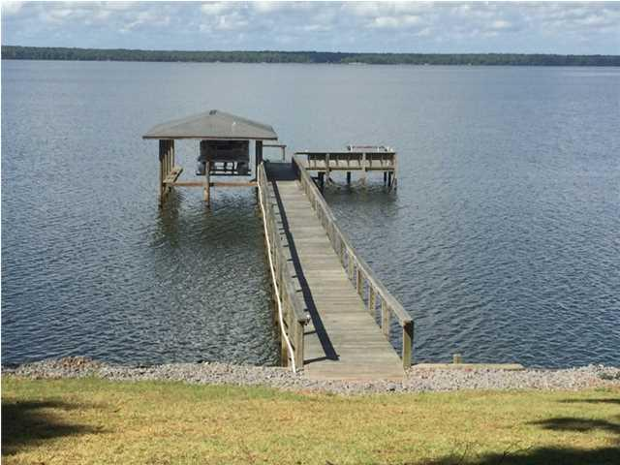
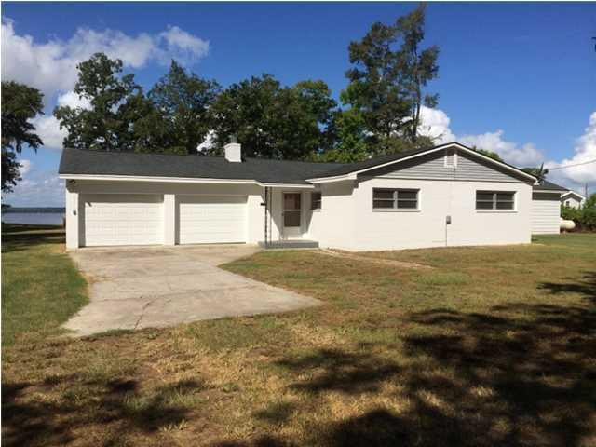
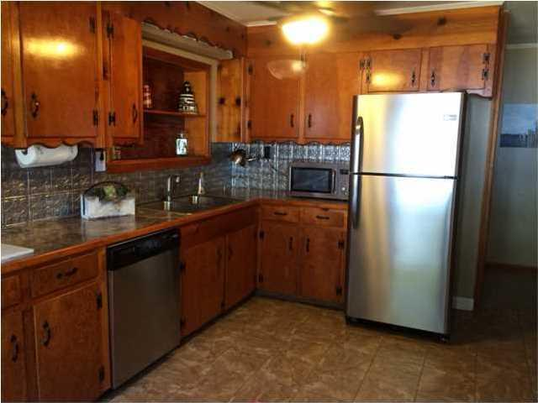
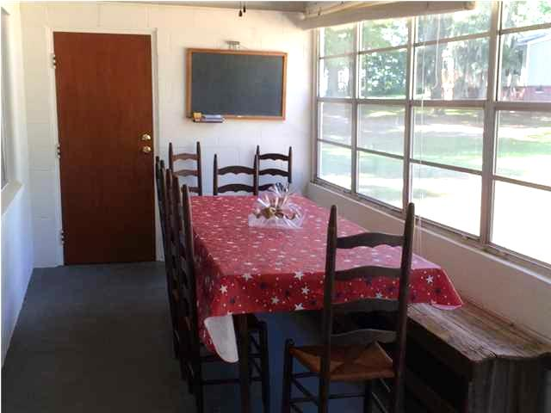
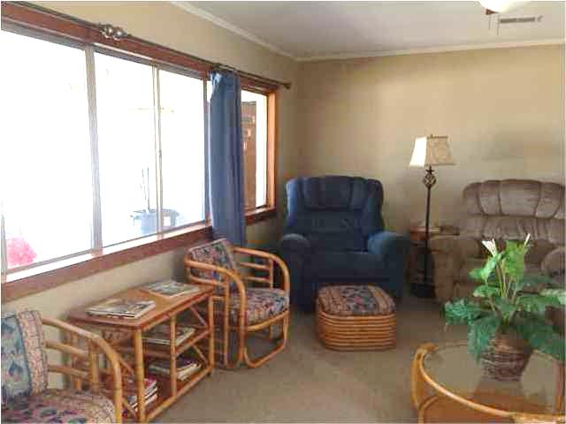
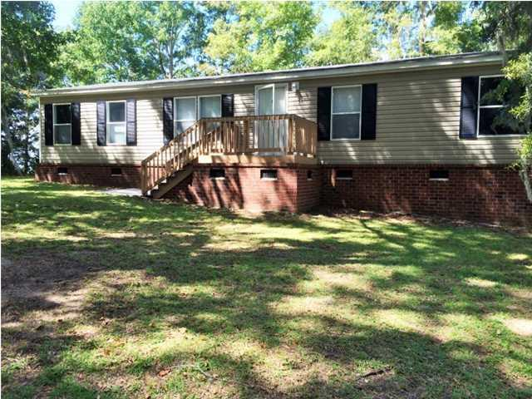
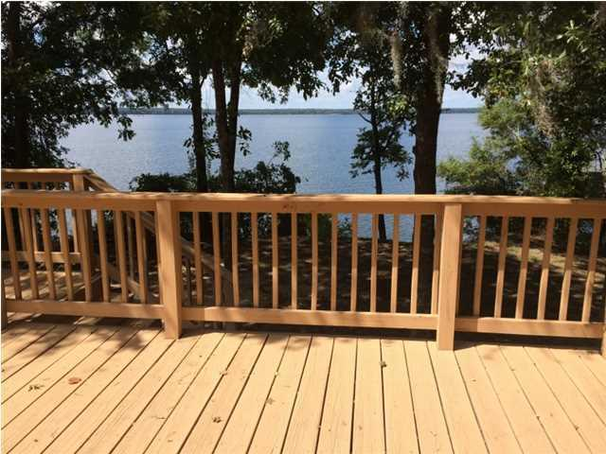

1237 Scott Lake Rd Scotts Lake Summerton, SC MLS# 1425079 $550,000 1,854 Sq Ft - 4 Bedroom - 2 Bath
Fantastic Views of
Lake Marion
Plan to enjoy gorgeous views and breathtaking sunsets from this great home on Lake Marion. Easy living on a single story floor plan with 8ft smooth ceilings. You will look forward to spending many days and evenings on the relaxing sun porch facing the Lake. This property can be sold as 1 lot with 2 homes, a dock and a boat lift for $550,000. The sellers are also giving the option to divide the lot and have them sold separately. If divided, Lot 48 will list for $345,000, which includes a nicely decorated block house with 4 bedrooms, 2 bathrooms, and dock with a boat lift. Lot 50 will list for $225,000 which includes a manufactured home and 1 hook up station for additional living. This lot could also be used for a rental income property. This spacious home comes with 3 bedrooms, 2 bathrooms and 1400+ sq. ft. Everything in the home stays with the property. There is a beautiful Trex deck on the front overlooking the lake. Must see this property to appreciate its value.
Barbara Limehouse
Mobile: 843-870-8291
barbara@southernshoresre.com
Southern Shores Real Estate
107 S. Main St
Summerville, SC 29483

