Slide 1
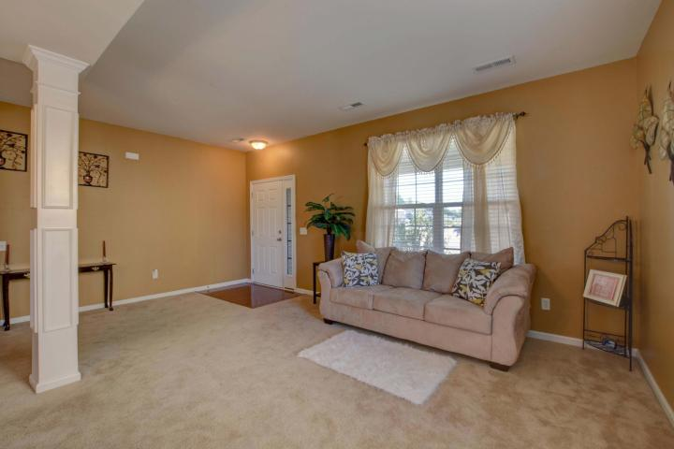
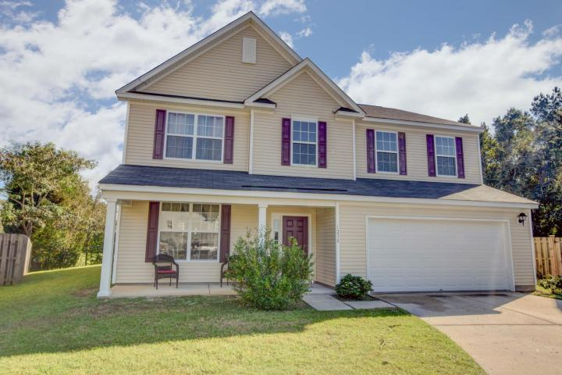
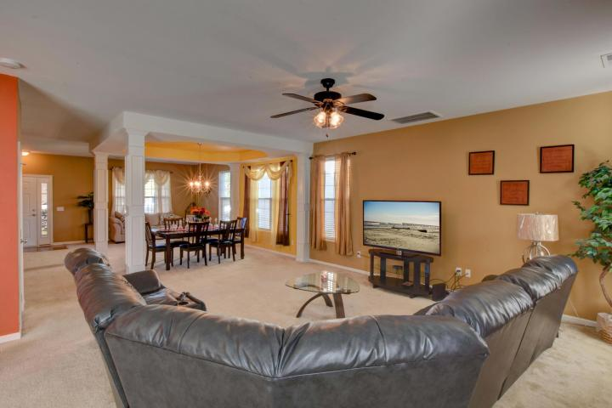
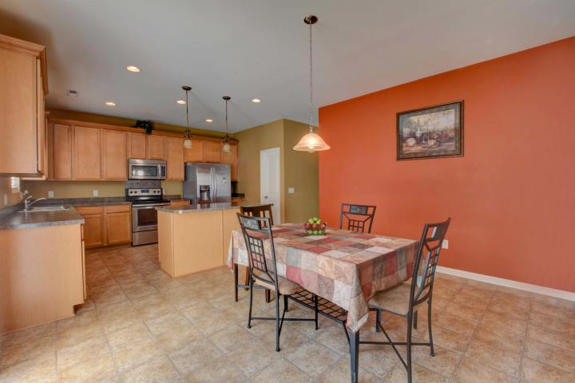
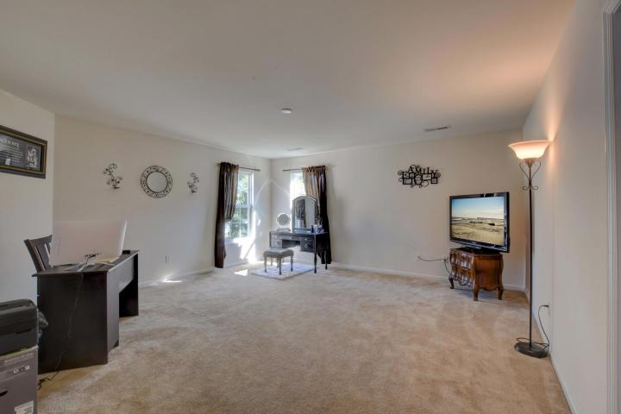
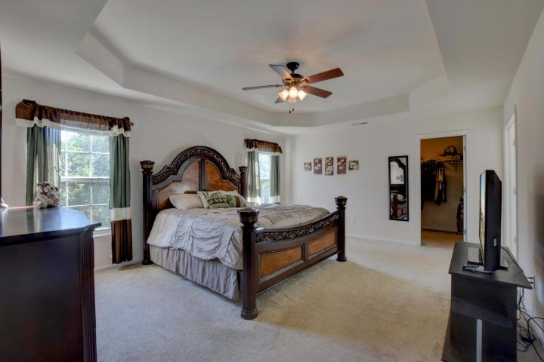
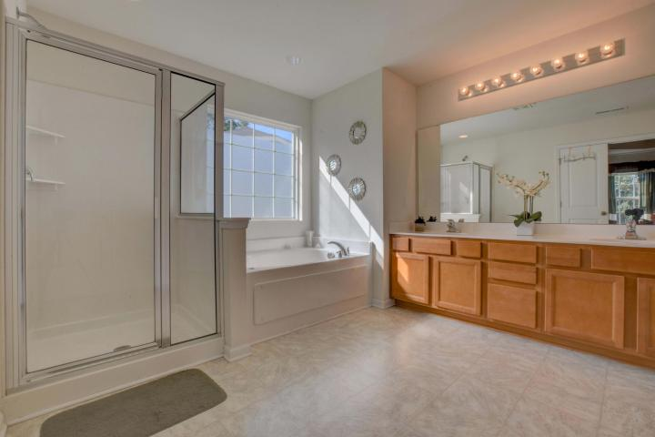
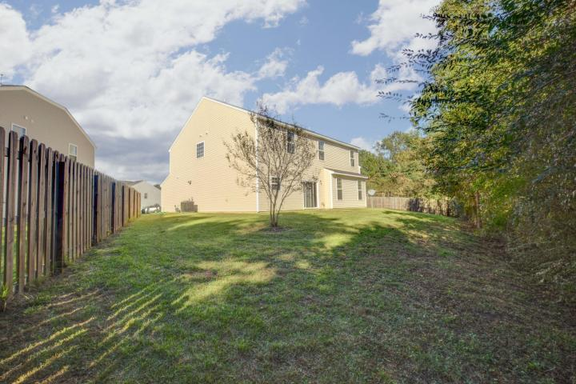


Cul De Sac Living
1238 Cosmos Road
Myers Mill ~ Summerville, SC 29483
MLS# 17028184 ~ $275,000
Welcome Home!
If you are looking for a cul de sac for your kids to play in LOOK NO FURTHER! This enormous home is waiting for your family now!4 large bedrooms all upstairs surrounding a huge loft area for a 2nd family room or an office or recreation area. Master Bath opens up beyond double doors for privacy. Dual sinks, stand alone shower & Garden tub perfect for relaxing. The kitchen island is the perfect location for family gathering after a long day, before you venture to the table for a meal. Preparing for the holidays is a no brainer with all this counter space, and serving dinner to the dining room is a where the magic happens when you are all around the table. Backyard is waiting for your love & a firepit, starry nights ahead in DD2 school district and close to everything!
Lisa Horan
Full Service Realtor
843-501-8856
lisaghoran@gmail.com
AgentOwned Premiere Group • 100 Crowfield Blvd • Goose Creek, SC 29445

