Slide 1

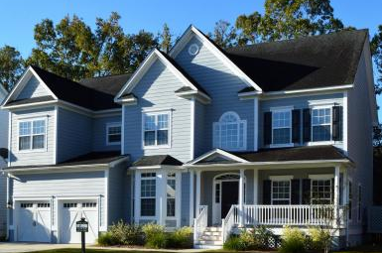
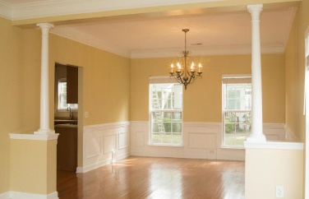
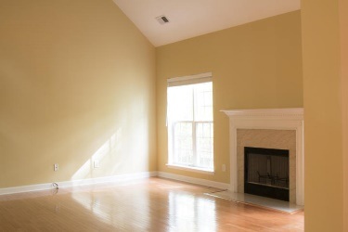
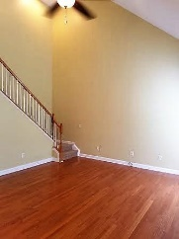
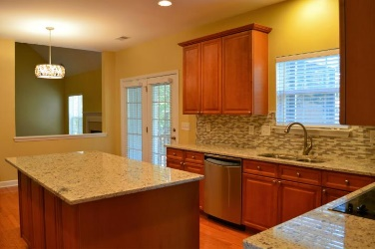
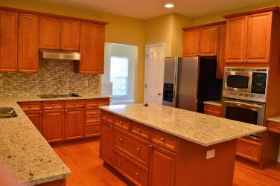
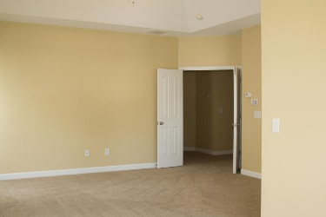
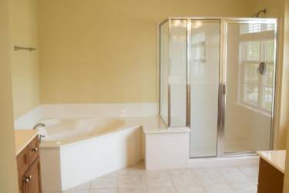
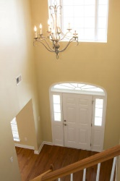
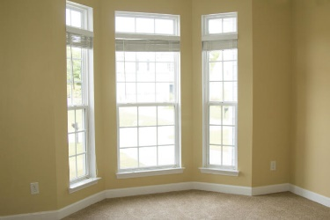
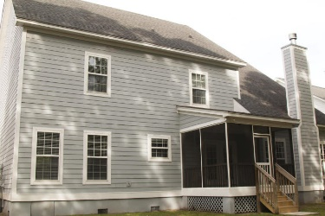



$2,500 Agent Bonus & Improved Price!
1238 White Tail Path
Hunt Club
Charleston, SC 29414
MLS# 17009074
$410,000
3,263 SF
4 Bedrooms :: 2½ Bath
New HVAC! NEW interior and exterior PAINT! New Carpet! New fixtures throughout. NEW Granite counter tops and glass tile back-splash. The backyard has a new gated fence enclosure. New Landscaping! Be prepared to be wowed when you walk into this home. Beautiful hardwood floors throughout the main level of the home, except for the study/flex room. The gourmet kitchen has been outfitted with gorgeous granite counter tops, glass tile back-splash, all stainless-steel appliances, tons of counter space, kitchen island with cabinets and drawers, pantry and a “home command center” with built in desk. There is an over-sized breakfast nook for your everyday dining with access to the screened in porch. The elegant formal dining room sits on the other side of the kitchen that flows effortlessly into the formal living, great for entertaining.
Downstairs is anchored by a huge family room with a wood burning fireplace, as well as, a bright and open formal living room. There are 2 open staircases, in the double height entryway and the family room. Additionally, there is a powder room, laundry room, flex space/study, and a large storage closet.
All bedrooms including the master suite are on the second floor. The master suite is HUGE!!! Master includes a large sitting area and on suite bathroom fitted with his and her vanities, stand up shower and a separate jetted tub. The three additional bedrooms are all generous in size with large closets.
This home is stunning and is ready for all your own personal touches.
Lizzie H Ray
(843) 452-9298
lizzieray1122@gmail.com
Eric Draper
(843) 442-7118
eric.draper@gmail.com
www.charlestonrealestategroup.com
Charleston Real Estate Group | 792 Folly Rd. C1 | Charleston, SC 29412

