Slide 1

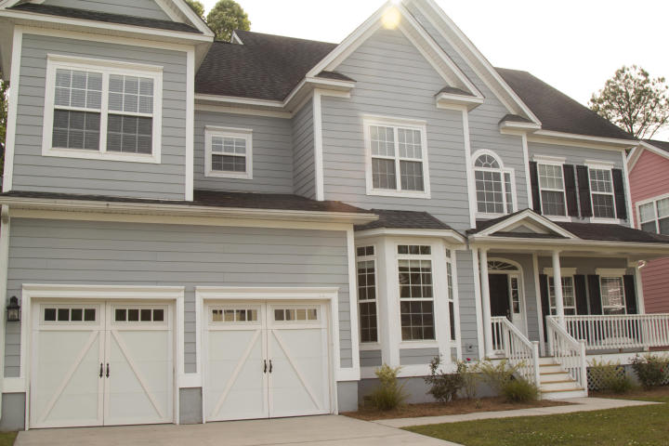
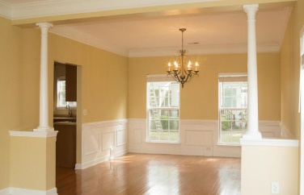
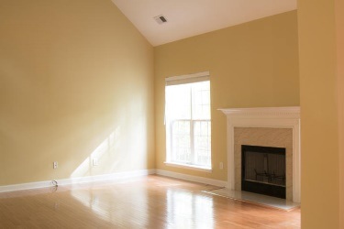
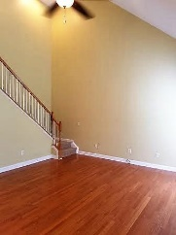
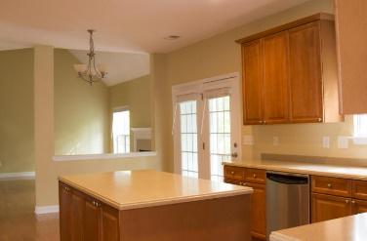
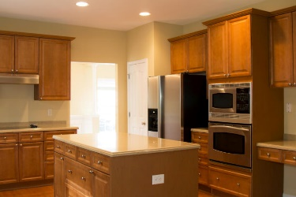
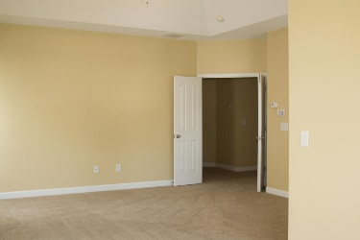
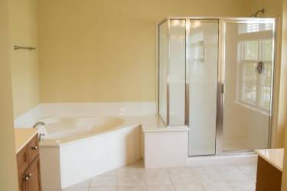
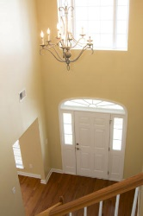
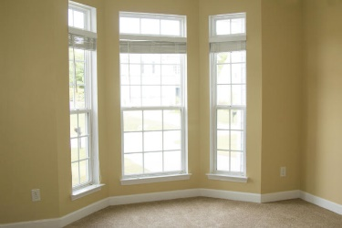
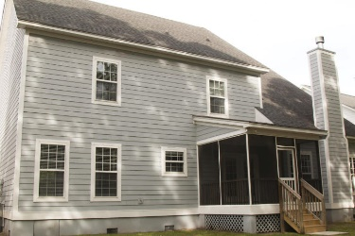



Hunt Club Stunner!
1238 White Tail Path
Hunt Club
Charleston, SC 29414
MLS# 16016108
$425,000
3,263 SF
4 Bedrooms :: 2½ Bath
Be prepared to be wowed when you walk into this home. Beautiful hardwood floors throughout the main level of the home, with the exception of the study/flex room. There are 2 open stairways, the first in the double height entryway and the second is off of the family room. The gourmet kitchen has been outfitted with gorgeous Corian counter tops, all stainless steel appliances, tons of counter space, kitchen island with cabinets and drawers, pantry and a HOME COMMAND center with built in desk. There is an over sized breakfast nook for your everyday dining. Formal dining room is just on the other side of the kitchen.
Downstairs is anchored by a huge family room with a fireplace as well as a bright and open formal living room. The laundry/mudroom, powder room and study round out the first floor of this home.
All bedrooms including the master suite are on the second floor. The master suite is HUGE!!! Master includes a large sitting area and on suite bathroom fitted with his and her vanities, stand up shower and a separate jetted tub. The three additional bedrooms are all of good size with big closets.
New HVAC! All NEW interior and exterior paint! NEW carpets on staircases and entire second floor (minus the bathrooms)! New fixtures throughout the entire home. Additional can lighting has been added over one staircase.
This home is absolutely stunning and is ready for all of your own personal touches.
Lizzie H Ray
(843) 452-9298
lizzieray1122@gmail.com
Eric Draper
(843) 442-7118
eric.draper@gmail.com
www.charlestonrealestategroup.com
Charleston Real Estate Group | 792 Folly Rd. C1 | Charleston, SC 29412

