Slide 1

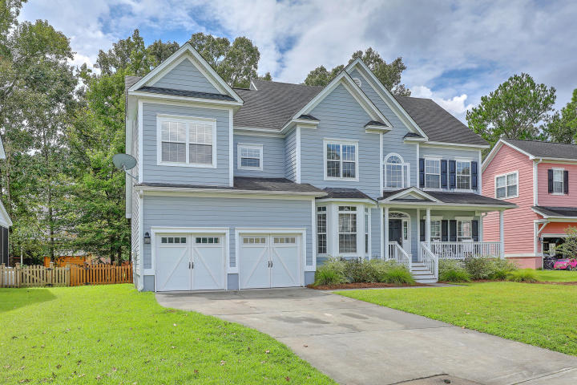
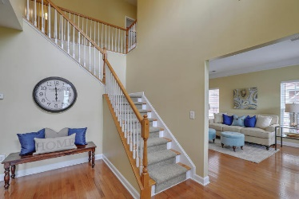
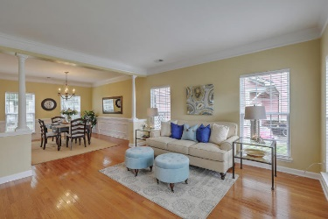
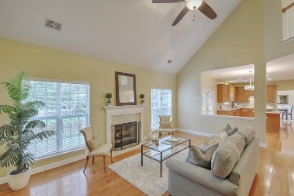
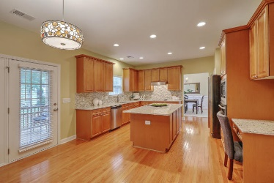
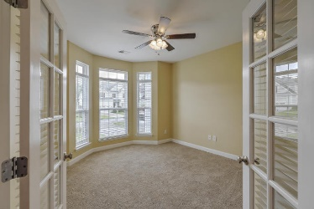
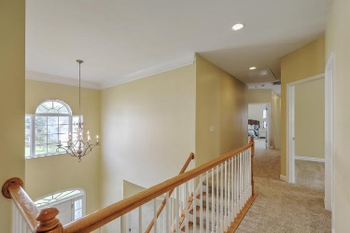
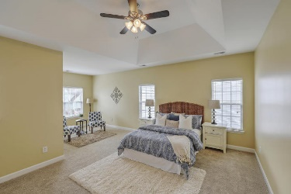
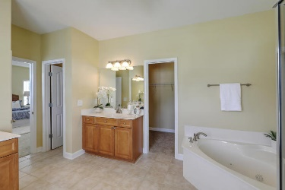
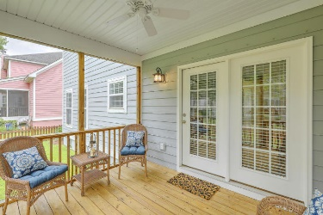
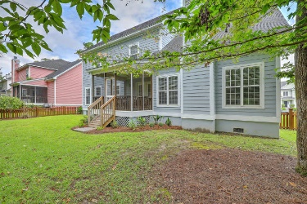



New Improved Price!
1238 White Tail Path
Hunt Club
Charleston, SC 29414
MLS# 17024665
$390,000
3,263 SF
4 Bedrooms :: 2½ Bath
Live where CLASS and CONVENIENCE collide.
Stunning home in prestigious Hunt Club subdivision, a wonderful family oriented community that offers beautiful, high quality homes. This home of 3200+ square feet has 4 true bedrooms as well as a flex-room that could be used as 5th bedroom. Cooks paradise kitchen with granite counter-tops, glass tile back-splash, stainless steel appliances, HUGE island, tons of counter space and tons of cabinets. There is an oversized breakfast nook that leads out to large screened in porch. With the exception of of the study/flex-space the entire first floor has nice oak hardwood floors. New carpet in study, on both set of stairs, all bedrooms and hallways upstairs. The first floor of the home is anchored by a cozy family room with wood burning fireplace and bright and open formal living room that flows effortlessly into the formal dining room. This home is great for entertaining!
All bedrooms including the master are on the second floor. The master suite is impressive.... there is a large sitting area as well as the en suite bathroom fitted with his and hers vanities, stand up shower, large jetted tub and the enormous walk in closet. The 3 additional bedrooms are all of good size with big closets.
Lizzie H Ray
(843) 452-9298
lizzieray1122@gmail.com
Eric Draper
(843) 442-7118
eric.draper@gmail.com
www.charlestonrealestategroup.com
Charleston Real Estate Group | 792 Folly Rd. C1 | Charleston, SC 29412

