Slide 1
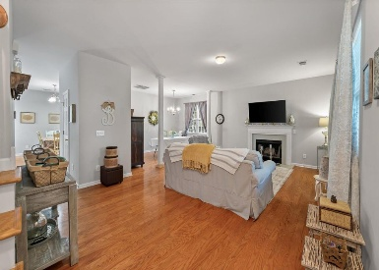
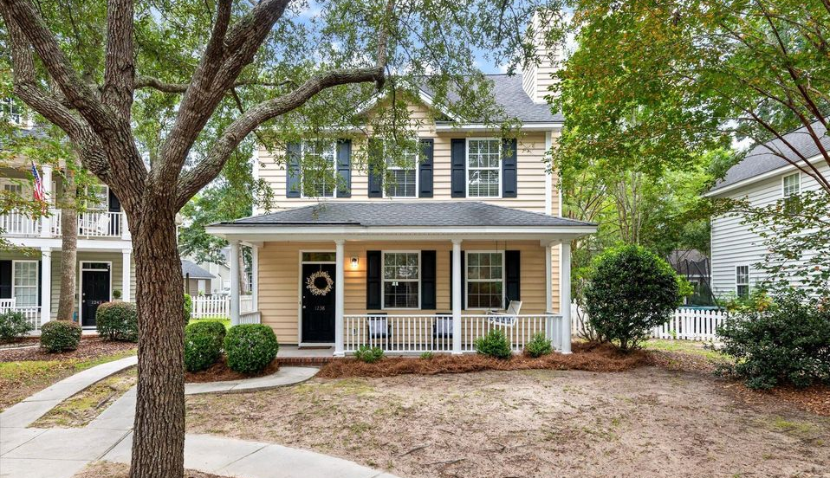
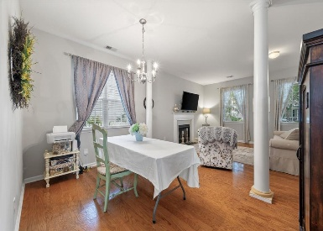
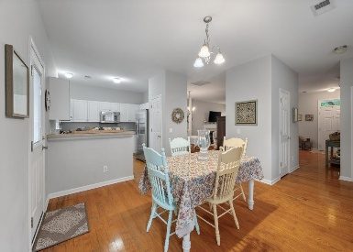
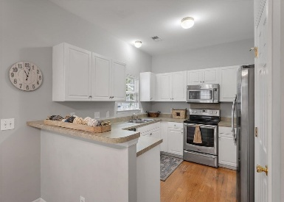
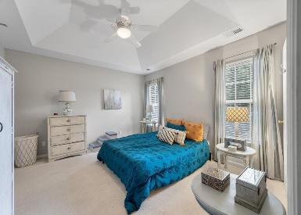
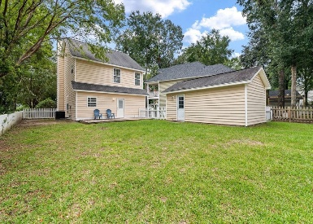
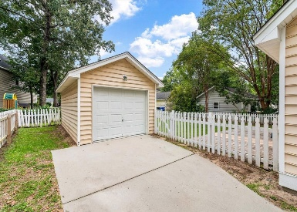


1238 Falling Moss Drive Laurel Grove · Mount Pleasant, SC 29466 MLS# 25025376 · $589,950
Huge Price Reduction
Welcome to Mount Pleasant's best kept secret, Laurel Grove! This precious little community is nestled between the Ivy Hall Subdivision and Park West. You can walk, bike or golf cart to Oakland Shopping Center and to other area shops and restaurants. This home features 3 bedrooms and 2 1/2 baths and boasts hardwood floors downstairs.
The kitchen has stainless steel appliances, a pantry and a window at the kitchen sink that overlooks the backyard. The family room has a wood burning fireplace and there is a flex space that could be used as a formal dining area or an office space. The three bedrooms are located upstairs. The primary suite includes a spacious en suite bathroom with large walk in closet.
The yard is a good size and has a patio that is great for adding seating for outdoor dining or relaxing in the wonderful Lowcountry weather. In addition to the patio there is a full front porch that also offers a great space for outdoor living! Also the property has a one car garage perfect for storage! The home sits on a cul de sac which offers a nice quiet feel!
Carey Nikonchuk
843-276-1701
cnikonchuk@gmail.com
www.brennamangroup.com

