Slide 1
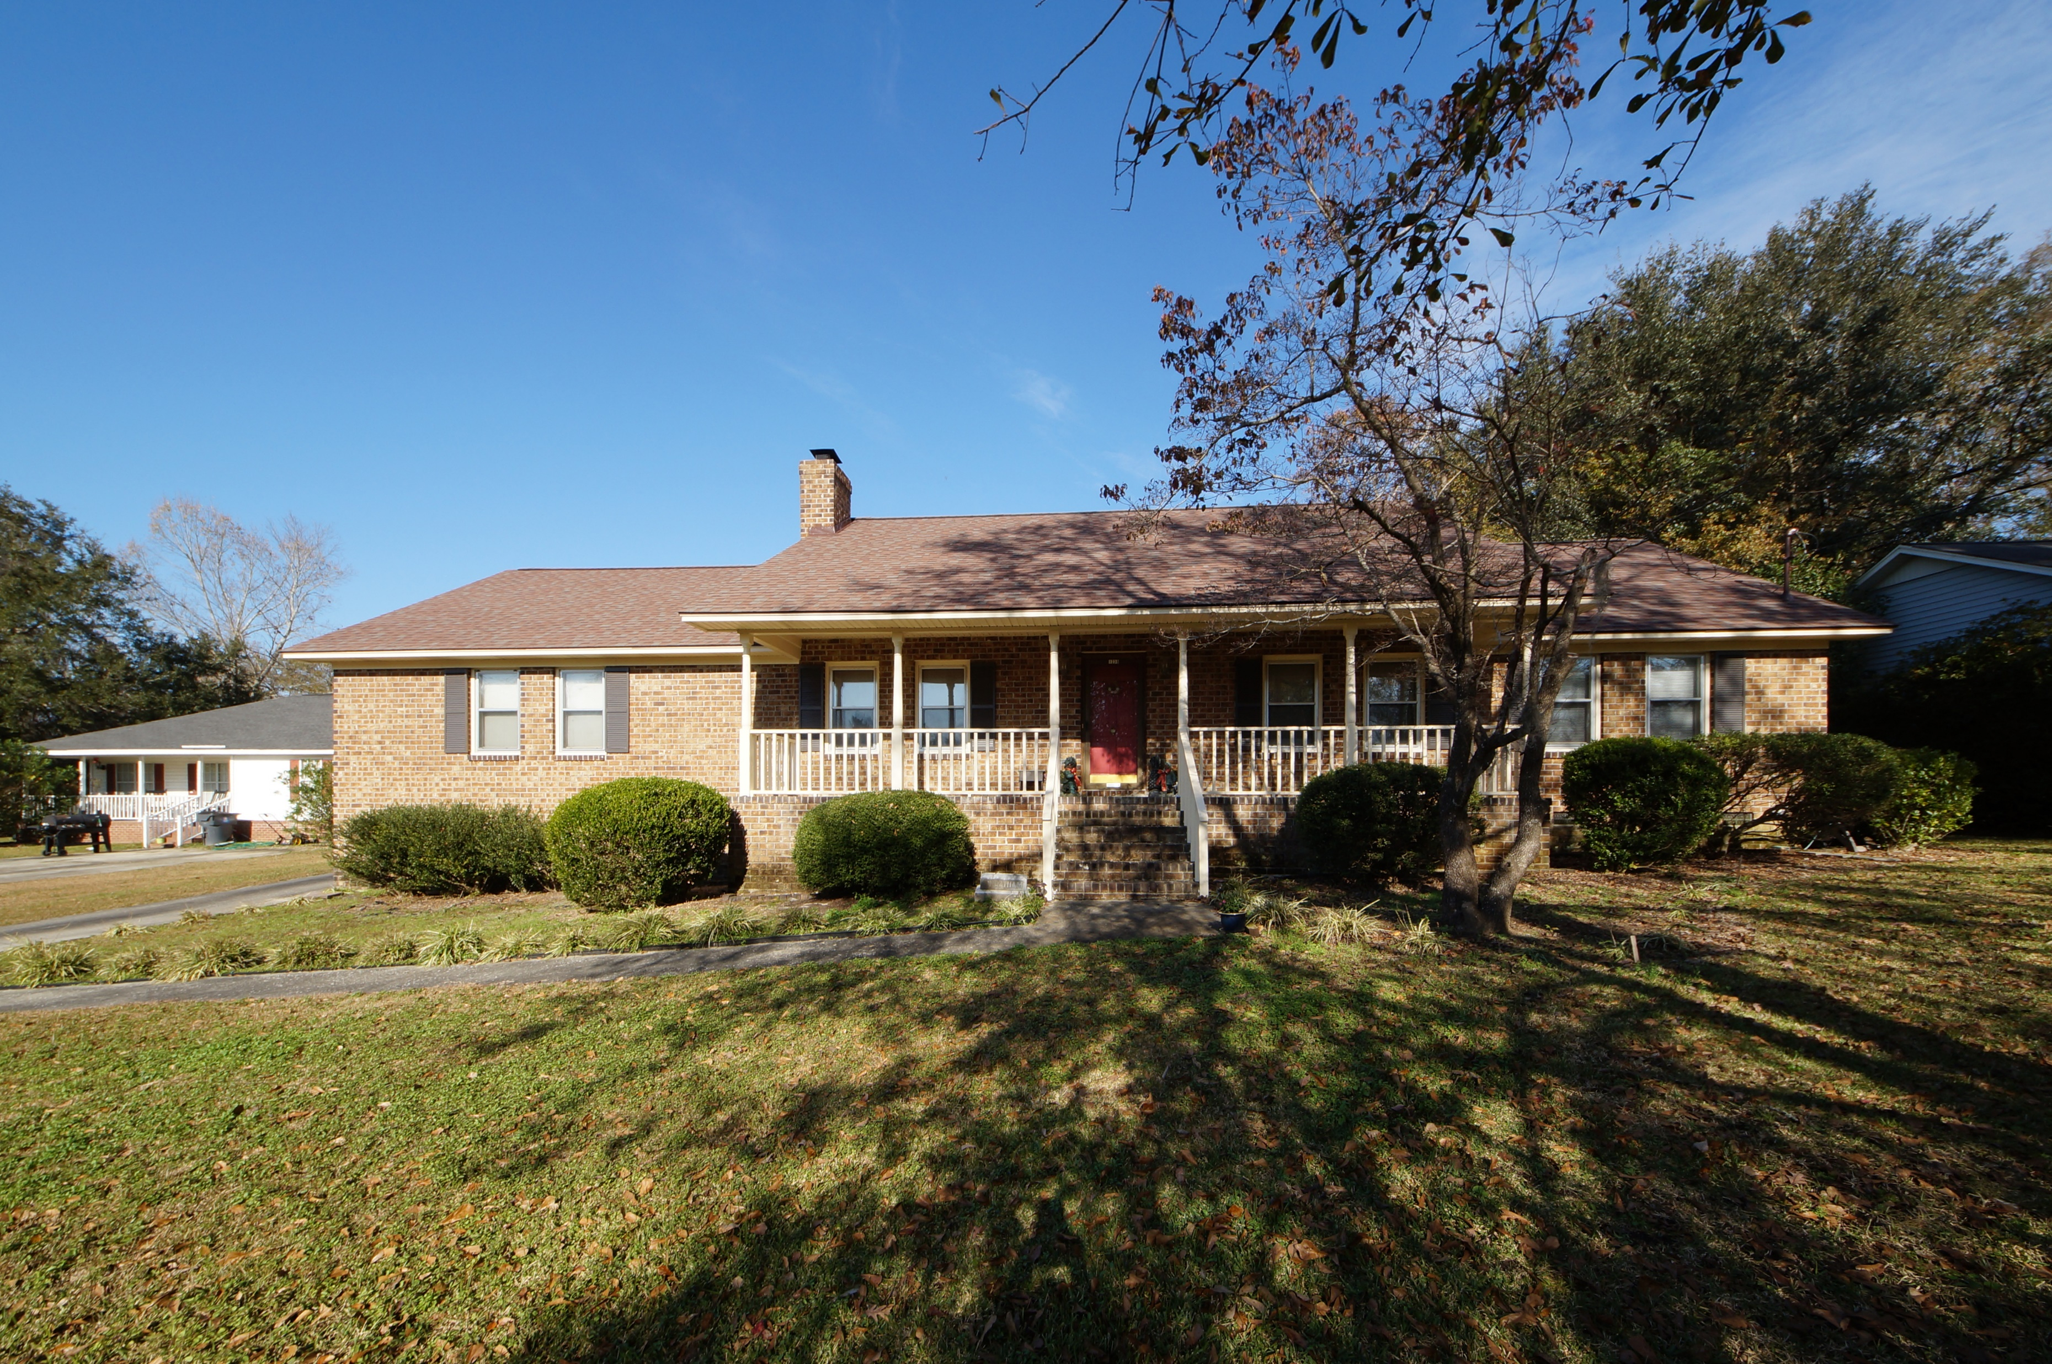
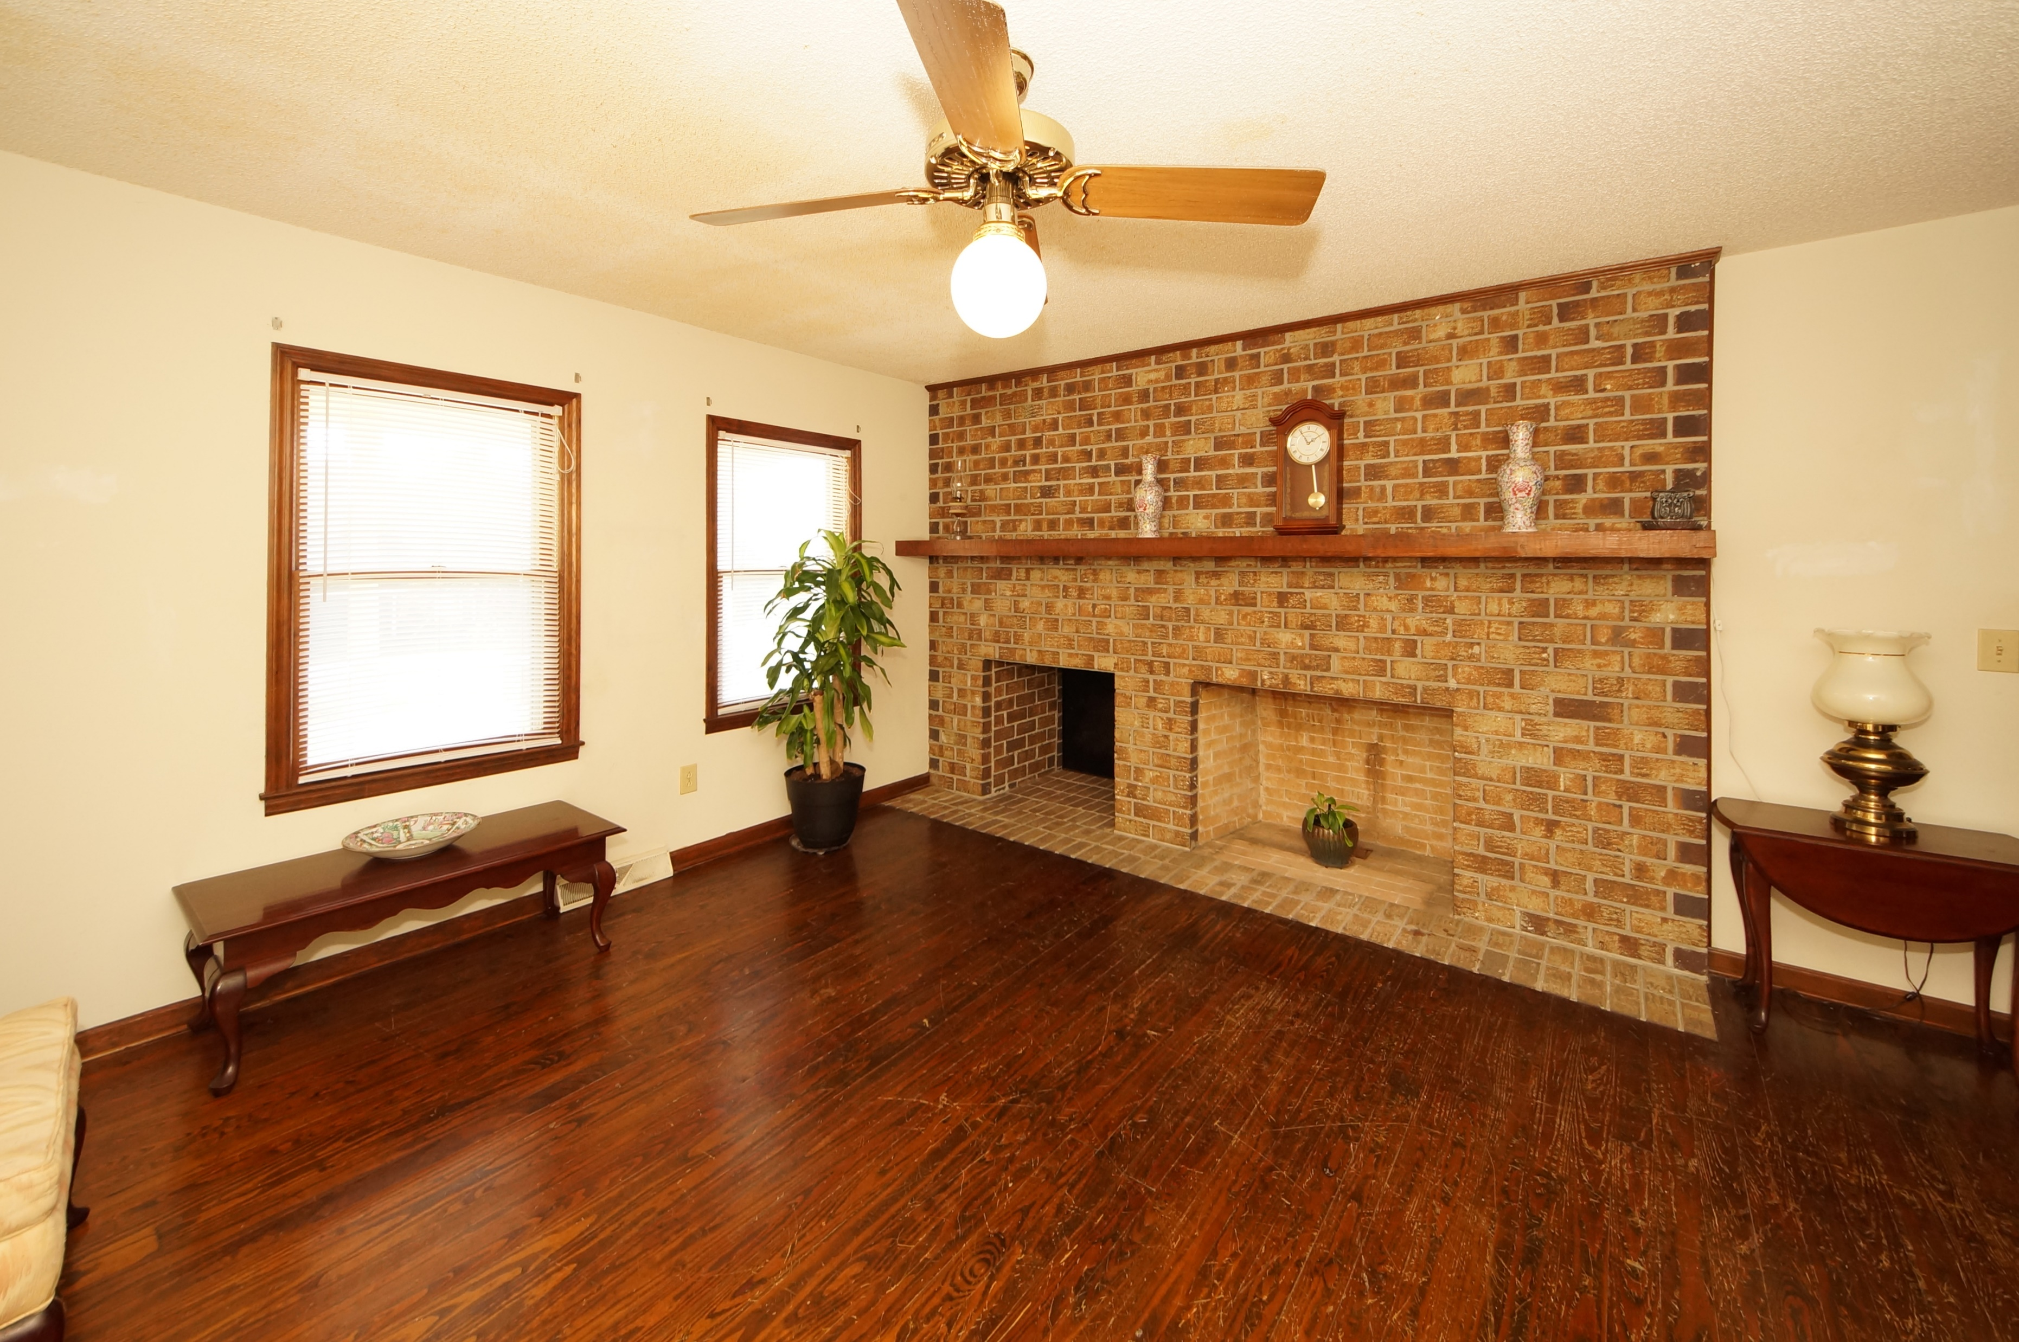
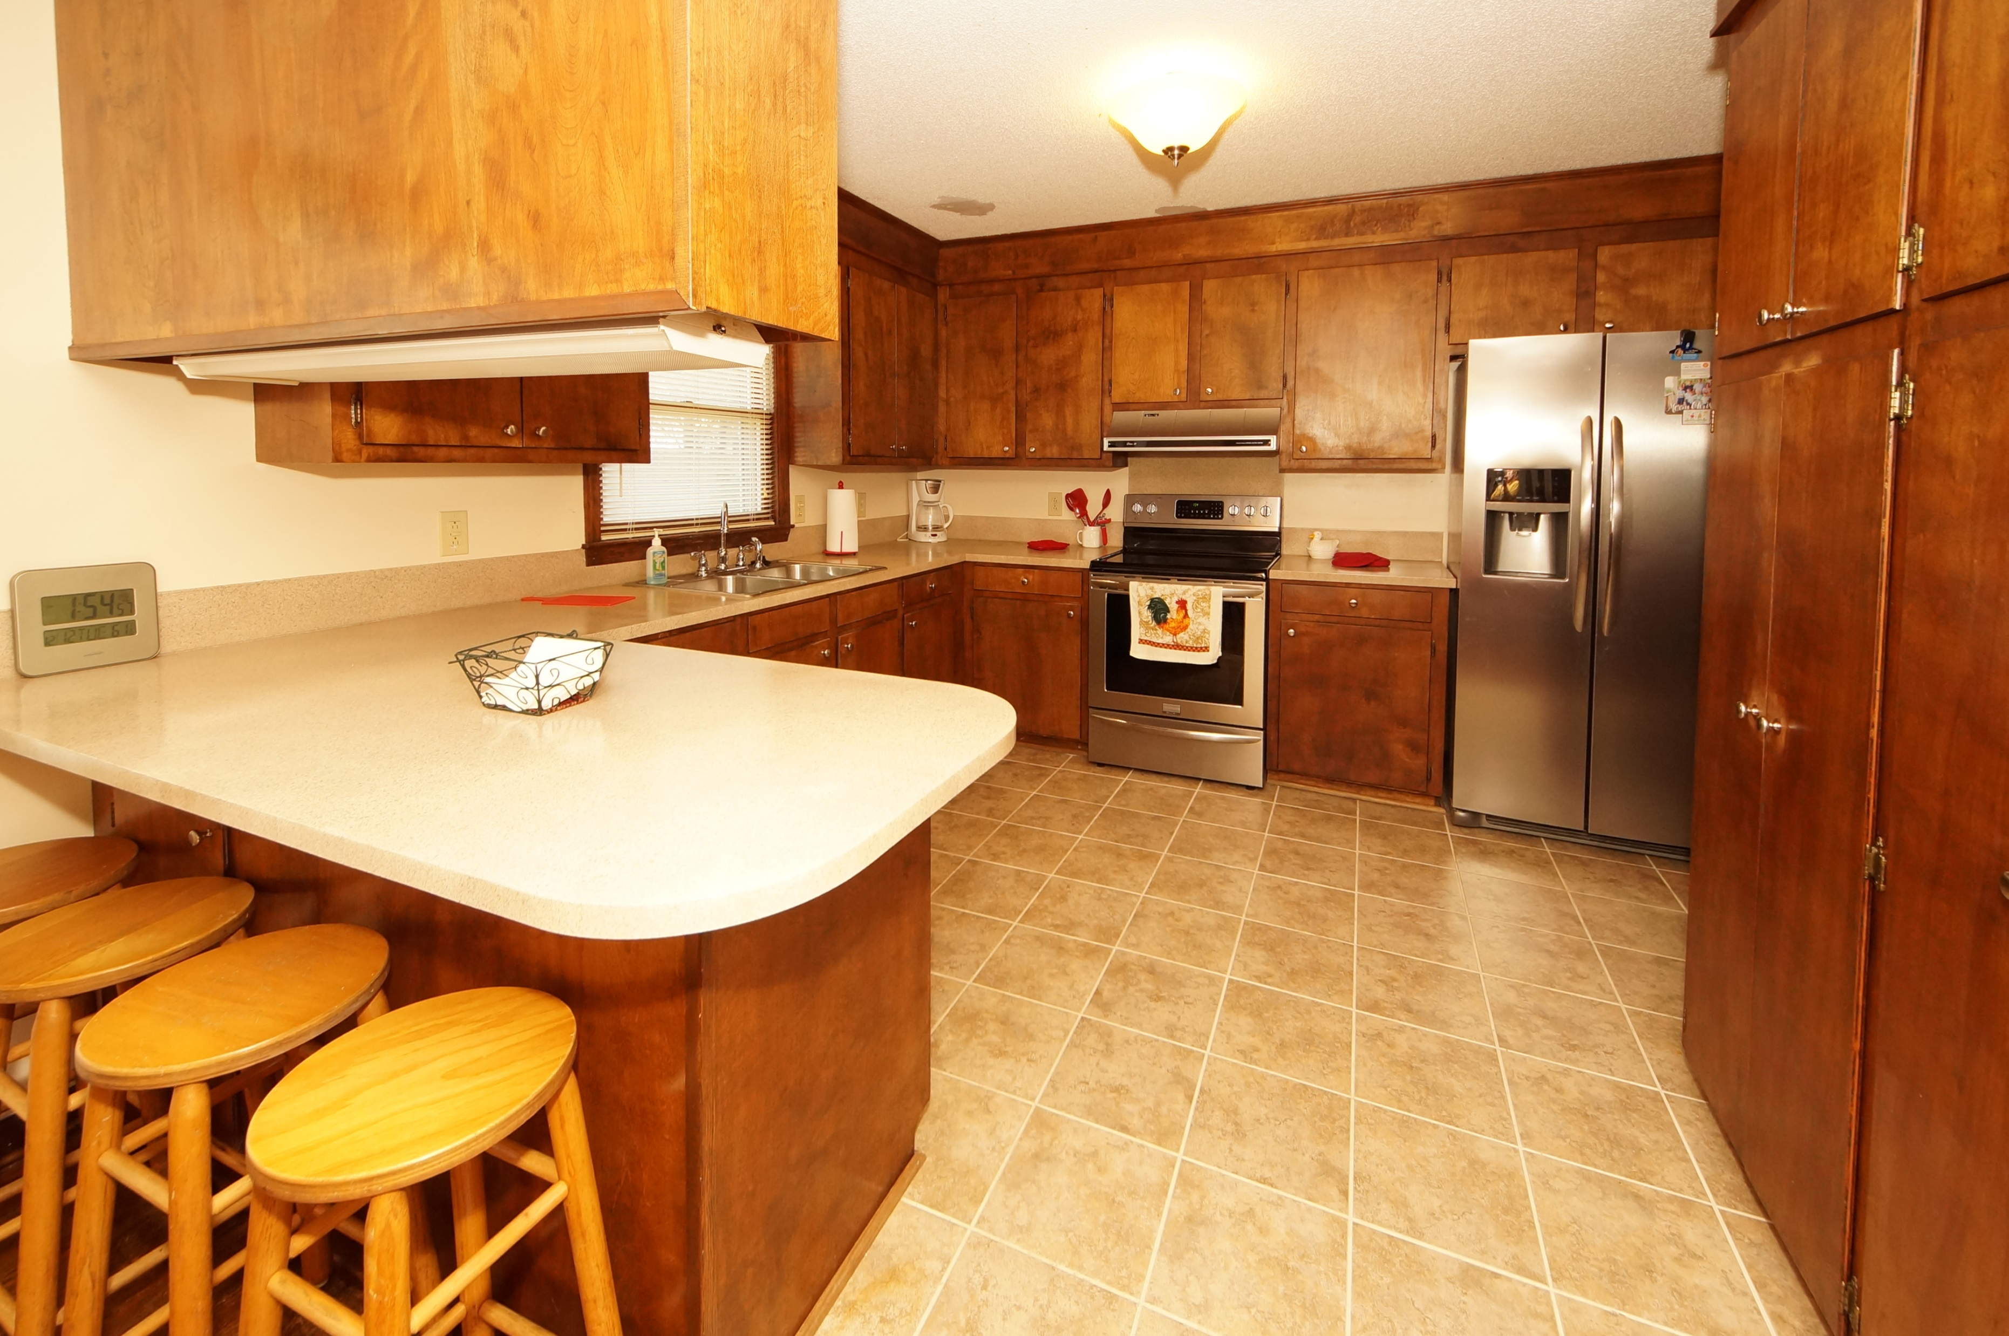
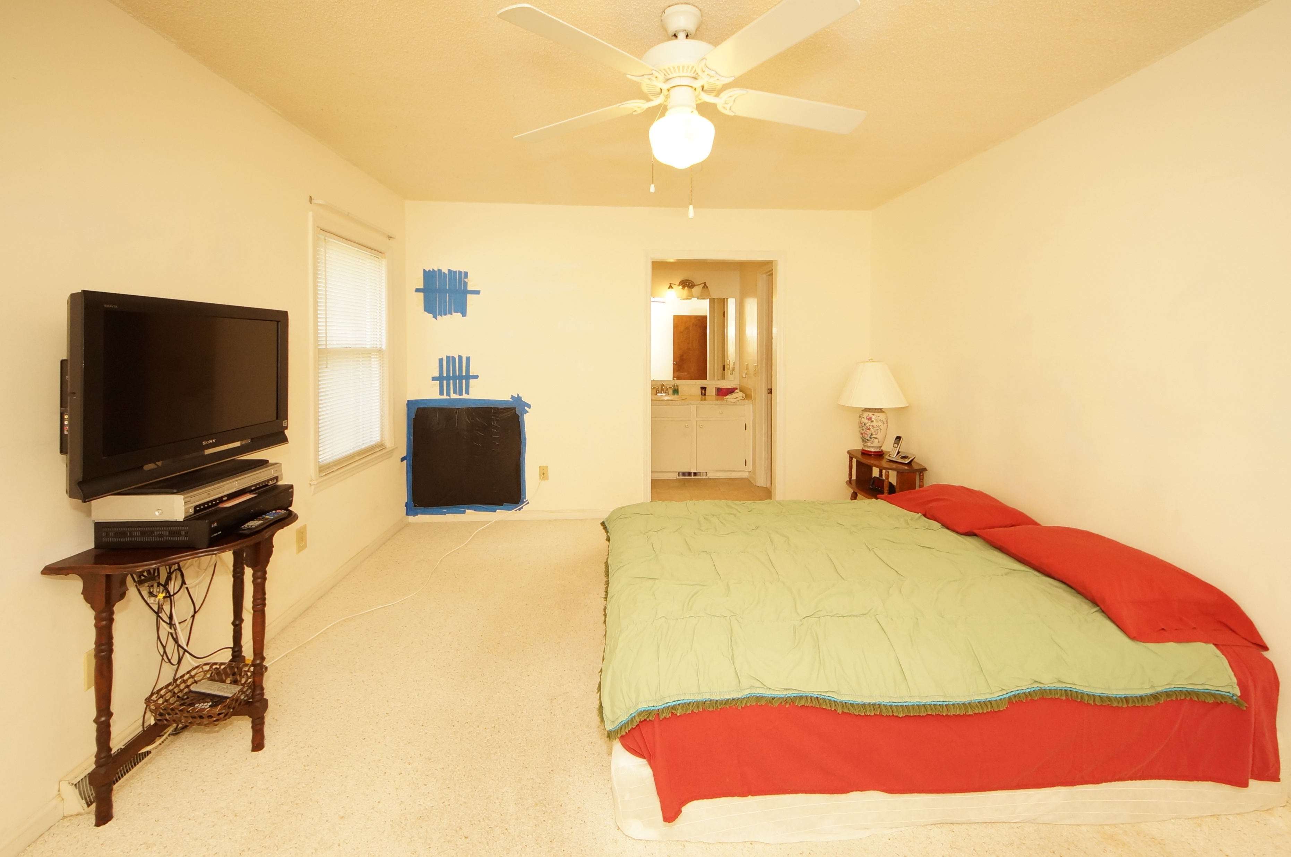


1239 Edward Drive
Fairlawn Barony :: Moncks Corner, SC 29461
MLS# 17032759 :: $245,000
4 Bed / 2 Bath
Priced To Sell in Fairlawn Barony
Just Reduced
Priced right for the opportunity to own a brick home in well established Fairlawn Barony. New roof was installed July 2017 and stainless appliances are 2 years old. Enjoy an oversized yard, garage entrance in the back of the home, spacious porch and spectacular fireplace in the family room. The seller states the mantle is over 150 years old cut from the wood from the Barony Plantation Barn. Three bedrooms down stairs, large kitchen and fourth bedroom/bonus room upstairs. Make sure you view the potential extra square footage upstairs through the the closet. Our listing price reflects sellers motivation and we have purchased a AHS home warranty.
Connie White, Broker
843-532-3356
conniesyouragent@gmail.com
Charleston Homes · 597 Old Mt. Holly Road · Suite 301 · Goose Creek, SC 29445

