Slide 1
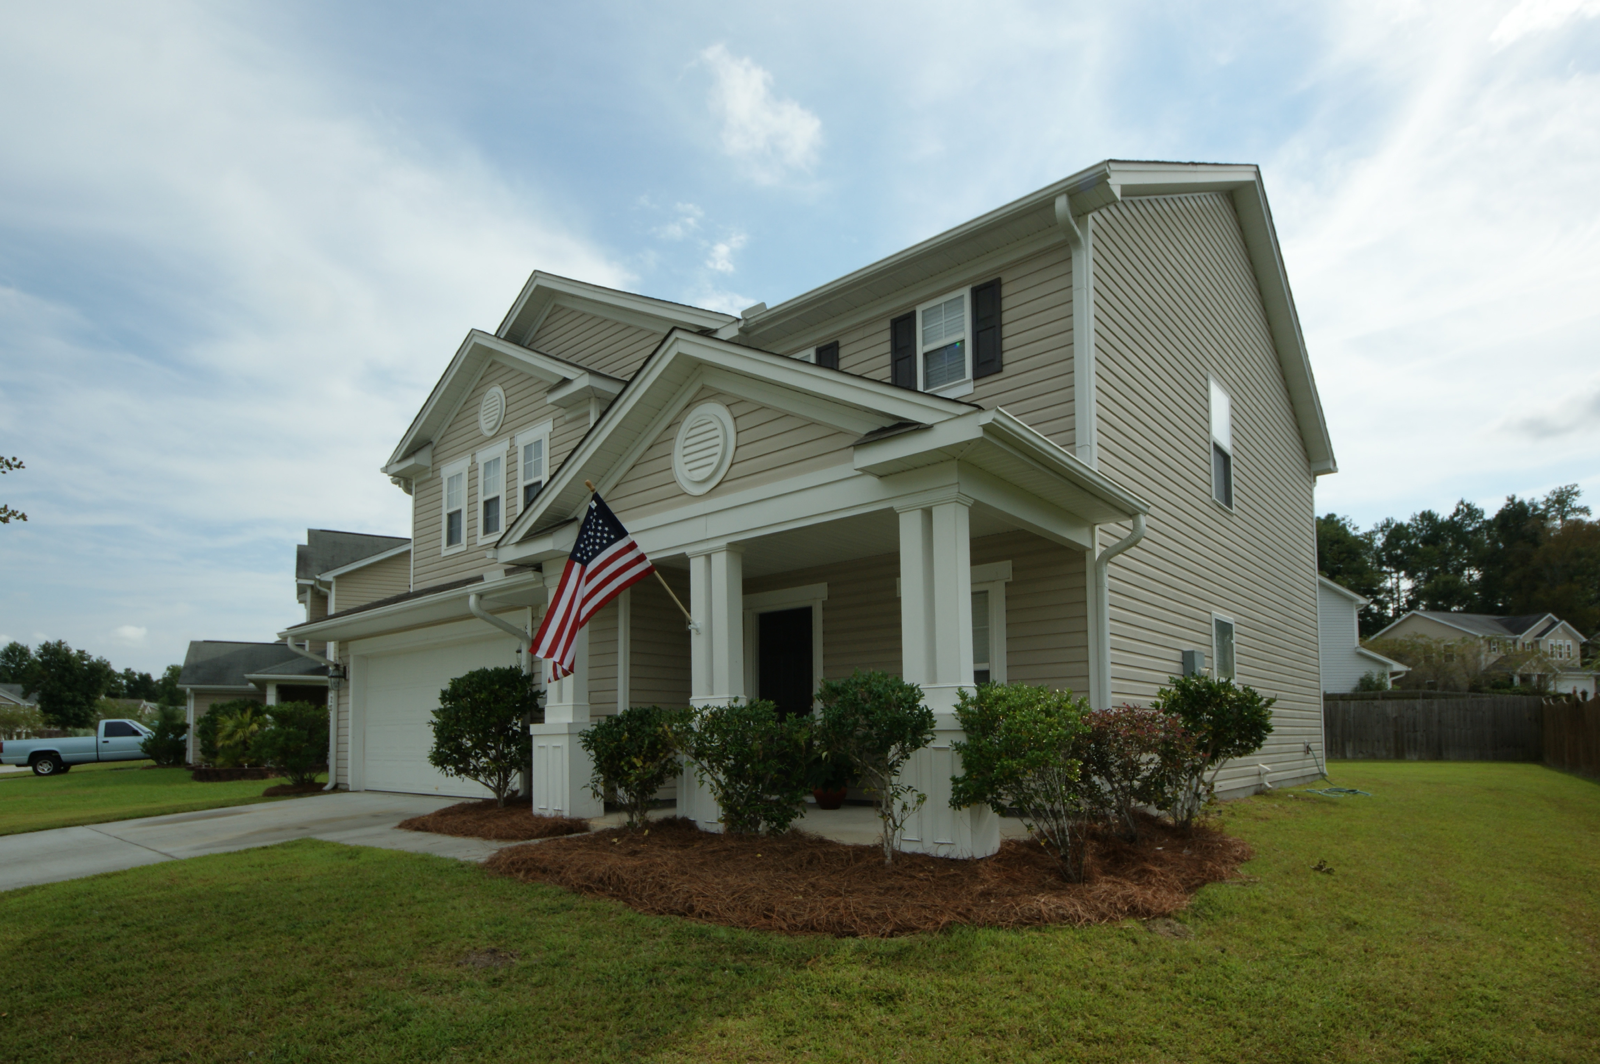
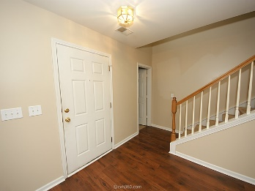
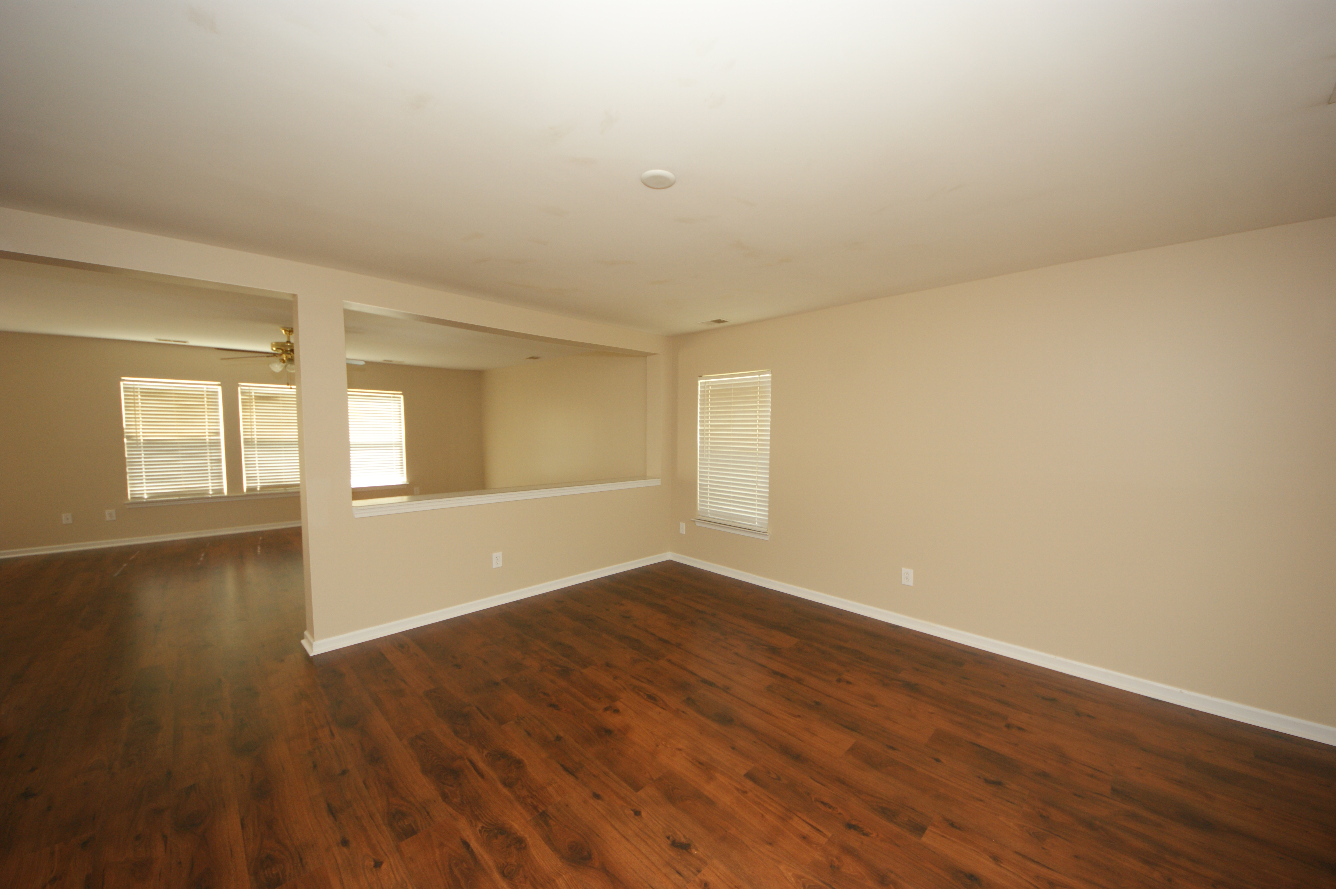
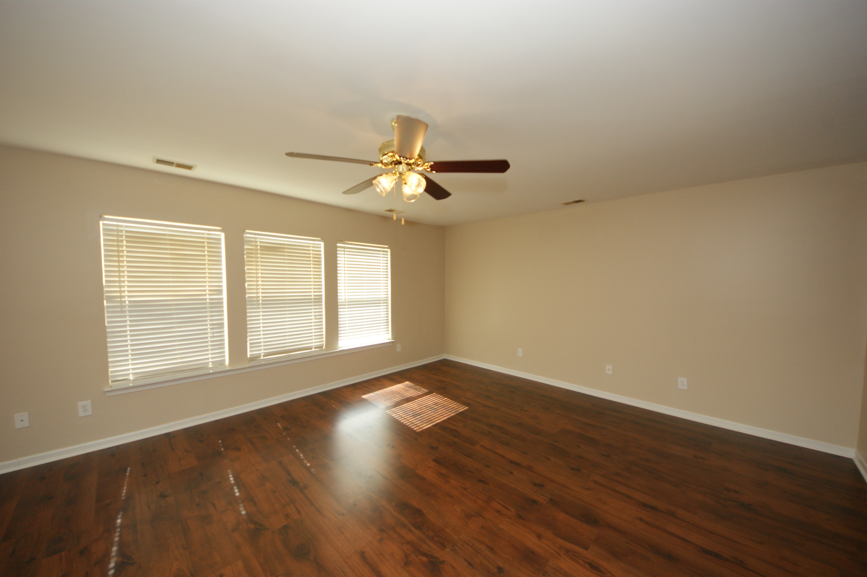
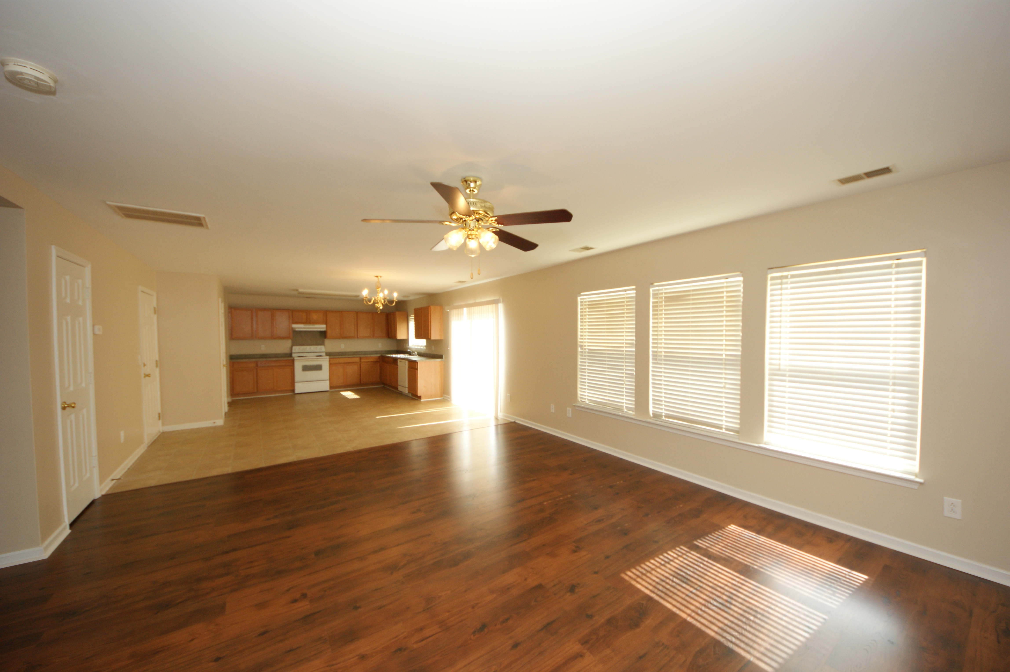
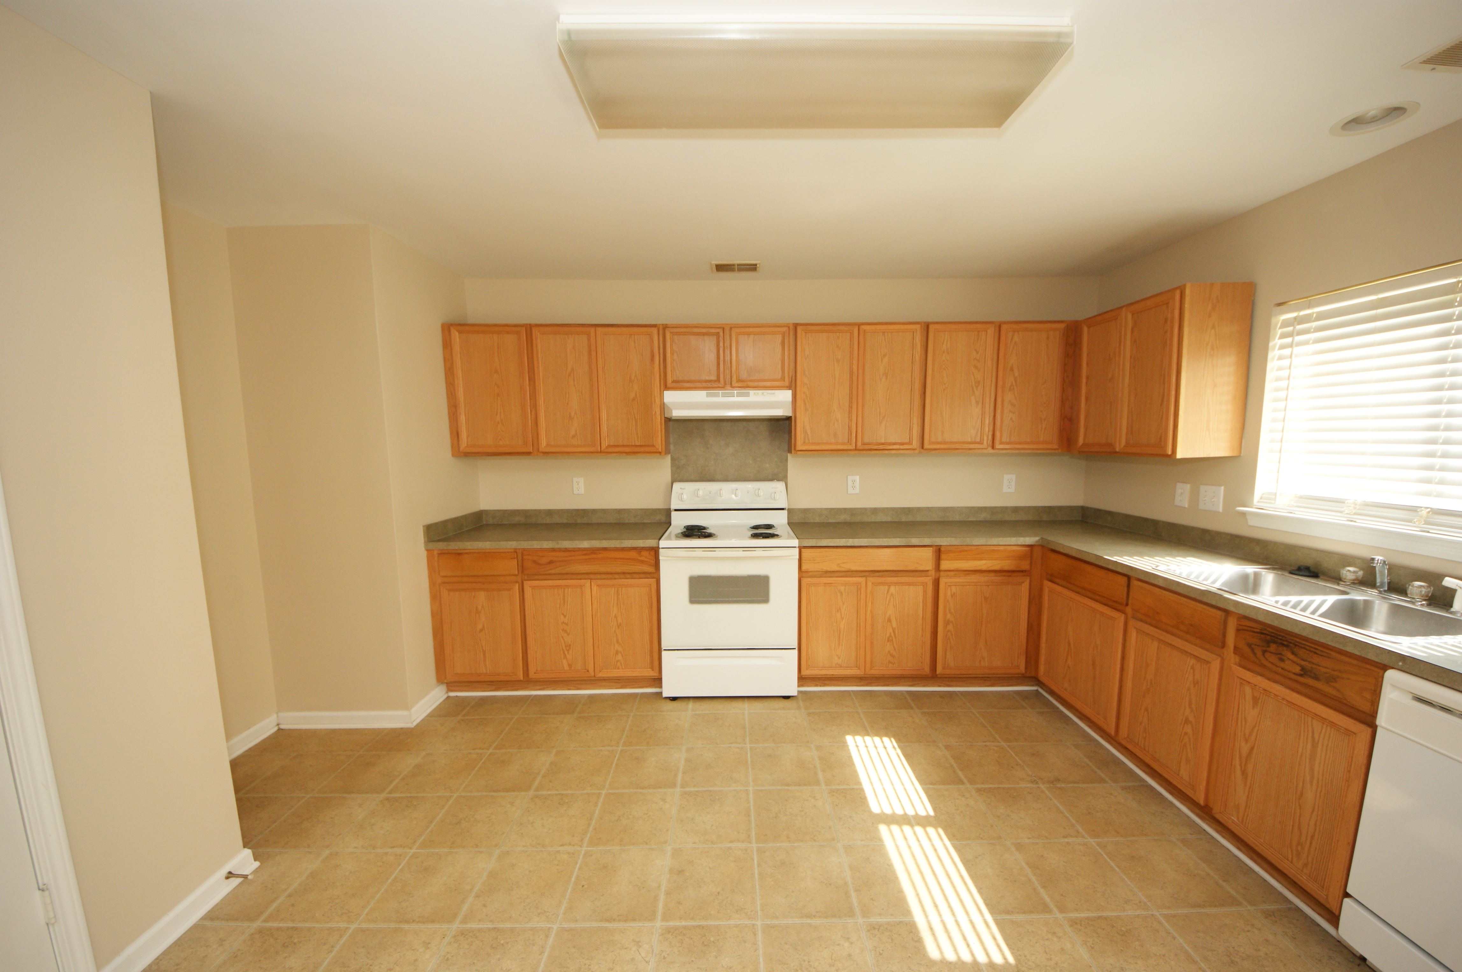
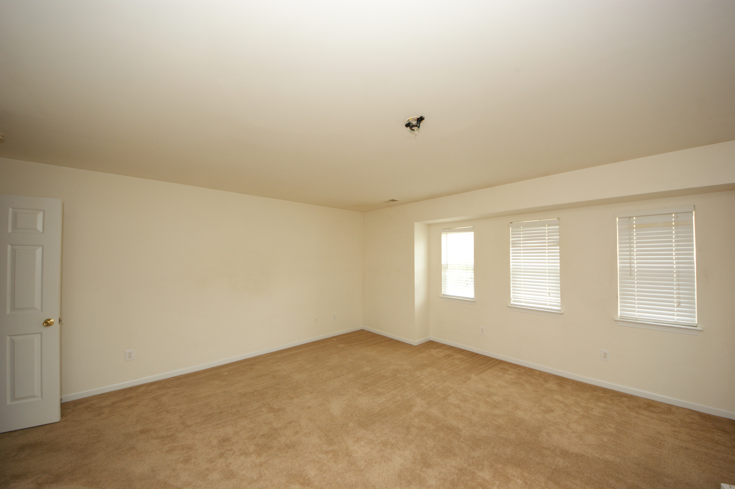
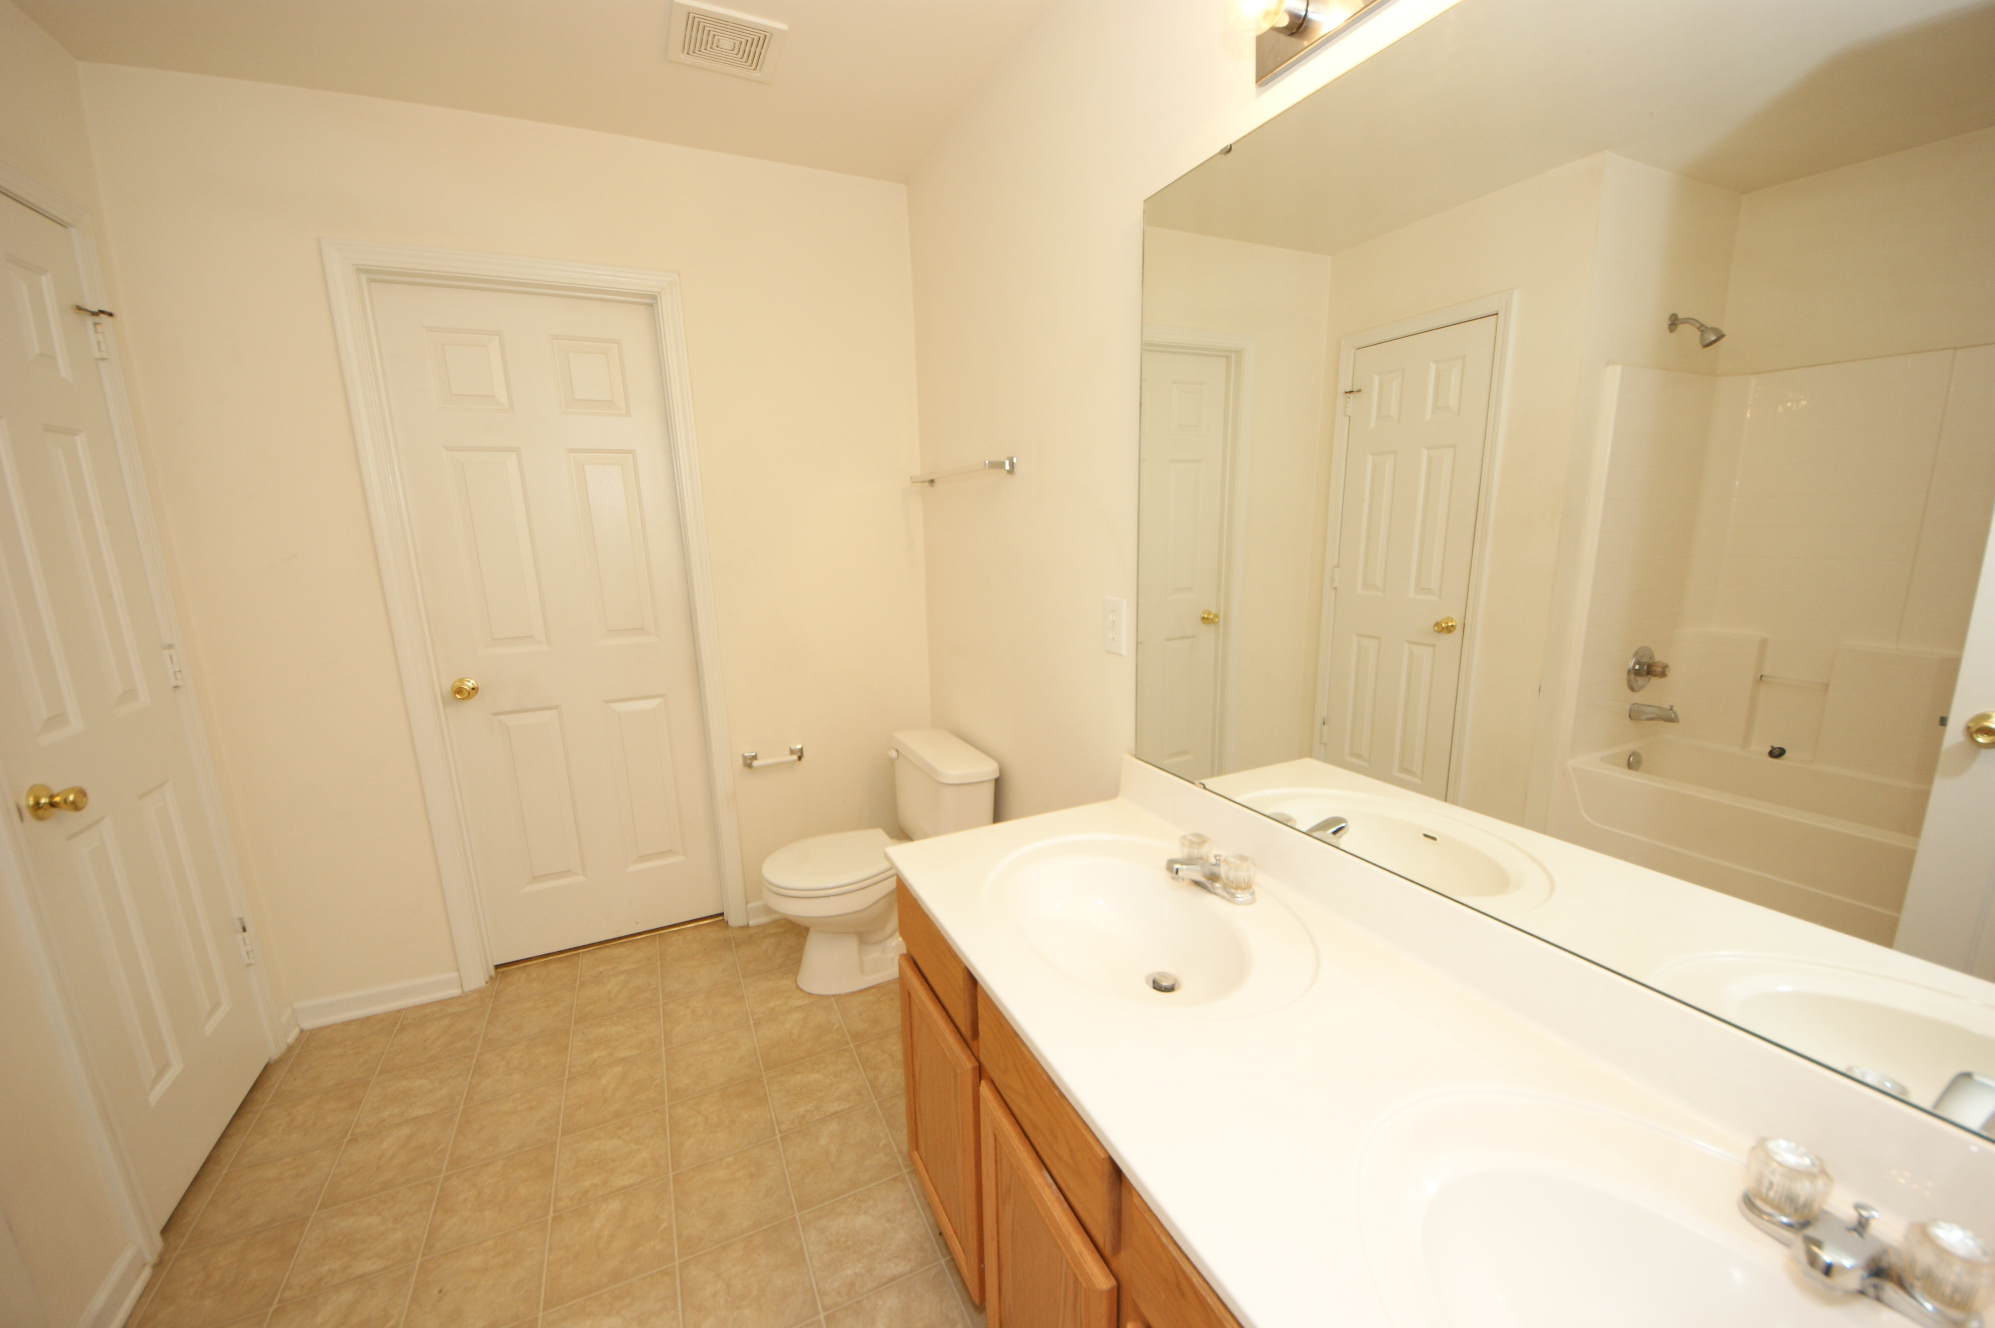
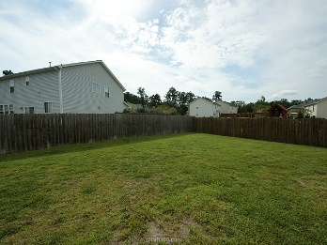
Brand New Flooring!
123 Graduate Lane
Eagle Run
Ladson, SC 29456
MLS# 15014474
$195,990
BRAND NEW flooring in the downstairs and freshly painted as well. This home is move in ready! This spacious 4 bedroom is located in desirable Dorchester District 2 schools, and within walking distance to Oakbrook Elementary and Middle School. Open floorplan complimented very well by the new dark laminate floors. All bedrooms are upstairs with an oversized MASTER SUITE! Master bath includes walk in closet and dual sinks. Come take a look for yourself at this great deal in Eagle Run!
Sean Harrington
(843) 226-9652
sean@milerproperties.com

