Slide 1
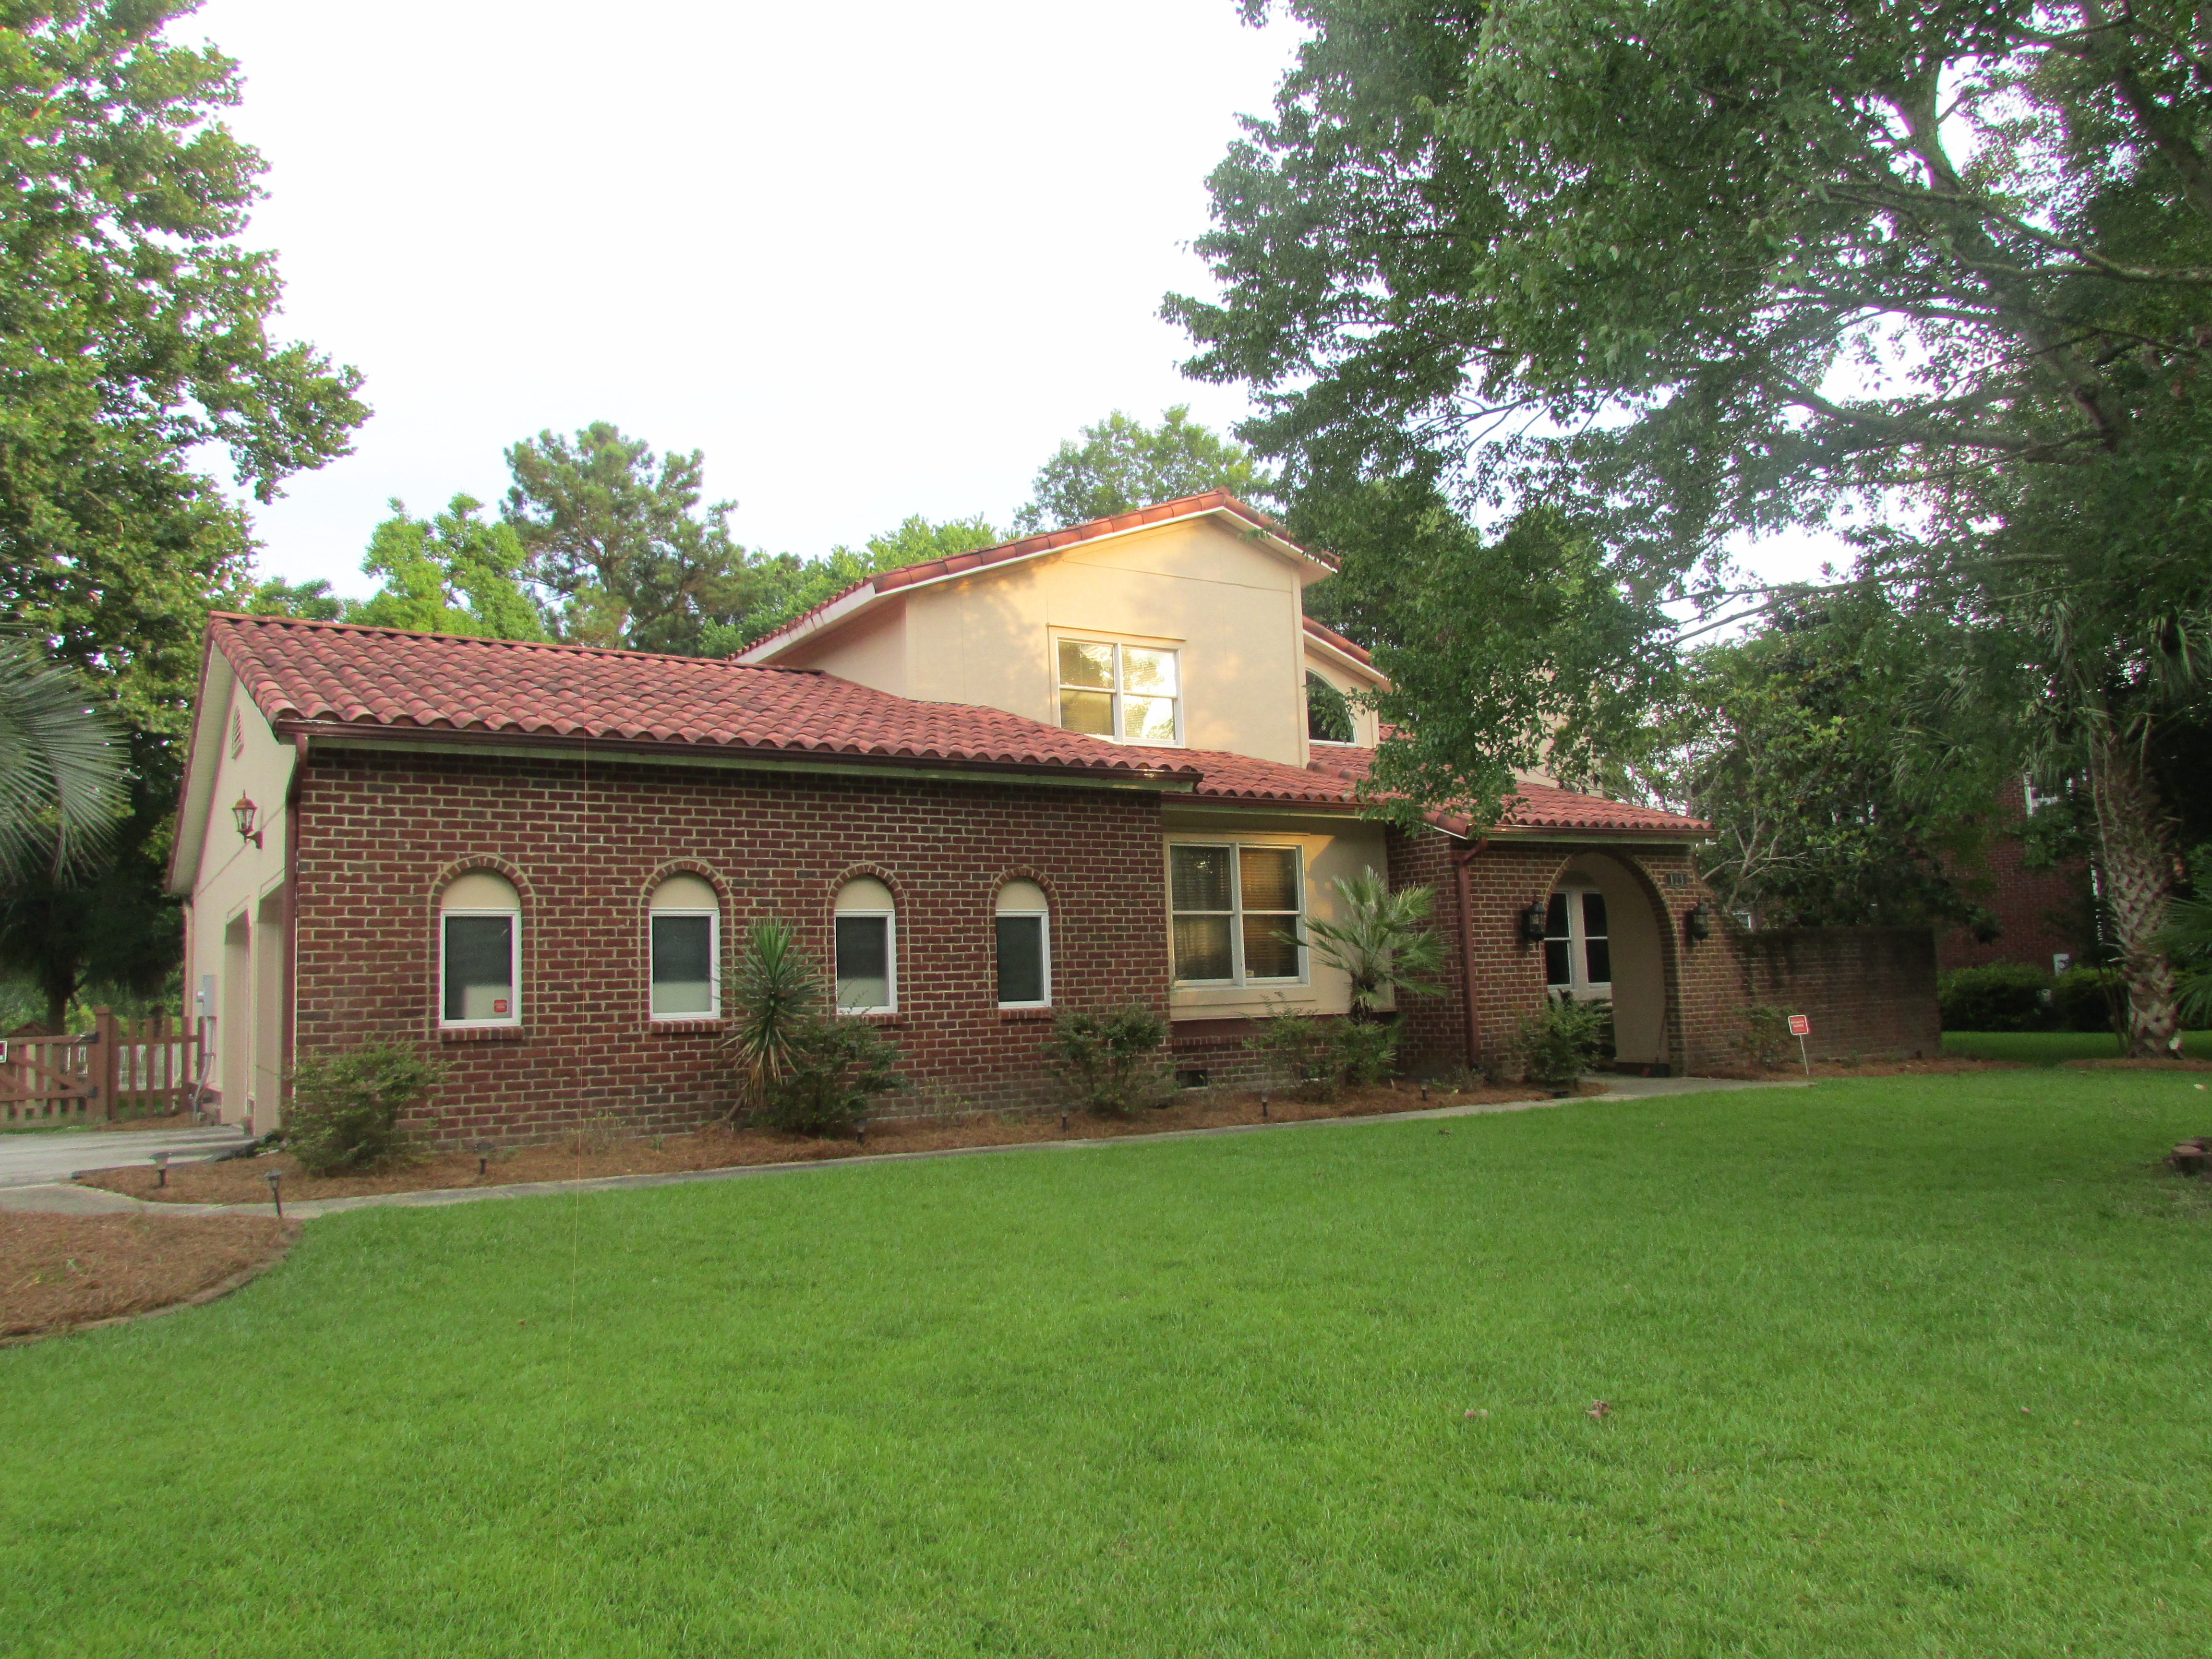
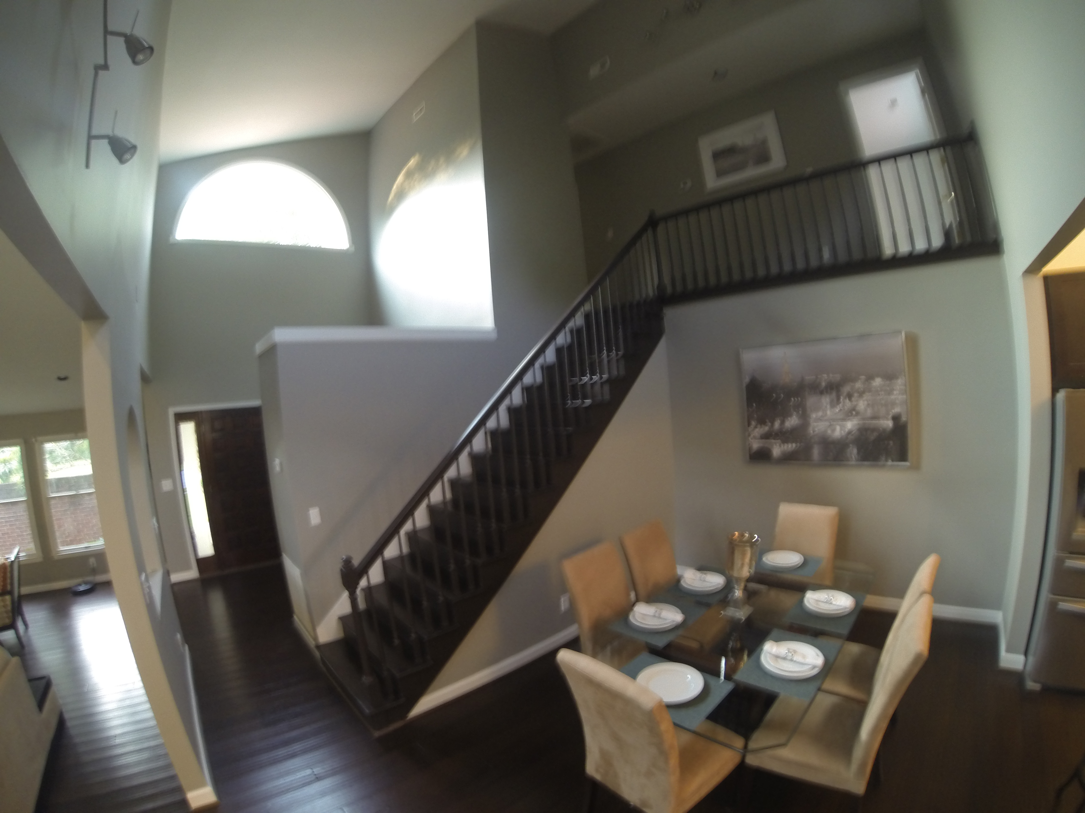
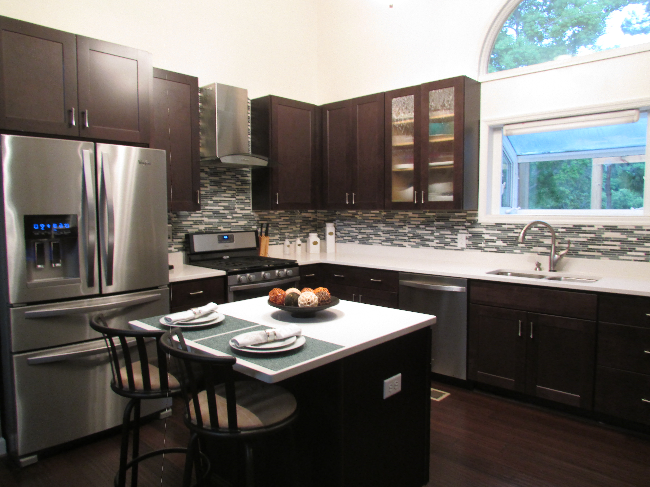
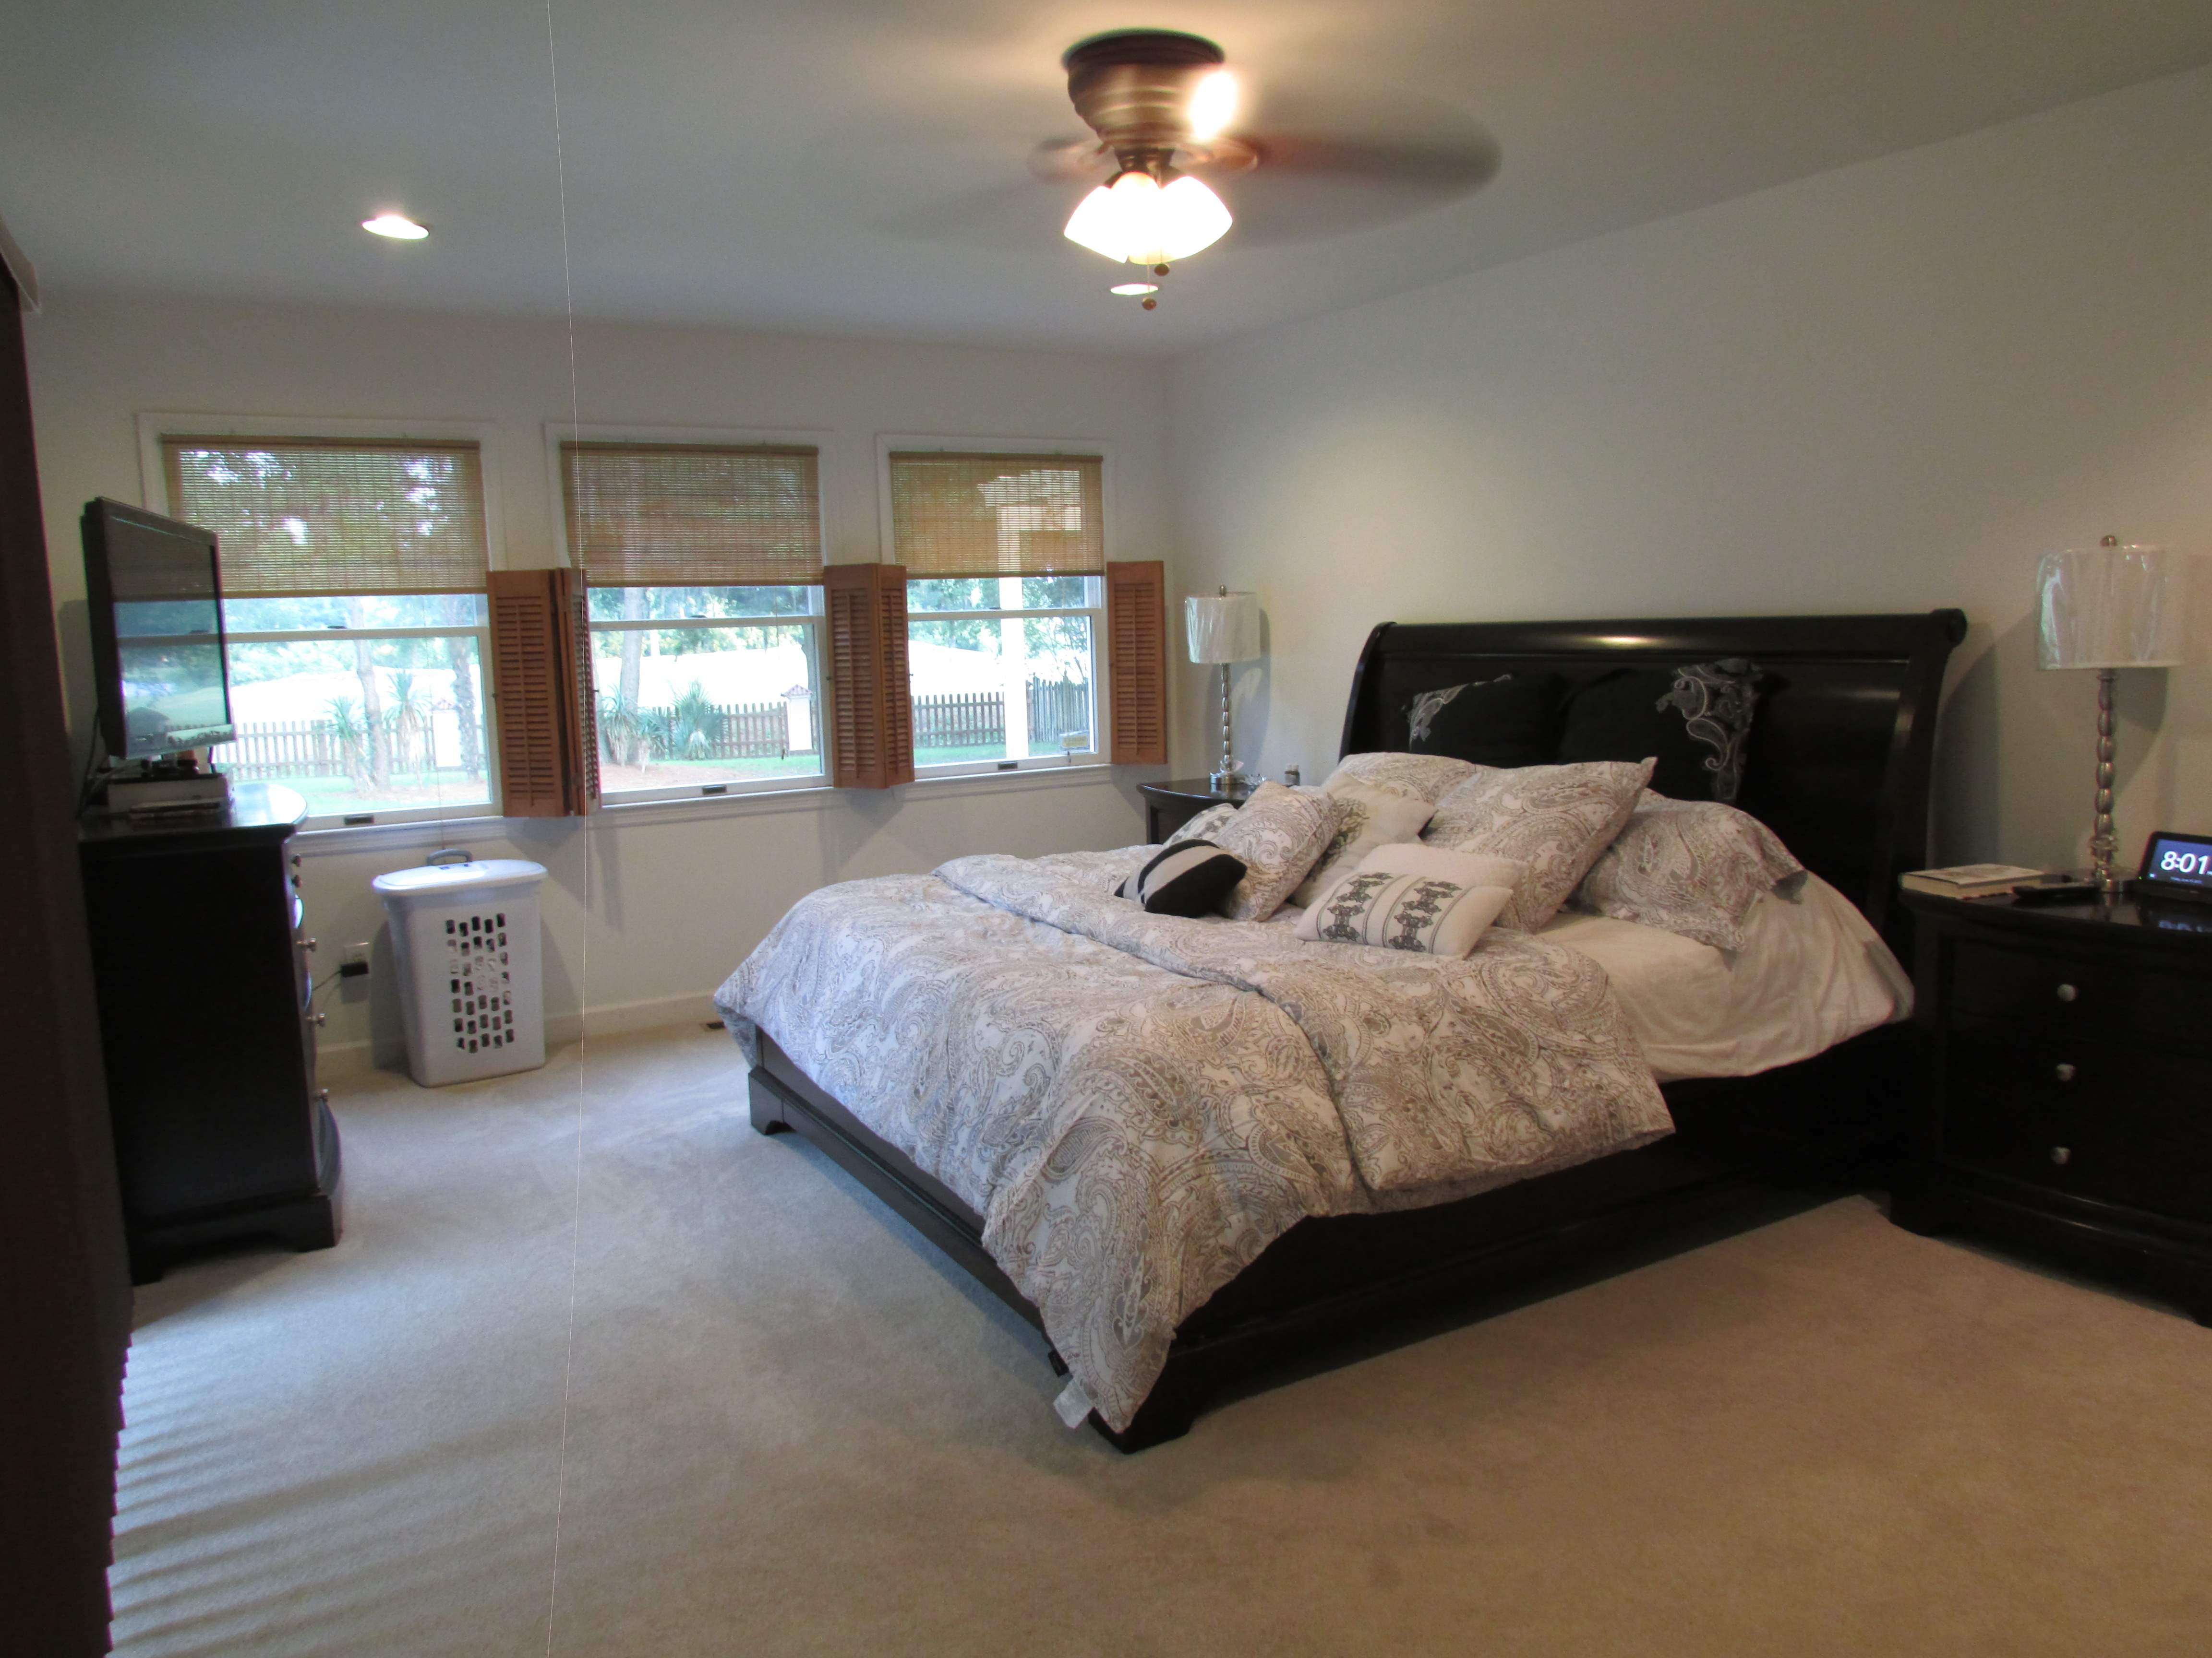
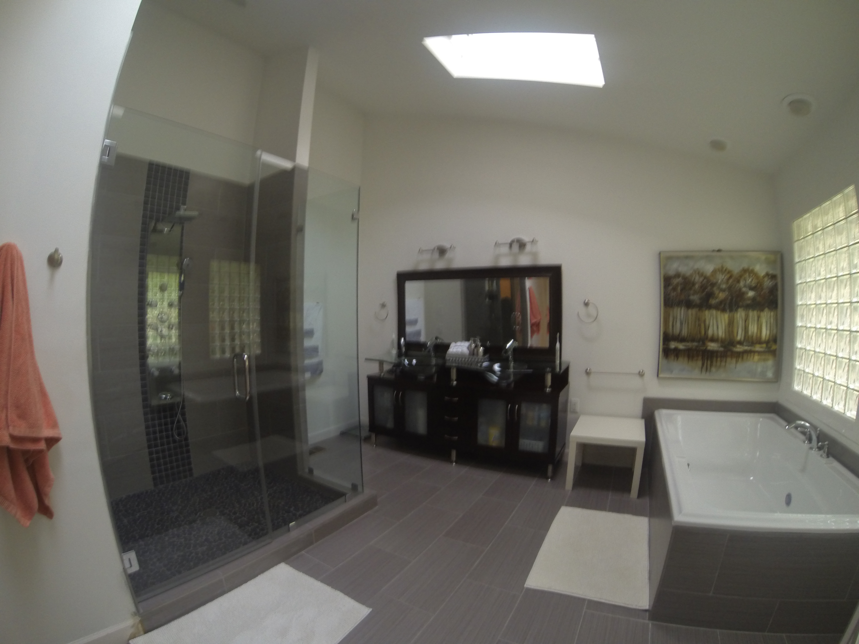
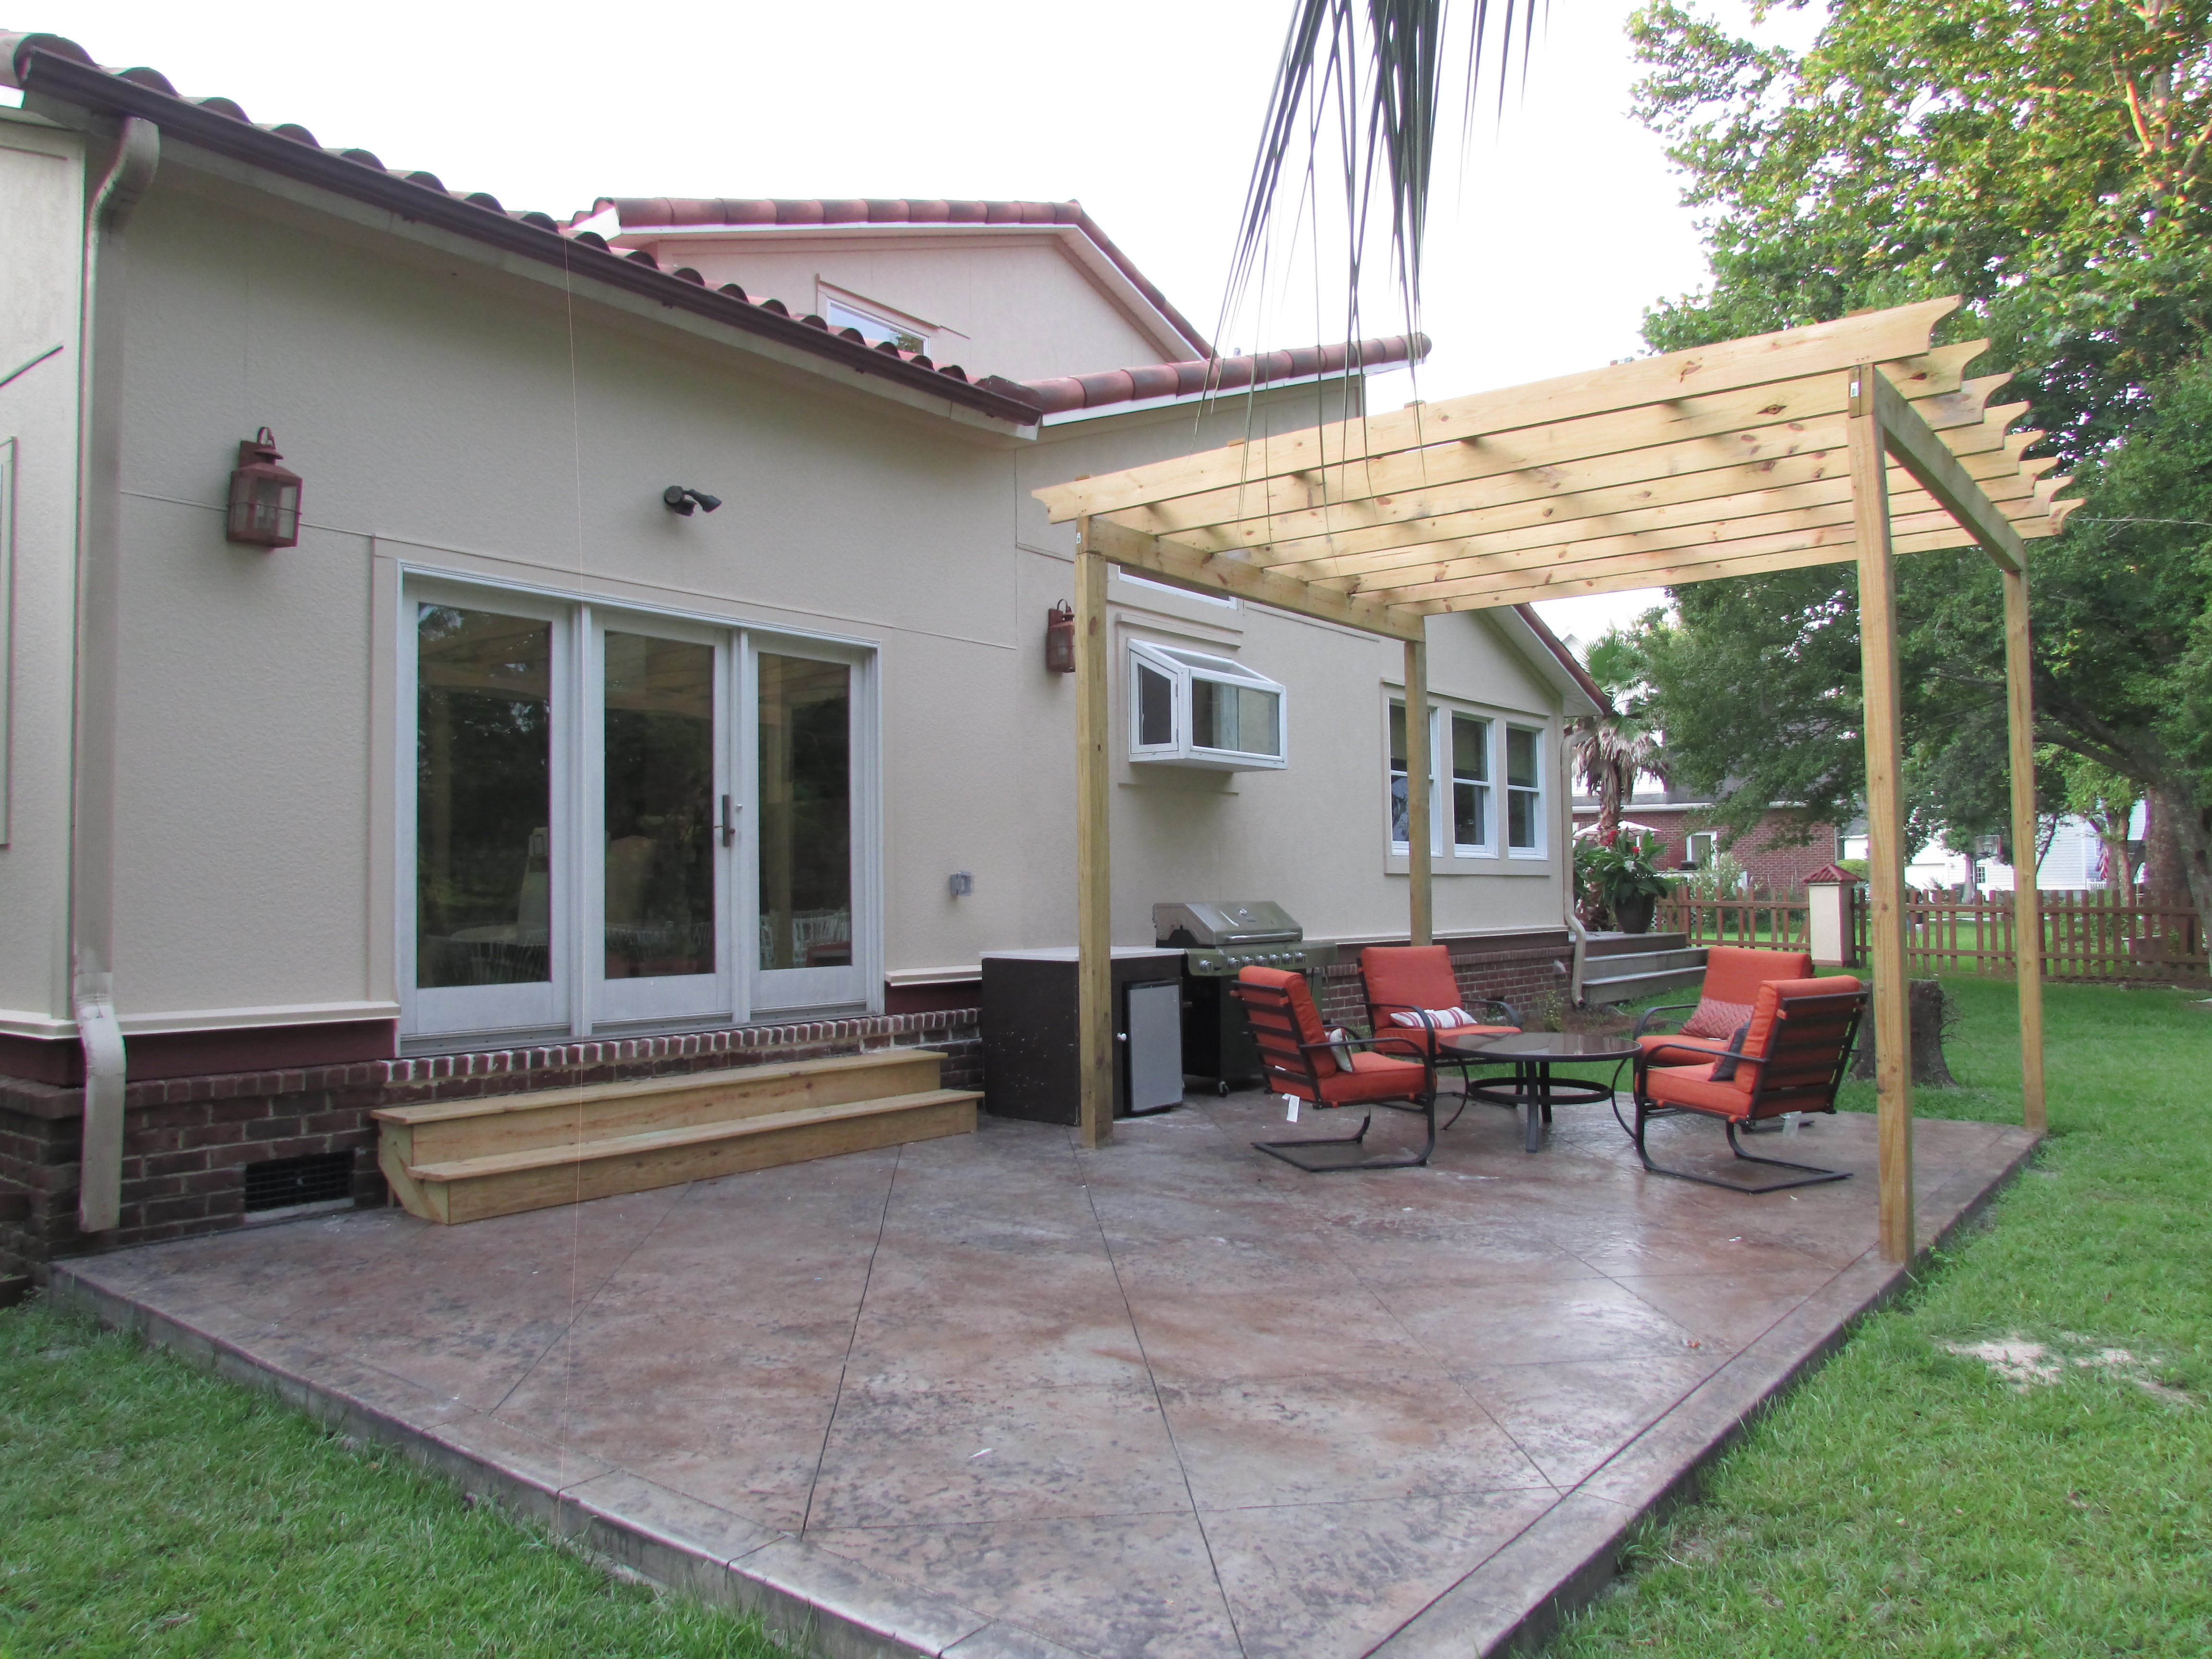

123 Shadowmoss Parkway
Shadowmoss Plantation | Charleston
MLS# 15016347 | $374,900
Fully renovated home overlooking golf course
Take advantage of this unbelievable opportunity to own a custom home in one of the larger golf course lots in Shadowmoss Plantation. This southwestern style home, fully renovated, is a one of a kind property situated along the 13th hole directly on the Shadowmoss golf course. This home offers everything. This home has an open floor plan with soaring high ceilings and arched windows to allow lots of natural light in. The great room is enormous and has a gas burning fire place and flows perfectly into the kitchen or out to the tranquil back patio overlooking the huge back yard. Master bedroom is downstairs and has an extra large walk-in closet, bath with a luxurious air bath tub with chromatherapy and separate extra large shower.
Carolina One Real Estate
1265 Folly Rd
Charleston, SC 29412
Lilian Roa
Mobile - (954) 593-1315
Office - (843) 310-1043
lroa@carolinaone.com

