Slide 1
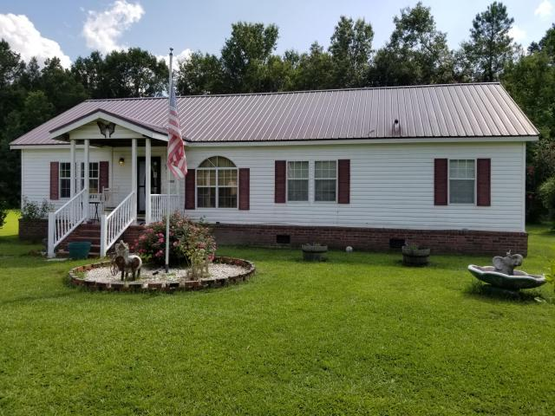
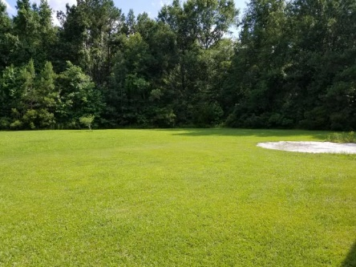
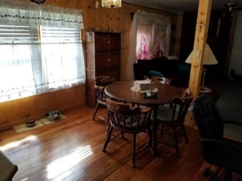
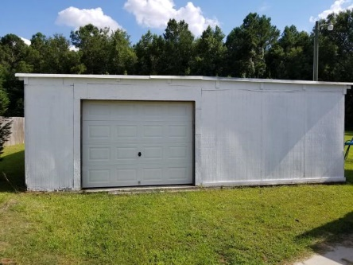
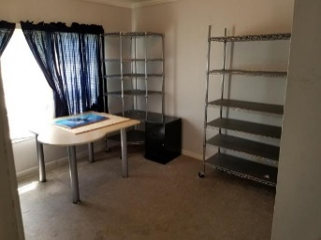
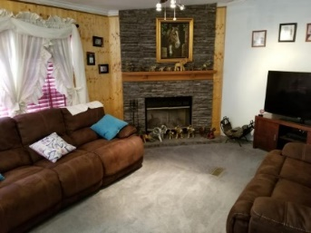
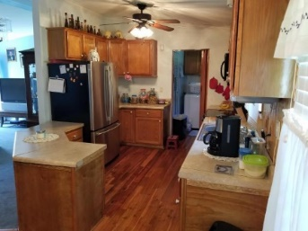
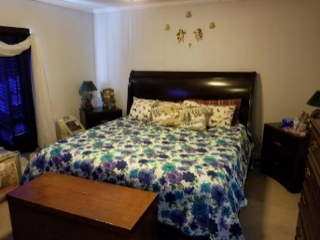
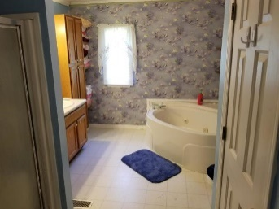
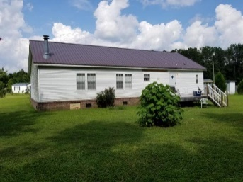


Agent & Buyer Bonus | 3 Beds & 2 Baths | No HOA 1.4+ Acres | Garage & Storage | Close to Volvo!
123 Shellmore Trail Leisure Acres ~ Summerville, SC 29486 ~ MLS# 18016828 ~ $180,000
This Home Has Been Detitled, Set On Permanent Foundation And Is Taxed With The Land As ONE Piece Of Real Property.
123 Shellmore Trail is a rare find in Summerville with over 1.4 acres of land! Attractive 3 bed, 2 bath home with new appliances!
Plenty of space in the den to have guests over and to keep warm during the winter with the wood-burning fireplace. The kitchen has solid wood floors with a less than 2 years old stove and microwave, and less than 1 year old dishwasher. The owner added a water filter in the large crawl space with moisture control, which filters all water throughout the house.
The metal roof was replaced in 2011. This home also comes with a 24x48 garage w/ electricity, a handyman's dream and perfect for storing tools. In addition, there's a large detached storage container, with electricity, to store all your outdoor equipment, tools, and decorations.
With only a 15 minute drive to the new Volvo plant, having the largest lot of over 1.4 acres, no HOA, and no neighbors in your backyard, you cannot beat this Summerville gem! Come see for yourself!
Nick Mazzilli (843) 640-5575
nick@nickmcharleston.com www.nickmcharleston.com
Reside Real Estate LLC
155 Wingo Way Unit 421 Mt. Pleasant, SC 29464

