Slide 1
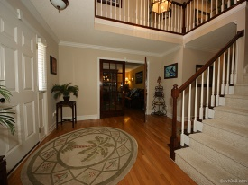
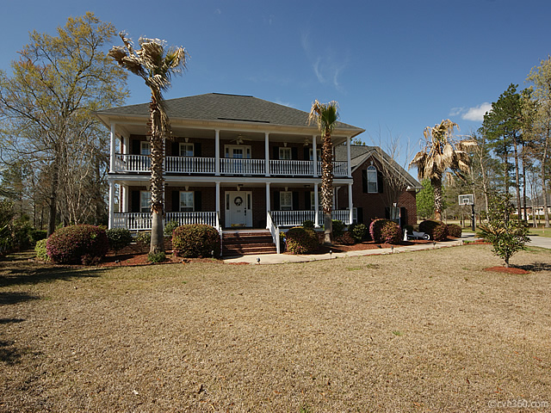
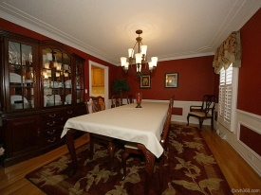
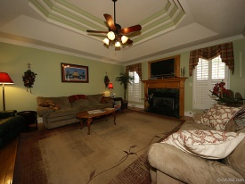
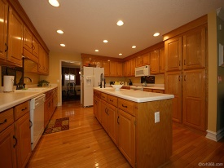
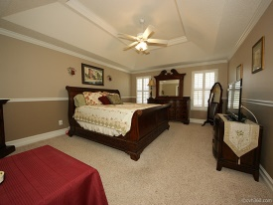
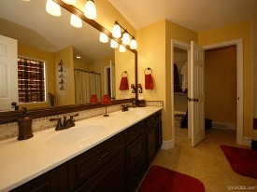
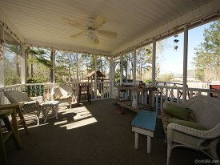

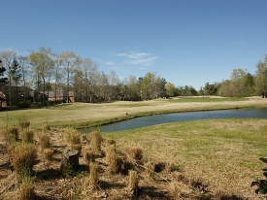
Open House Saturday 11 to 2
123 Thames Dr
Crowfield Plantation
Goose Creek, SC 29445
MLS# 1408410 | $429,900
5 Bed / 3½ Bath
Price Reduced and Priced to Sell!
Gorgeous brick home on the golf course! Double porches reflect the southern charm of the south and invite you to enjoy the warm summer days. This large floor plan is open and spacious with formal living and dining rooms, family room with gas fire place and 5 large bedrooms. The kitchen is a chefs dream boasting ****NEW WHIRLPOOL STAINLESS APPLIANCES installed 07/10/2014,*** a center island and an abundance of oak cabinets. The home features hardwood floors down stairs, plantation shutters and upgraded Quoizel light figures through out. The downstairs master bedroom has a large master bath with dual sinks, a whirlpool tub, separate shower and a huge walk in closet. This home is situated on a cul-de-sac with a screen porch and deck. Enjoy entertaining family and friends in the back yard that is truly a peaceful paradise located on the 9th hole. Please watch our virtual tour for more pictures of this beautiful home!
Connie White, Broker
C: 843-532-3356
conniesyouragent@gmail.com
Charleston Homes
111 Spring Hall Dr
Goose Creek, SC 29445

