Slide 1
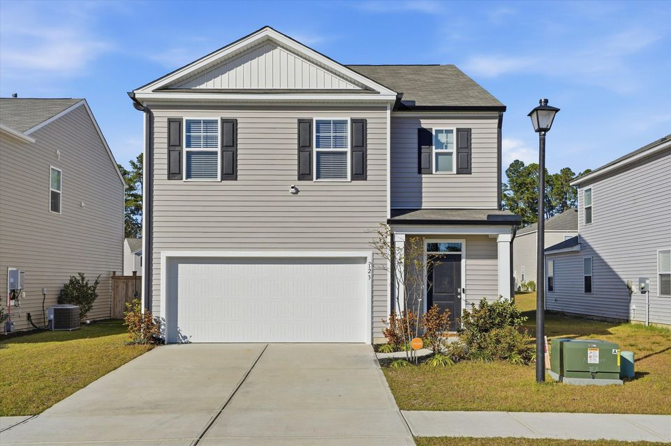
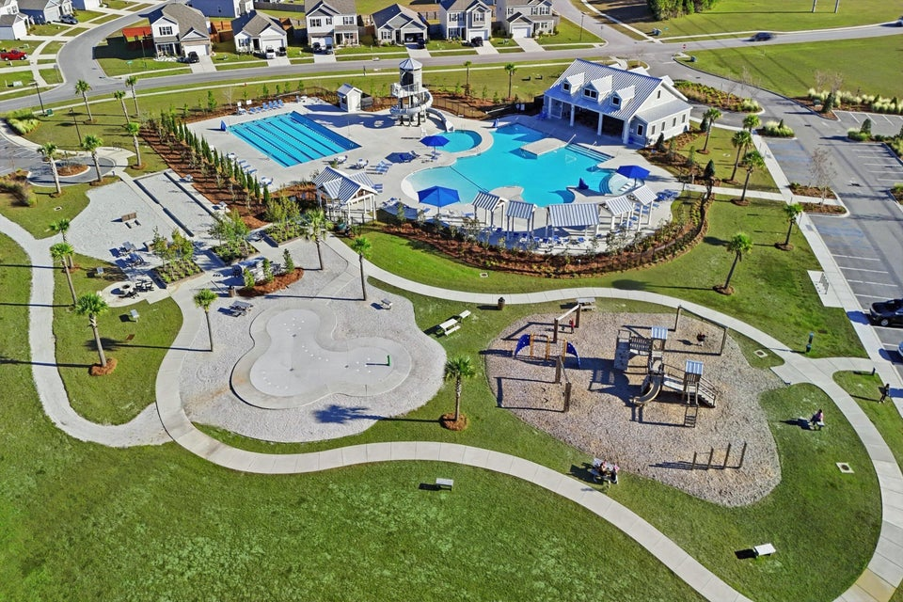


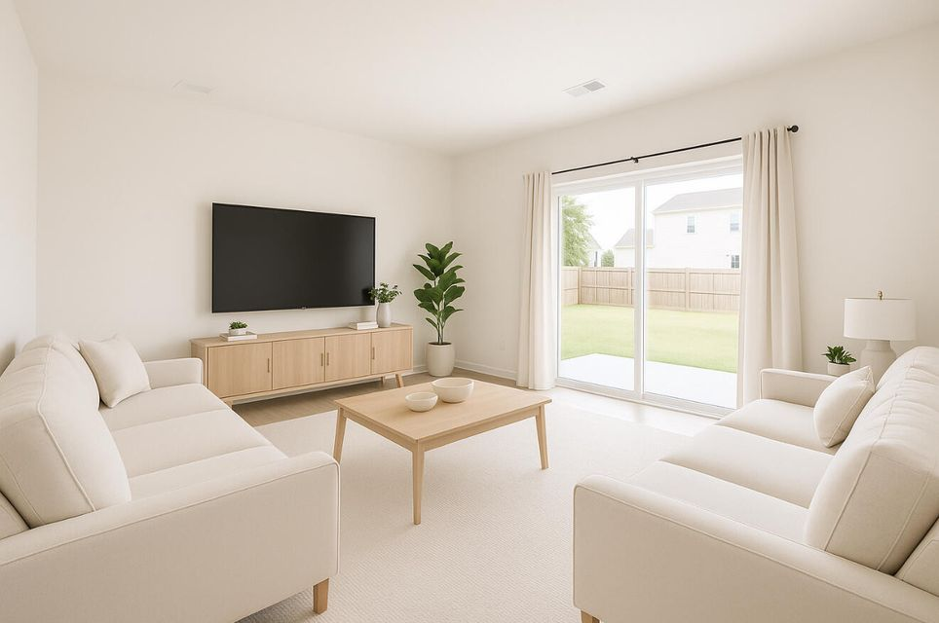
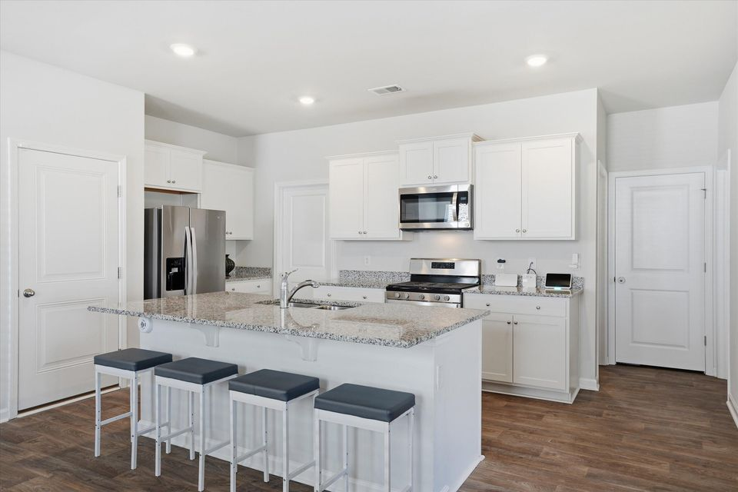
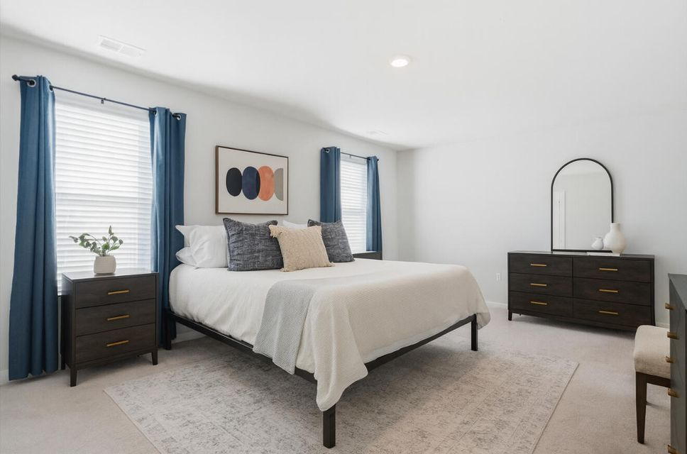
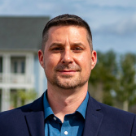
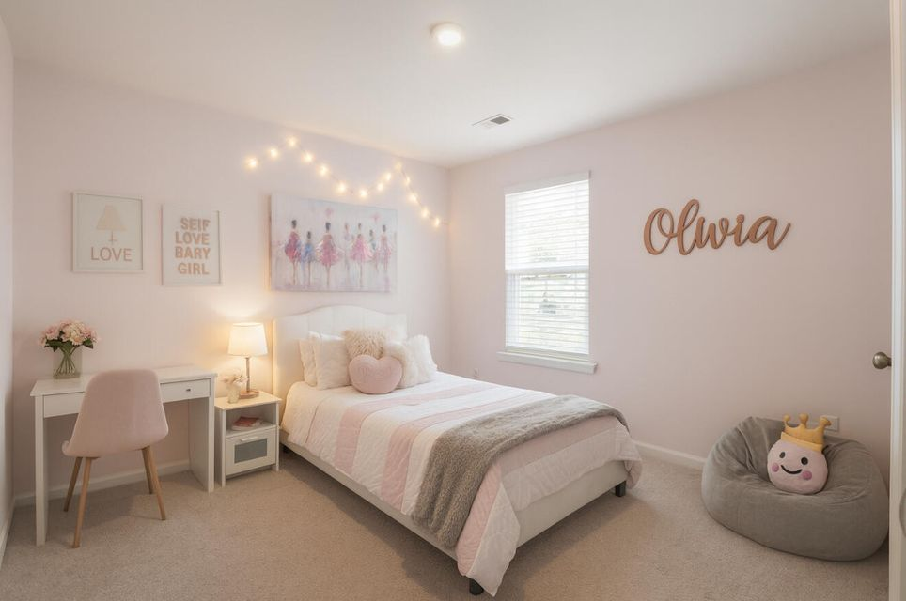
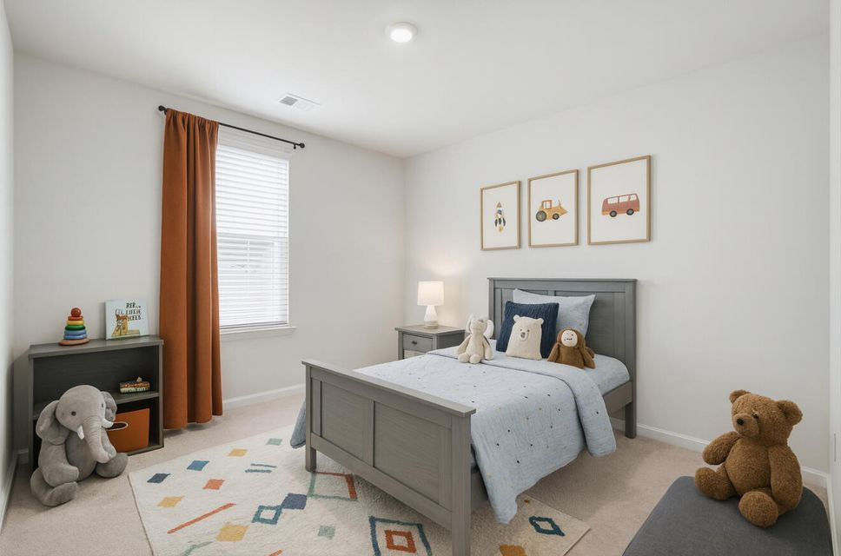

#25030603
Free Golf Cart
123 Horizon Ridge Drive
Cane Bay Plantation
Summerville, SC 29486
*with purchase of home
Open House
Sat 10-12 & Sun 10-12
5 BED
3 BATH
2,384 SF
$399,999
FREE GOLF CART with the purchase of this beautiful home that's only three years old! This community offers some of the best amenities in all of Cane Bay, including resort-style pools, an incredible spiral water slide, playgrounds, bike paths, walking trails, a campsite, and so much more. This spacious Robie floor plan features 9' ceilings, gas cooking and heating, 5 bedrooms and 3 full bathrooms. The first floor includes a private guest suite, while the second floor offers the owner's suite, three additional bedrooms, and a generous loft. The kitchen is an absolute dream--complete with a massive center island and an oversized walk-in pantry. The backyard is fully fenced, the home has gutters installed, window blinds are already in place, and the refrigerator conveys. It's truly move-in ready from day one!
You'll love the convenience of living in Cane Bay, where shopping, restaurants, grocery stores, and everyday essentials are just minutes away. This home checks all the boxes! Back on the market due to buyer's home not selling.
Meg H. Kandik
843-814-5137
Meg@HolyCityRE.com
www.holycityre.com
Brand Name Real Estate
4 Carriage Ln
Charleston 29407
Matt Kimes
843-860-1669 | mattkimeshomes@gmail.com
www.mattkimeshomes.com
Some images AI modified

