Slide 1
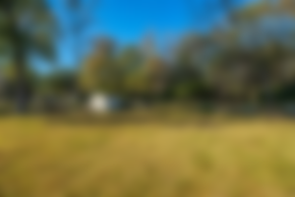
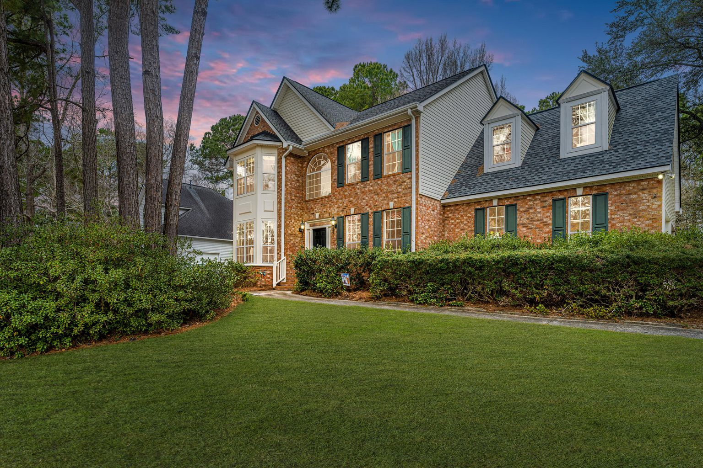
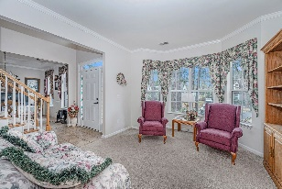
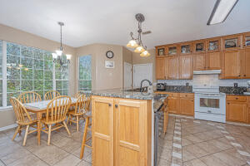
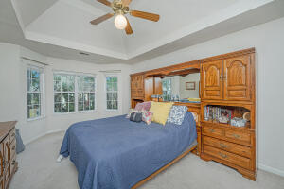
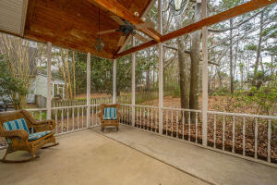
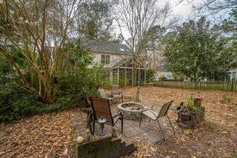


Desirable Legend Oaks Plantation!! DDII schools! Large 0.4 acre lot! No cookie cutter home here!
123 Old Course Road
Legend Oaks Plantation ~ Summerville, SC 29485
MLS# 22003900 ~ $429,990
One owner home! Arrive and be impressed by the large lot with mature trees! Stately brick front home with side entry garage. Enter the foyer with formal living room to the left and formal dining room to the right. Continue down the hall, past the hall closet and half bath. Arrive at the comfortable and open living area. Kitchen is on the right with beautiful granite counters and decorative cabinets to show off your special pieces. There is plenty of work space, walk in pantry and additional pantry. Family and friends can sit at the bar and converse with the cook or relax at the table looking out the bay window onto the large backyard. Entertaining or relaxing can continue in the family room or onto the screened porch. This is a great home for entertaining or quiet family or time. Backyard is huge with mature trees and lots of space to play or relax around a firepit. Back inside and upstairs find the 4 bedrooms. Owners suite is to left upstairs. This room is very spacious with a large bathroom, includes dual vanities, garden soaking tub, separate shower, water closet and his and her closets. There are 2 bedrooms off the hall along with the bathroom and laundry, the 4th bedroom is at end of hall, is large with quaint dormers and has a closet. This home has been well maintained. Legend Oaks is within a golf course community with available memberships to the pool, tennis courts or golf course. The club house can provide current pricing. Beech Hill Elementary, Ashley Ridge HS. The new middle school is set to open next school year, contact DDII for details. Call today for a private showing.
Laurie Loparo (843) 442-1290 | laurieloparo@gmail.com
www.lauriesellscharleston.com
Carolina One Real Estate | 873 Orleans Road, Ste 102 | Charleston, SC 29407-5753

