Slide 1
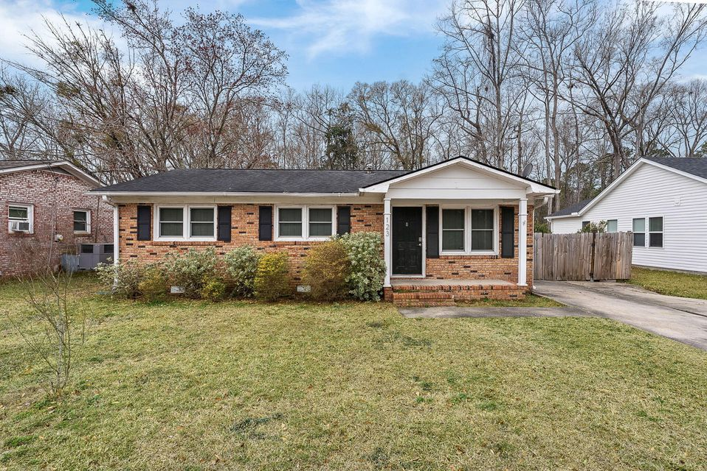
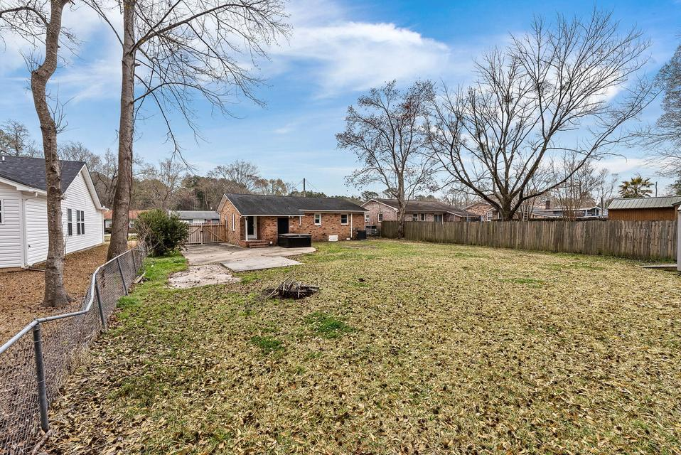
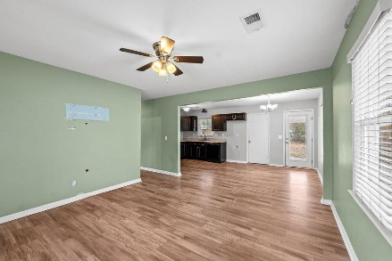
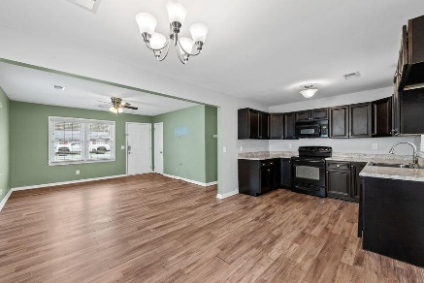
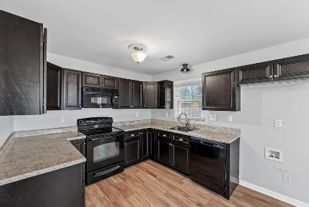
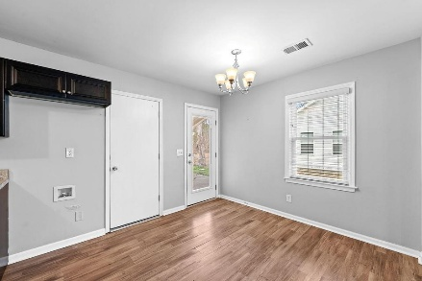
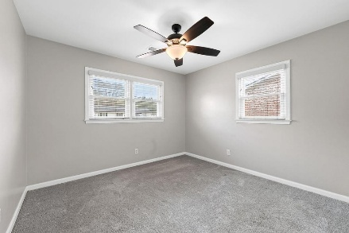
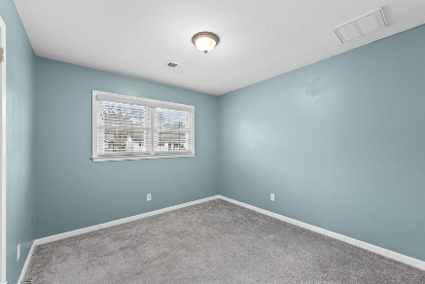
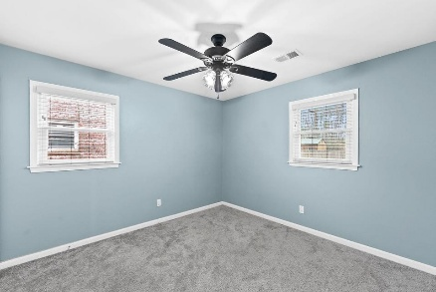
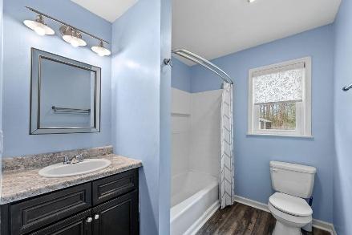


123 Pandora Drive
Motivated Seller!
Great Starter Home Or Investment Property Under $300k
West Greenview Acres | Goose Creek
MLS# 26005635 | $270,000
A charming single story brick ranch perfect for first time home buyers, downsizers, or investors.
Step inside to a move in ready home. There is a beautiful eat kitchen, living room, three bedrooms, full bath and laundry room. The spacious fenced in yard has room for your toys, boat, garden and more. The shed conveys.
No HOA. Come see this home in person to appreciate what it has to offer.
Kelly Rozier
(843) 209-3129
kellywrozier@gmail.com
Brand Name Real Estate
4 Carriage Lane Suite 106
Charleston, SC 29407

