Slide 1
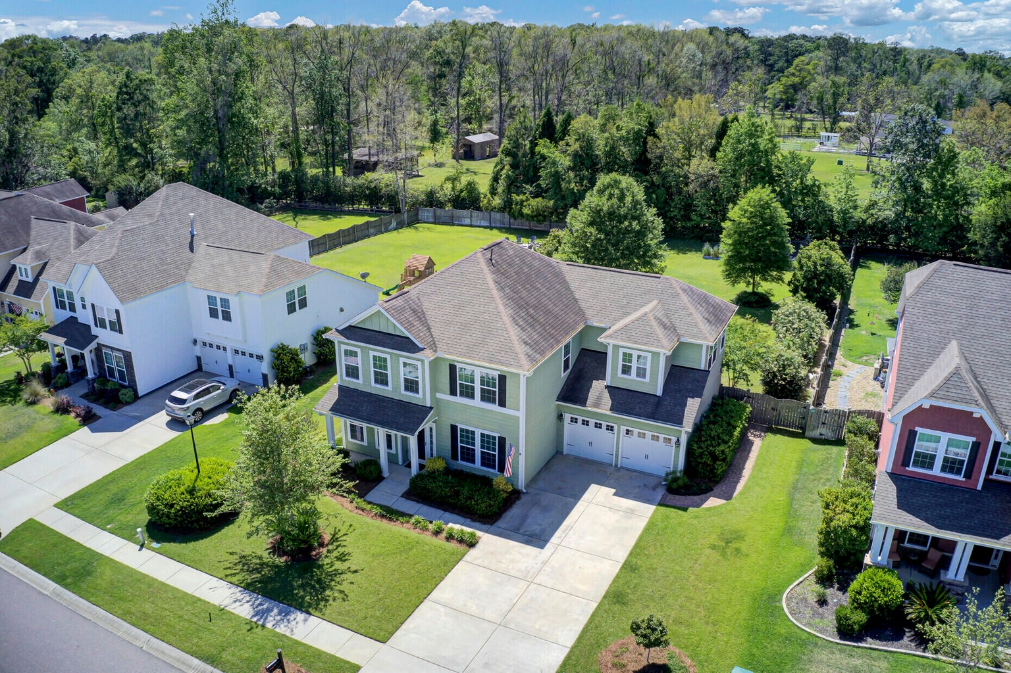
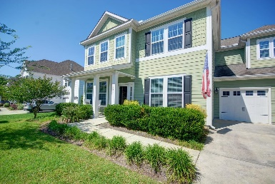
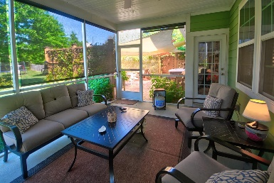
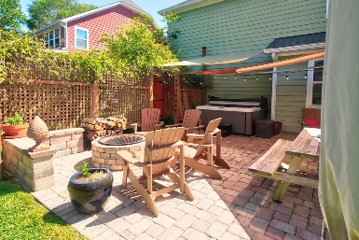
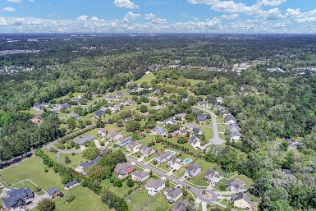


123 Stagecoach Lane Carriage Hill | Summerville, SC 29483 | MLS# 23008773 | $575,000
Stunning Ocean Views
in Seabrook
This gorgeous house in the small subdivision of Carriage Hill has so much to offer! Live the proverbial Lowcountry lifestyle in this 5-bedroom, 2-garage home with Hardie Plank siding, located on a .38 acre private lot, which backs up to a 21-acre estate. The eat-in kitchen is at the heart of the home, and offers a gas stove, granite countertops, a large kitchen island, and a butler's pantry, all open to the family room with a gas fireplace. It also includes a comfy breakfast nook for the family, as well as a lovely dining room for guests. The book door opens out to a generous screened in porch, which itself opens out to a paver patio, complete with a fire pit and privacy trellis, perfect for entertaining or stretching out on a quiet Saturday morning. In addition to the five bedrooms, the house also boasts an additional flex space, perfect for an office. The homeowner has made many upgrades: In ground sprinklers, architectural gutters, and Lutron Maestro Dimmers and LED lighting throughout, as well as Reliance Controls 10 Circuit Transfer switch, to keep the home running in the case of power loss. The home is also very energy efficient, with a radiant barrier, and gas water heater. Nearby amenities include close proximity to Pine Forest Country Club, Pinewood Prep, as well as being near to I-26 and Historic Downtown Summerville, which caters to both cosmopolitan tastes and small-town sensibilities, with its array of restaurants, galleries, and year-round community events.
Video Tour
Fantastic Rental Property
Mari-anne Stabenau 843-813-0085
mstabenau@sc.rr.com
My Website
Long & Foster Real Estate
112 W. Doty Ave., Suite C
Summerville, SC 29483

