Slide 1
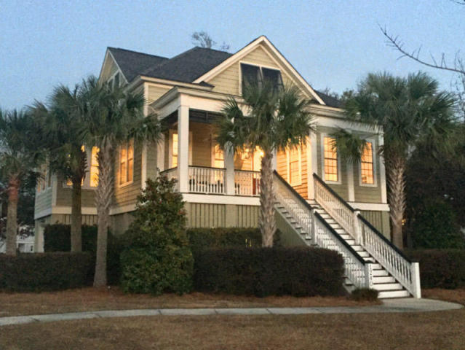
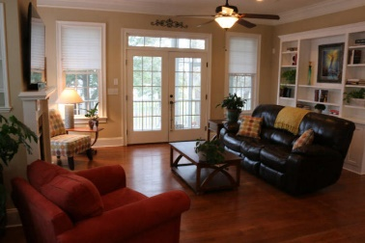
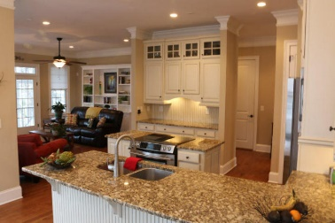
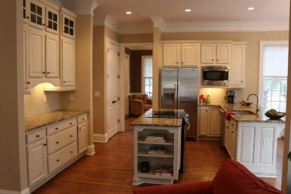
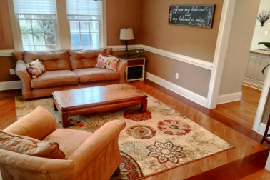
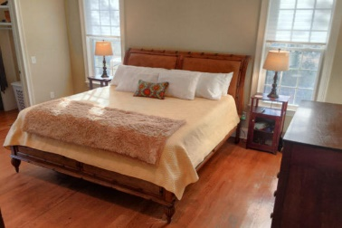
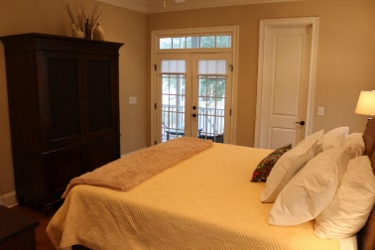
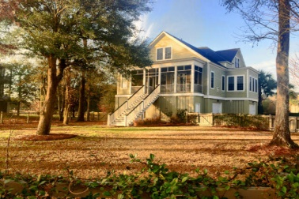
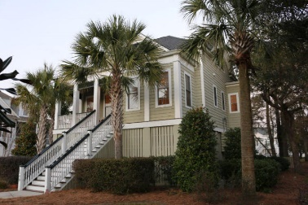


Potential Short Sale!
Price Reduced!
1240 Blue Sky Lane
Beresford Creek Landing ~ Charleston ~ MLS# 16002987 ~ $629,000
This beautiful 4 bedroom, 4 bath custom home is waiting for you. Close to 526, Boeing, and Daniel Island shops and restaurants, Beresford Creek Landing has much to offer including pool, play park, boat storage and a community dock. The open floor has oak floors throughout the living area and kitchen. The kitchen features stainless appliances and granite counter tops, glazed kitchen cabinets, a built in buffet, and a breakfast counter. The light filled living area features a gas fireplace and French doors leading to a screened porch. Wired for surround sound in living area, master and porch. The master & guest room are on the main level as well as an extra living area or separate dining room. Upstairs are two other bedrooms with in suite bathrooms and a nice size office or playroom.
Chuck & Edy Mimms
Cell 843-224-9507
Office 843-530-8100 www.sanddollarsc.com
www.facebook.com/Sanddollarsc
Sand Dollar Real Estate Group | 2205 Middle Street | Suite 203, Mailbox 2 | Sullivans Island, SC 29482

