Slide 1

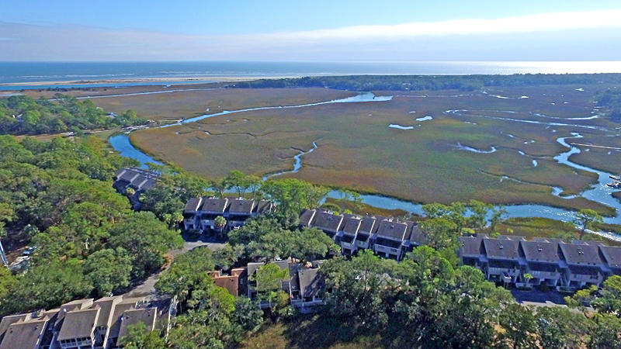
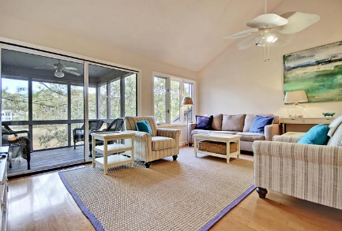
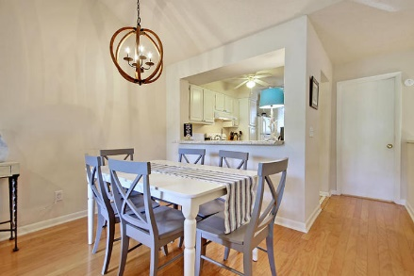
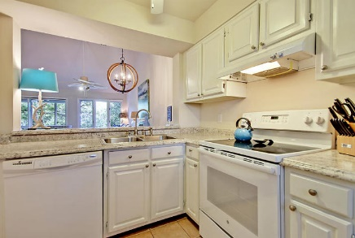
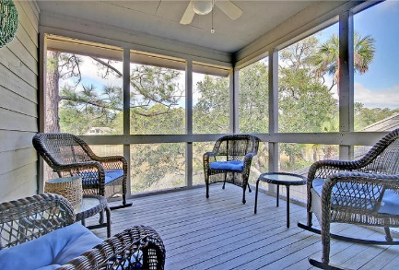
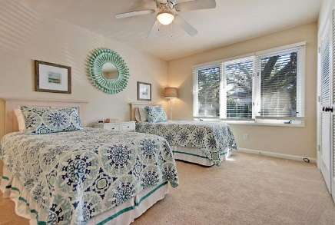
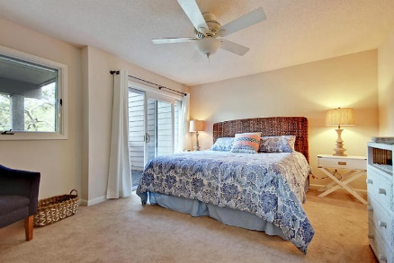
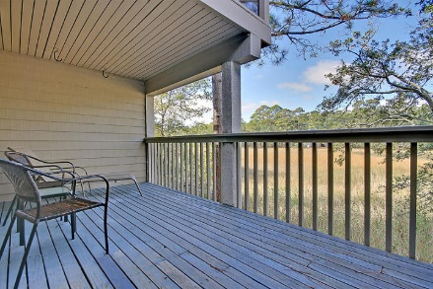
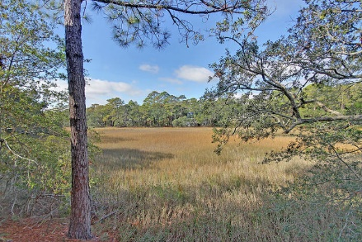


Wonderfully Updated Seabrook Villa
1240 Creek Watch Trace
Creek Watch Villas · Seabrook Island, SC 29455 · MLS# 18000171 · $245,000
2 Bed · 2 Bath · 1,160sf
This updated townhouse has great marsh views from its first floor master and deck, or its large living area and fantastic screened porch on the top floor. You’ll get ocean breezes & see abundant wildlife while enjoying the quiet atmosphere in this highly rentable two bedroom villa with two full baths. The community pool is a very short walk, and just a little farther is the crabbing dock and boat launch. The beach, golf courses, tennis center, and equestrian center are all just down the road. New paint & carpet, appliances convey, & furnishings are negotiable.
Lee Lindler Cell (843) 637-0803 | LeeL@NVRealtyGroup.com
NV Realty Group | 1900 Seabrook Island Rd | Johns Island, SC 29455
LeeLindler.NVRealtyGroup.com

