Slide 1

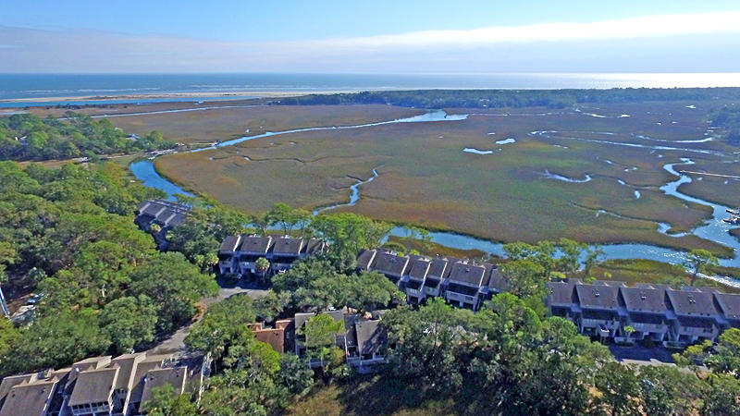
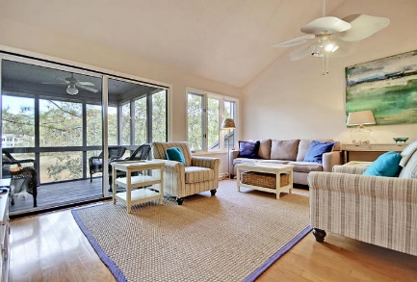
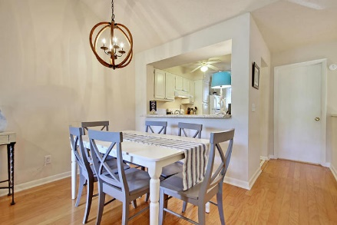
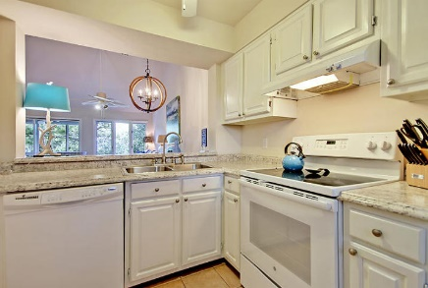
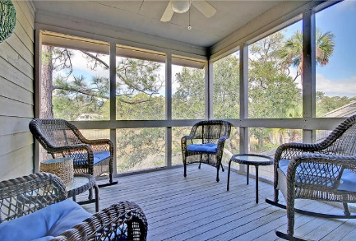
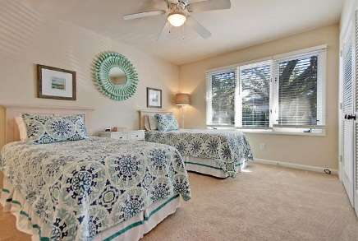
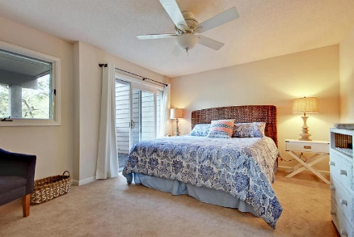
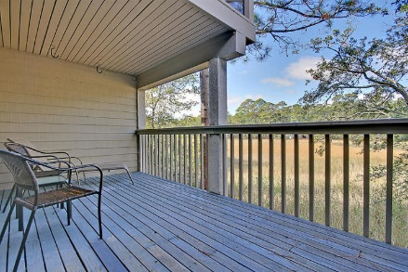
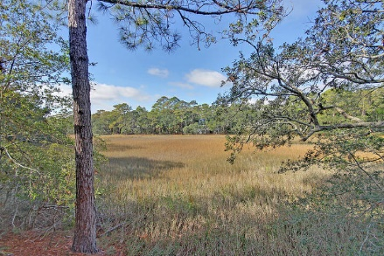


Wonderfully Updated Seabrook Villa $25,000+ In Gross Rents Is Easily Attainable
1240 Creek Watch Trace
Creek Watch Villas · Seabrook Island, SC 29455 · MLS# 18000171 · $224,000
2 Bed · 2 Bath · 1,160sf
This spacious villa has great marsh views from its first floor master suite with a private deck, or from its large living area w/ vaulted ceiling and fantastic screened porch on the top floor. The kitchen and half bath are also located on the top floor for maximizing the views and natural light. You'll get nice breezes & see abundant wildlife while enjoying the quiet atmosphere in this highly rentable villa with two en suite bedrooms and two and one half baths. THE SELLER IS OFFERING A $10K CREDIT FOR CLOSING COST and/or UPGRADES WITH AN ACCEPTABLE OFFER! The swimming pool, crabbing dock, boat launch, and observation deck are just steps away. Enjoy the beach, golf courses, tennis center, the Lake House fitness center and pools, equestrian center, and all that Seabrook Island has to offer.
Lee Lindler Cell (843) 637-0803 | LeeL@NVRealtyGroup.com
NV Realty Group | 1900 Seabrook Island Rd | Johns Island, SC 29455
LeeLindler.NVRealtyGroup.com

