Slide 1
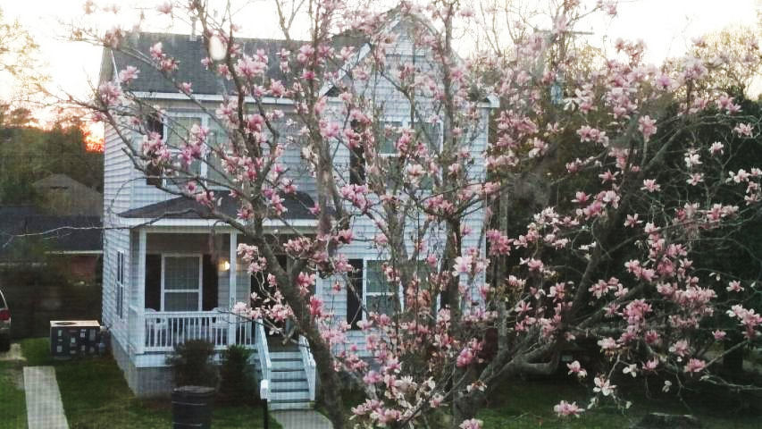
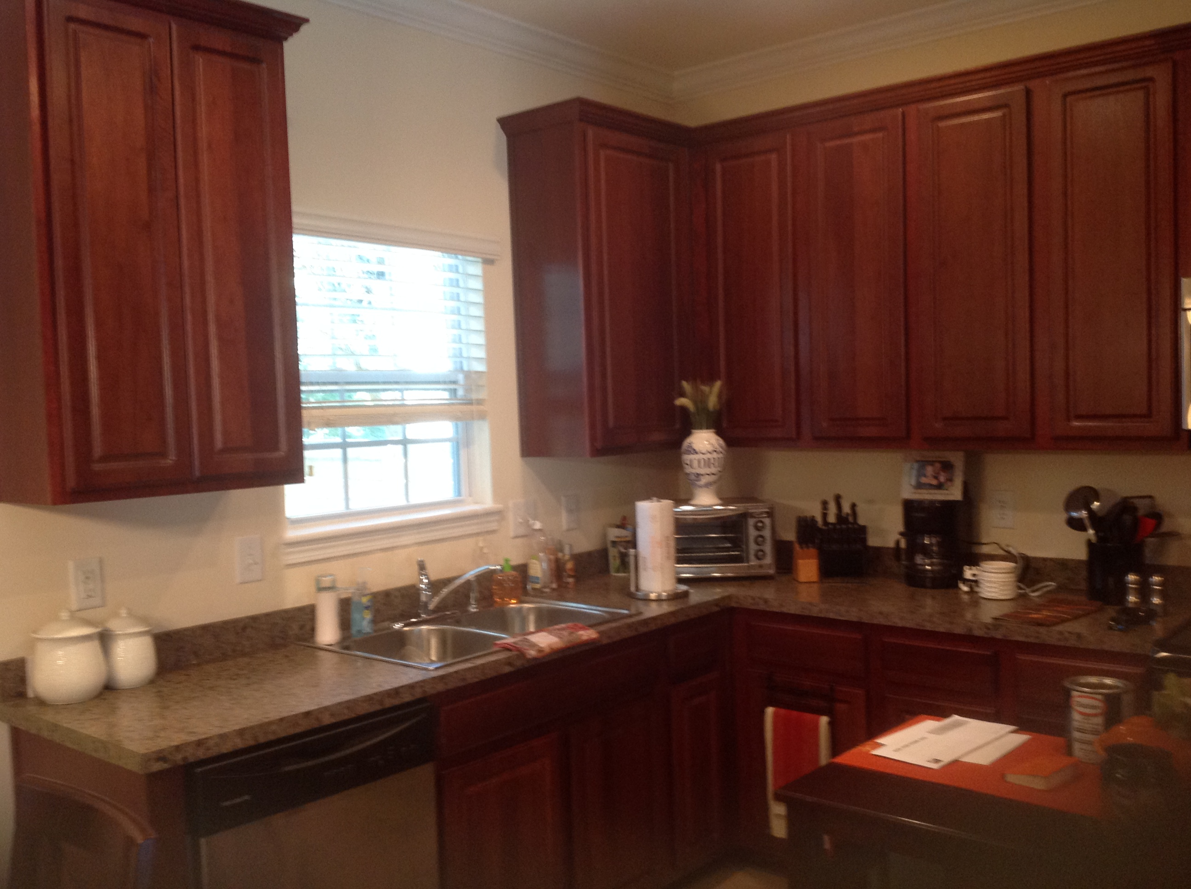
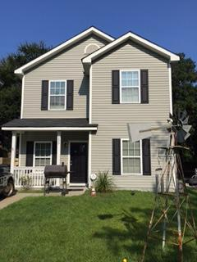
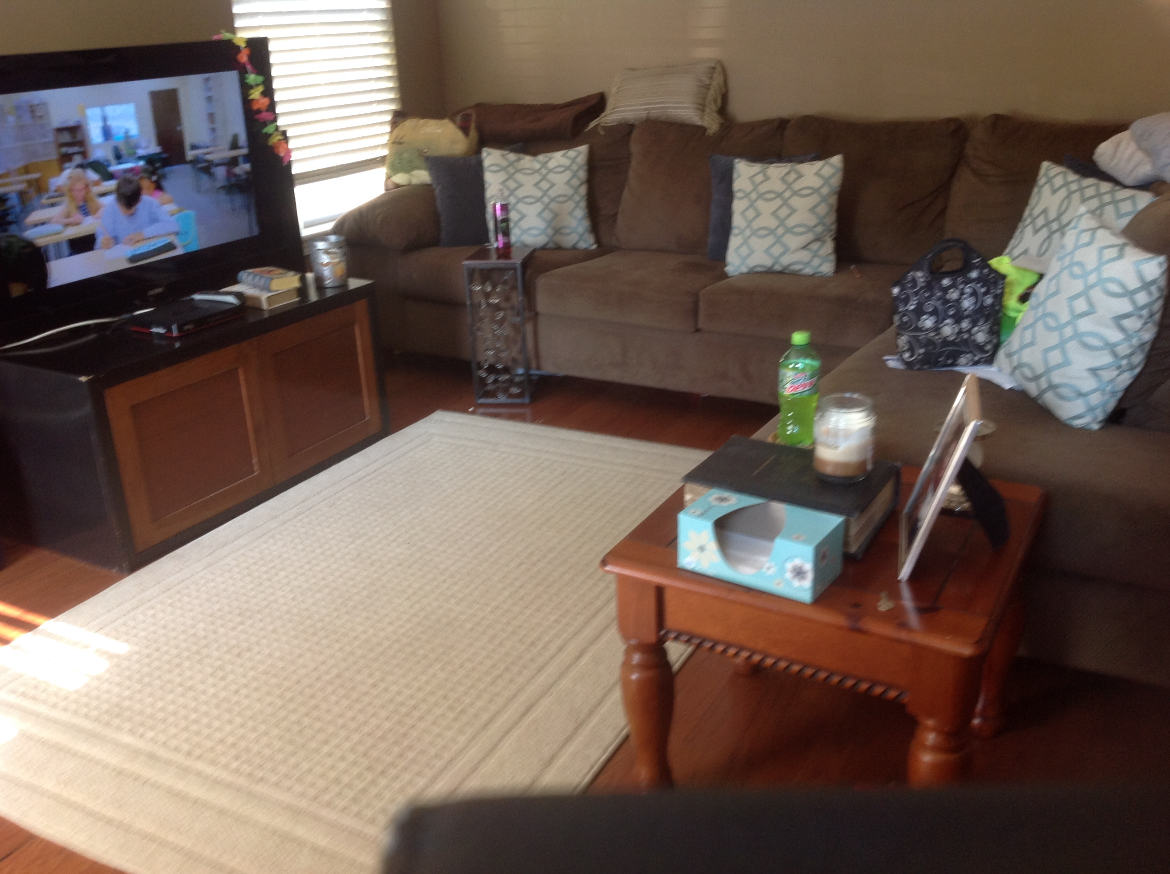
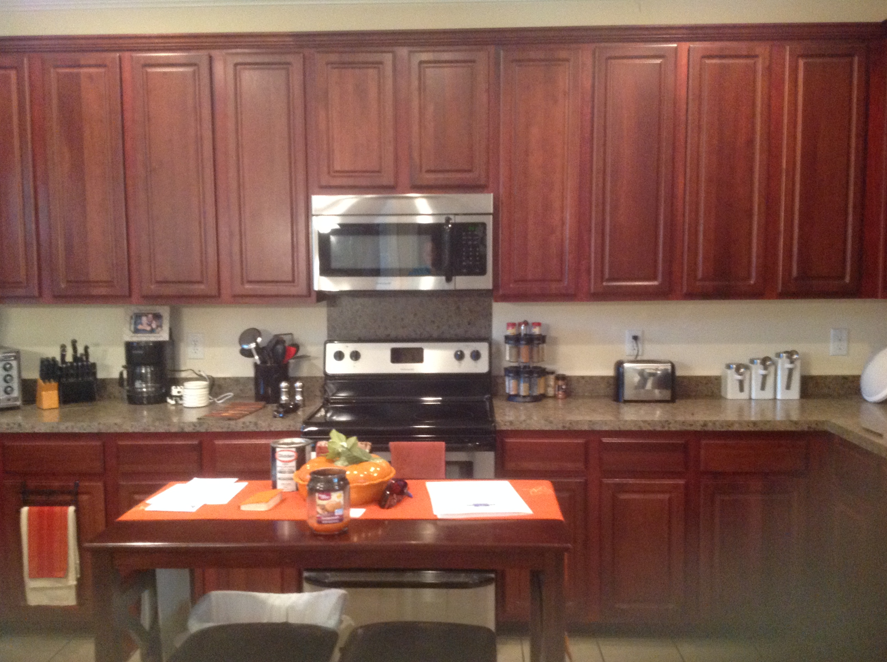
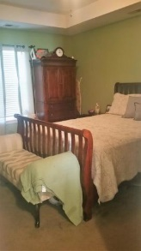
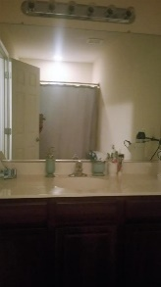
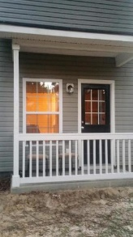
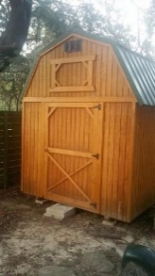

1241 Sumner Ave
Live Oaks at Sumner
North Charleston
MLS# 16024118
Price Reduced to $245,000
This custom home, built in 2011, couldn’t be in a better location. Near I-526, this 3br/3ba custom built home is perfect for the professional working at Boeing or on Daniel Island, Downtown, Mt Pleasant, North Charleston and Goose Creek. The Isle of Palms beach is only a 20 minute ride. Awesome 9 foot ceilings and crown molding downstairs. The home has a formal study with a French door directly off of the family room. There are hardwood floors in the family room and the study. The gorgeous custom kitchen features 42 inch cherry wood cabinets and pantry, an island and stainless steel appliances.
The large master suite is half the size of the entire upstairs and features a tray ceiling, walk in closet, sitting area and large private bathroom. The kitchen, laundry room and 3rd bathroom have cream colored ceramic tile floors that are accentuated with dark grout. Home has an energy efficient tankless hot water heater/flash hot water heater. There are ceiling fans in the family room, the study and all 3 bedrooms.
The backyard features a full privacy fence that is perfect for grilling out, get-togethers and just privately relaxing in the back yard. There is a new barn style shed that will stay with the home. There are 9 x 5 porches on the front and back of the home. If schools are another big consideration, this address allows for children to attend Charleston Creative Arts Elementary School and older children can attend the Charleston School of the Arts. Both are very successful schools.
Carla C Davis
Mobile - (843) 437-4873
gaweber@tds.net
AgentOwned Premiere Group
141 A N. Main Street
Summerville, SC 29483

