Slide 1
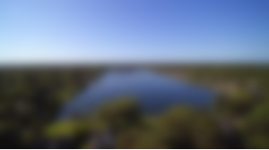
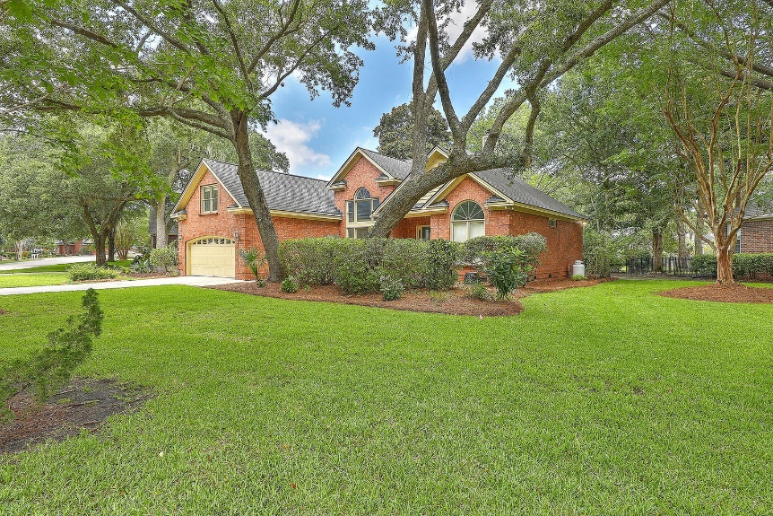
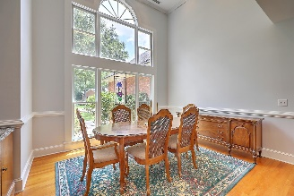
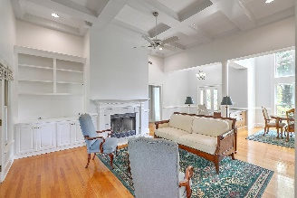
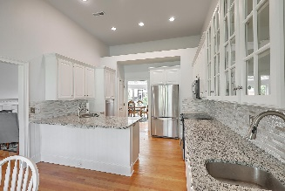
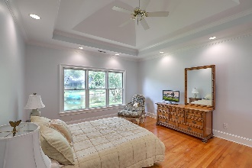
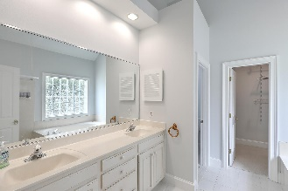
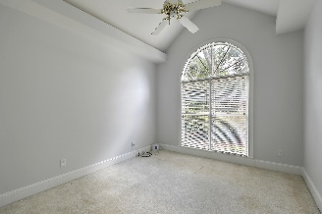
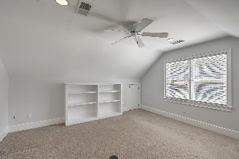
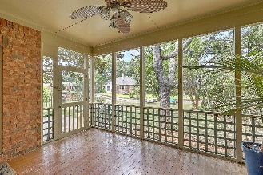
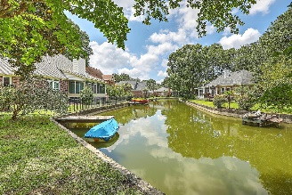
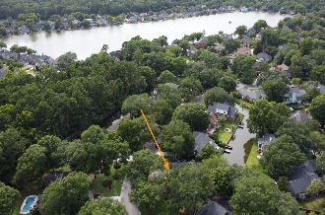

OPEN HOUSE/HAPPY HOUR 4-6PM Friday 7/14
1242 Hidden Lakes Dr
Hidden Lakes
Mount Pleasant, SC 29464
MLS# 23015366
$999,000
4 Bed | 2 Bath | 2,271 SF
Lovingly cared for through the years by the original owners, this incredible one-story brick ranch on a canal in Hidden Lakes is ready for its next owners. As you enter the foyer, you'll immediately notice the home's spacious feel, natural lighting, and tall ceilings. The floor plan features owner and guest accommodations separated by the living spaces, allowing for privacy. Two guest rooms are located to the right, connected by a small hallway, and feature a shared full bathroom. The generously-sized eat-in kitchen also has tall ceilings, heaps of counter space, and modern finishes including stainless appliances, solid-surface countertops, and tile backsplashes. The Main Bedroom sits on the opposite side of the home and features a spacious bathroom with dual vanities, a separate shower and tub, water closet, and walk-in closet. You'll also find a small laundry room on the main floor just outside the Main bedroom. (This space was converted from a 1/2 bath to make a larger laundry room, but could possibly be converted back should buyer desire a powder room). Down a small hallway towards the two-car attached garage is a staircase up to the large FROG, complete with two sizable cedar-lined closets. (One may be large enough to be remodeled into a bathroom). A beautiful canopy of mature trees surround the home, and the fantastic screened porch and back yard overlook the canal - complete with a small dock for your favorite small watercraft! Hidden Lakes is a truly unique neighborhood - situated centrally in Mount Pleasant, close to beaches and downtown. Its 55+ acre system of lakes and canals is perfect for paddling, sailing, and small electric boats, and also feeds a neighborhood irrigation system. A clubhouse, pool, tennis/pickleball/basketball courts, kids playground, and boat/rv storage yard (for an additional fee) round out the many amenities of this incredible neighborhood!

