Slide 1
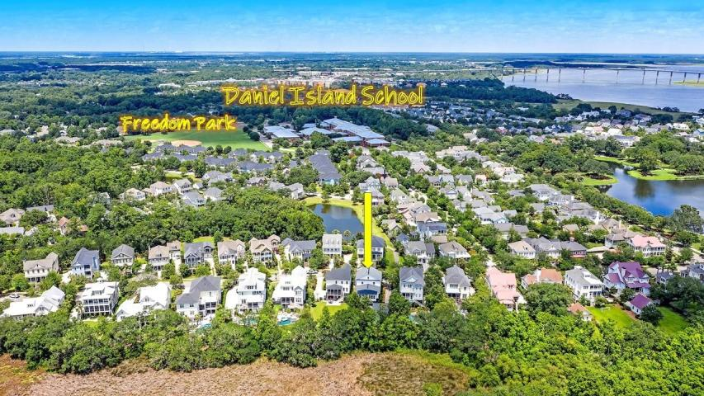

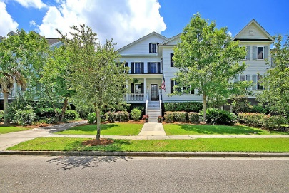
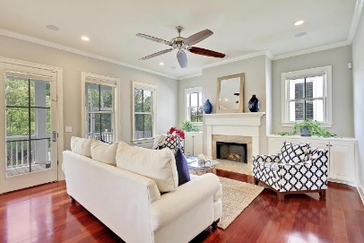
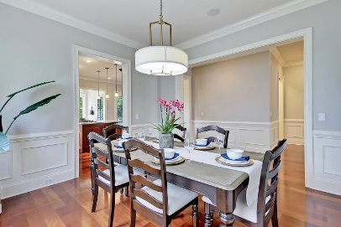
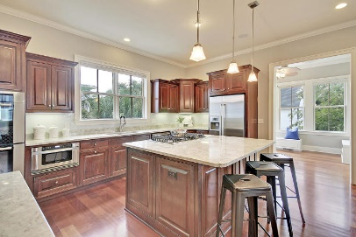
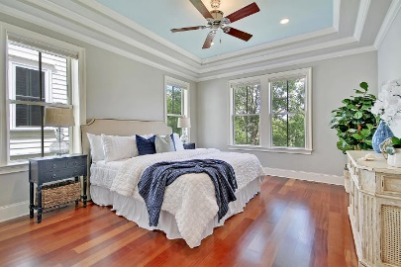
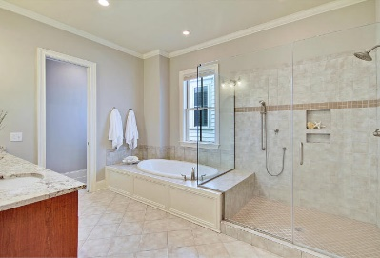
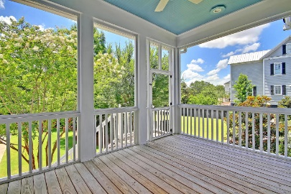
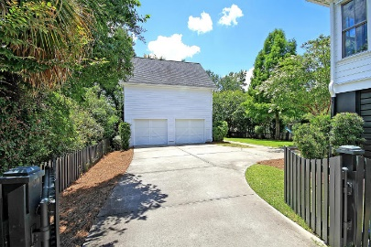
Great Downtown Investment Opportunity
Price Reduced!
1243 Smythe Street
Daniel Island, SC 29492 ~ MLS# 19019327 ~ $920,000
Custom home by Allen Custom Homes
Master bathroom has his and her vanities and large soaking tub
Tray ceiling in Master Bedroom
Second floor features two bedrooms with ensuite baths in addition to a second Master suite
Large storage area located on unfinished 3rd floor of home
Custom built in shelves and cabinets in home office
Kitchen features granite counter tops, Bosch appliances, double ovens, and a large center island breakfast bar with seating
Living room features fireplace with granite surround and custom built-ins
Brazilian Cherry hardwood flooring throughout the entire home
Surround sound with individual volume control in each room throughout the main level of the home
Wainscoting and crown moulding throughout the home
Hurricane shutters for all windows and doors which are easily installed from INSIDE the home
Lawn Irrigation System
Gutters with Leaf Guard
Great location close to Smythe Park, Daniel Island schools, public Library and community pools.
Community amenities include - miles of walking/biking trails, pools, multiple playgrounds and community boat dock, shops, restaurants and the Family Circle Tennis Center - a great venue for sporting events and concerts.
LOCATION, LOCATION, LOCATION! Custom built Charleston style home on desirable Daniel Island, a short drive from historic Charleston, great beaches and the airport. This 6 bedroom, 6 bathroom home has a lovely fenced yard, and sits on a premium marsh lot at the end of a cul-de-sac just steps away from Smythe Park. Smythe Park features an 11-acre lake with walking trails, picnic area and children's play area. Watch the 4th of July fireworks and enjoy free concerts from your own back yard! Home is also conveniently located 2 blocks from the Daniel Island School and community library. This home has the perfect layout for families of all ages and for entertaining friends. The open floor plan features a large kitchen with Bosch stainless appliances and tons of storage. There is a breakfast area and a formal dining room. The owner's retreat and the home office (which can serve as an additional bedroom with a full bath) are both conveniently located on the first floor. Upstairs you will find an open area perfect for a playroom or additional work space. 3 bedrooms and 3 full baths complete the second floor. The 6th bedroom with full bath is in the FROG above the 2-car detached garage. It has a separate entrance making it an ideal space for teens, guests or potential rental income. The front porch and screened in porch overlooking the private back yard are perfect for year round enjoyment. This home has too many upgrades and features to list and must be seen to fully appreciate it's location and layout!
Book your viewing today!
Paige Rhodes 843-830-3281
paige@mattoneillteam.com
Ben Laaper 843-642-3546
ben@mattoneillteam.com

