Slide 1
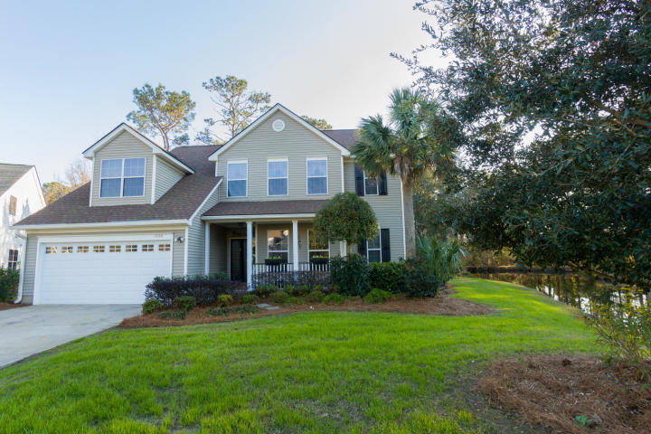
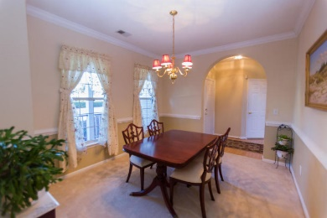
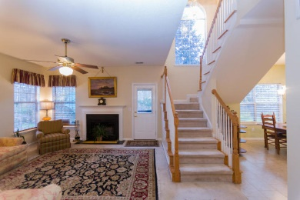
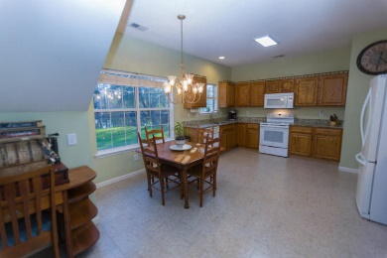
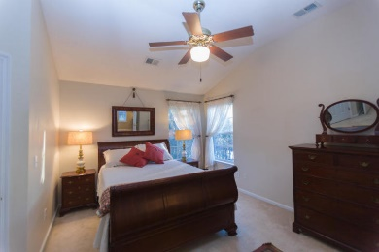
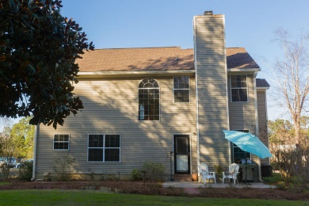
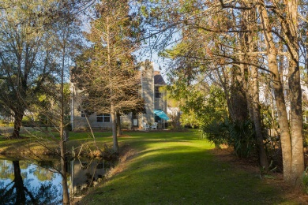
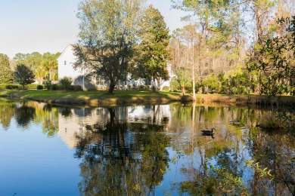
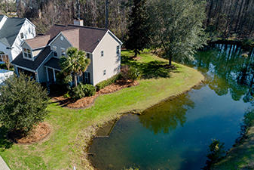


Buy the View…
The House is Free!
New Price!
1244 Old Course Lane
Charleston National ~ Mt Pleasant ~ MLS# 20003004 ~ $419,900
A lake runs beside it, around it, and behind it! Imagine beautiful lake views to enjoy everyday from your window, while sitting on the patio with your tea or coffee, or as you walk up to your front door. Well cared for home sits on the most unique and beautiful lot in all of Charleston National. It is a nature lover and an artist's dream home. Fish from your backyard. Let your imagination take you away! Club membership in Charleston National is FREE, Golf membership extra. Home offers Storm Doors, Dishwasher, Stove, Refrigerator/Freezer w ice maker, and built in microwave that convey. Washer/Dryer stay for buyer's convenience. New HVAC 2017 - Heil Coastal Exterior units with Heil Handlers in attic comes with a 10-year transferable warranty. New Roof 2013 Architectural Shingles with 30#felt
Christine DeCocker
(843) 860-9972
ttlrealtor@gmail.com
ERA Wilder Realty, 125-F Wappoo Creek Dr, Charleston, SC 29412

