Slide 1
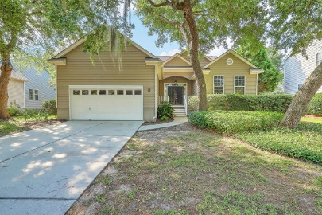
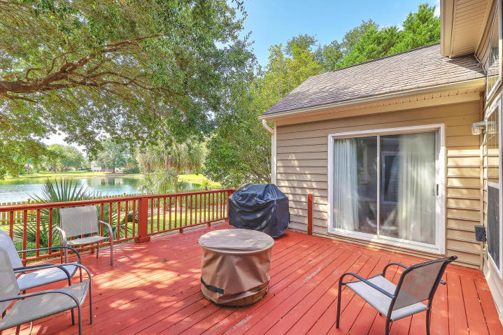
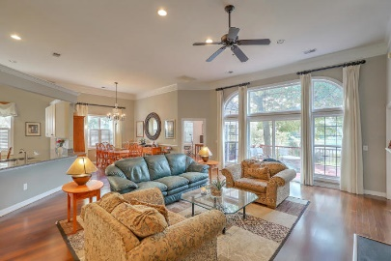
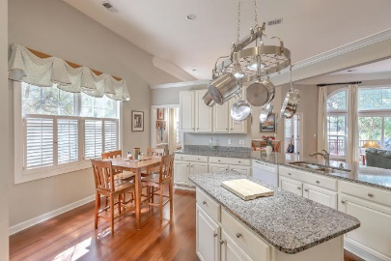
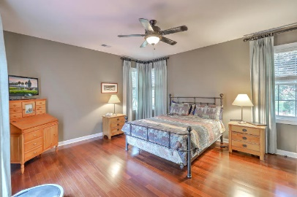
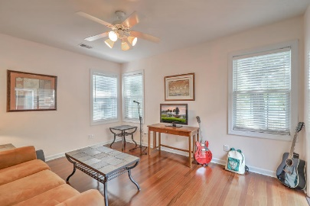
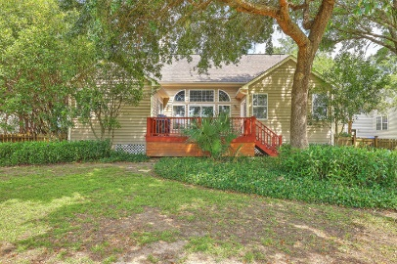
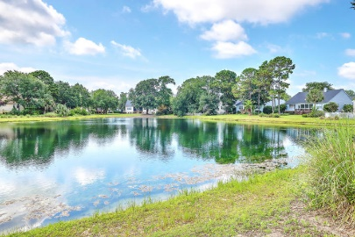


1244 Palmetto Peninsula Drive
Seaside Farms | Mount Pleasant, SC 29464 | MLS# 19018039 | $560,000
Open House Saturday, June 29 from 11am to 2pm.
Lovely pond front home in Seaside Farms. 2200 sq ft with 3 BR and 2 full baths, updated kitchen and deck overlooking pond. 2 car garage and fireplace!
Beautiful lake/pond front home with gorgeous views conveniently located near shopping and schools. Garage has nice storage area with stairs to reach it. Hardwood floors in Living area, kitchen, study and master bedroom. Updated kitchen with granite counter tops allowing a stunning view over the outside deck. There is a fireplace in the family room. Comes with a 2-10 Home Warranty. Must see as this will sell quickly. Neighborhood pool close by.
Randy Bazemore
O (843) 277-6677 | M (843) 524-6900
randybazemore99@gmail.com
http://rbazemore.century21properties.com
Century 21 Properties Plus | 2000 Sam Rittenberg Blvd #118 | Charleston, SC 29407

