Slide 1
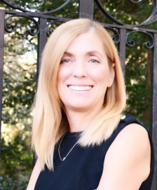
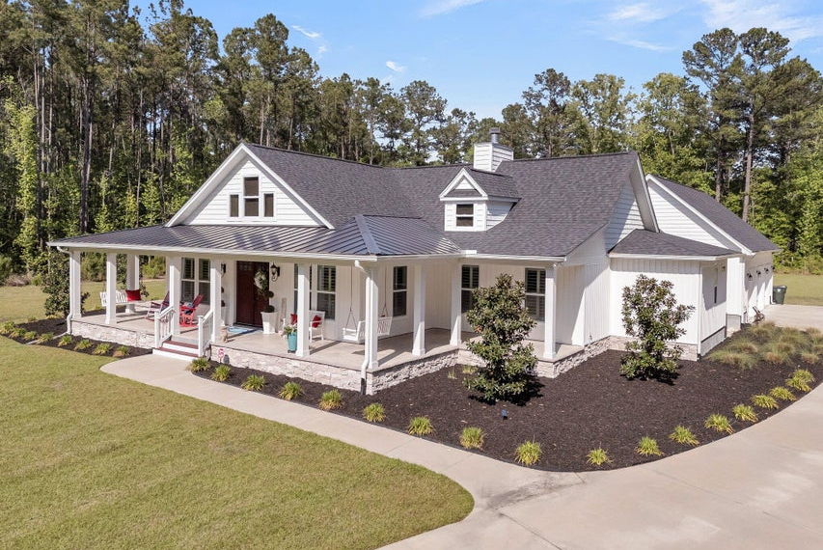
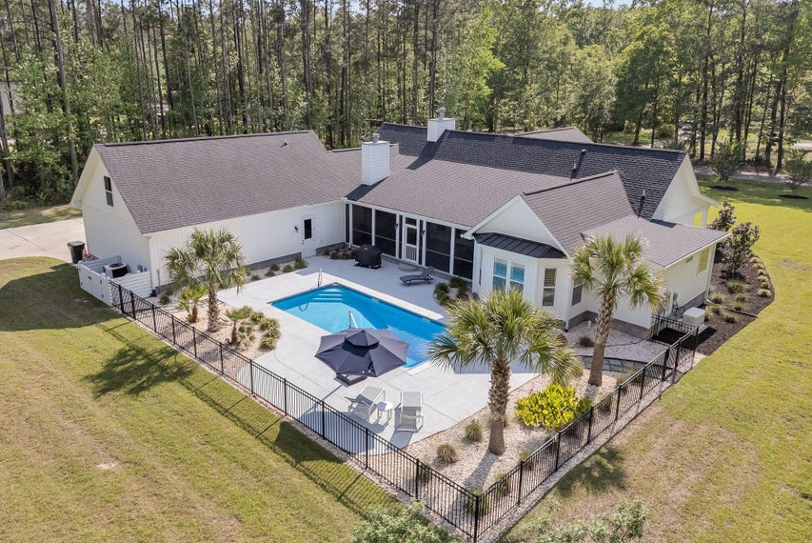
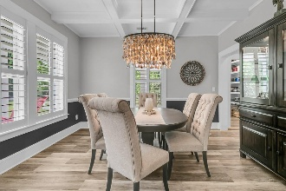
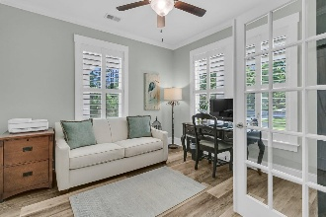
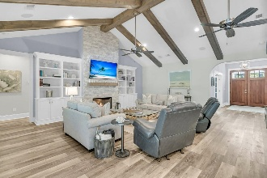
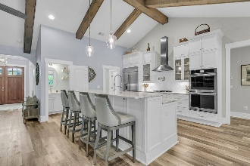
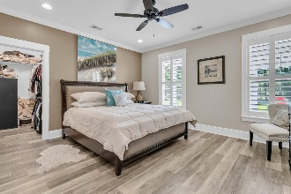

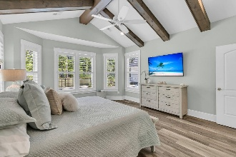
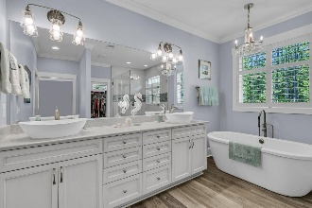
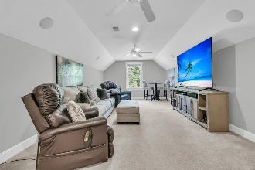
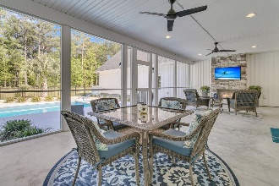
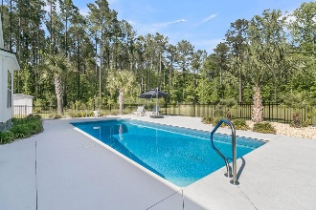
Debbie Cromer
ABR, RSPS, REALTOR, CRS
(843) 437-6342
debbie@debbiecromer.com
www.debbiecromer.com
Luxury Living on 2.15 Acres
1245 Saddlehorn Road
Eagle Harbor | Summerville, SC 29486 | MLS# 25011145 | $1,150,000
This is the unicorn you've been searching for—a truly rare combination of space, privacy, craftsmanship & outdoor living. Built in 2019 on 2.15 acres w/ a fenced backyard, custom in-ground pool, & professional landscaping, this one-story custom home offers over 3,100 square feet, 4 bedrooms, 2 full & 2 half baths, a 3-car garage, dedicated office, formal dining room, gourmet kitchen, large laundry room, & an upstairs FROG perfect for guests or a media room. The open floor plan is designed for both everyday comfort & entertaining, featuring 15 ' cathedral ceilings w/ exposed beams in the family room, kitchen and primary bedroom, crown molding, 8'' baseboards, & driftwood LVP flooring throughout. Plantation shutters cover every window for a clean, finished look.
The spacious kitchen includes stainless steel appliances, custom cabinetry w/ roll-out shelves, under-cabinet lighting, & a walk-in pantry. The living room features a gas fireplace & flows into a casual dining space, while a second fireplace warms the screened porch overlooking the pool. A 100-foot concrete driveway welcomes you home. Enjoy added peace of mind w/ a GENERAC whole-home generator & two Rinnai tankless water heaters. Community roads are scheduled to be resurfaced 2025.
Located near all that Nexton/Cane Bay has to offer: including shops, restaurants, & grocery stores...with convenient access to Volvo & Lake Moultrie in just 15 minutes, Boeing, Charleston International Airport, & Downtown Charleston in about 30 minutes, & the beach in approximately 45. This is a rare opportunity to own a meticulously maintained, move-in ready home where quality construction & everyday luxury meet.
TAKE A VIRTUAL TOUR
Century 21 Properties Plus | 1090 Park West Blvd; Ste 103 | Mount Pleasant, SC 29466

