Slide 1
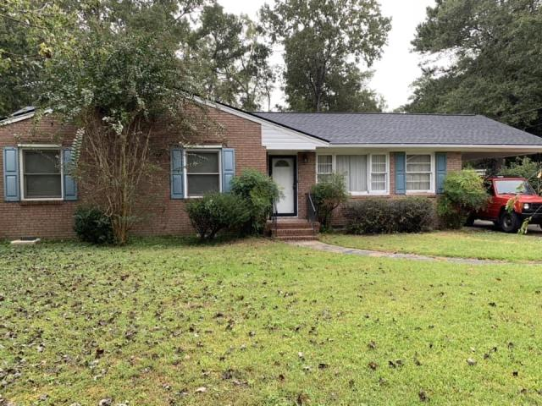
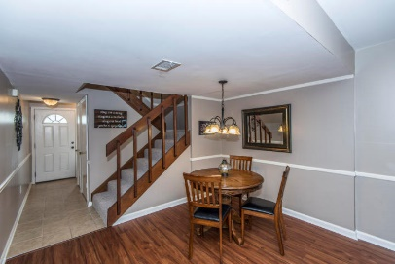
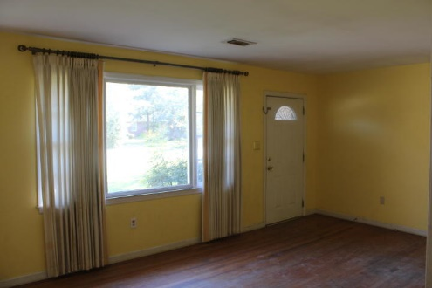
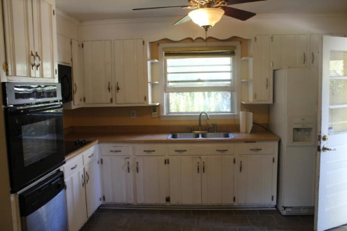
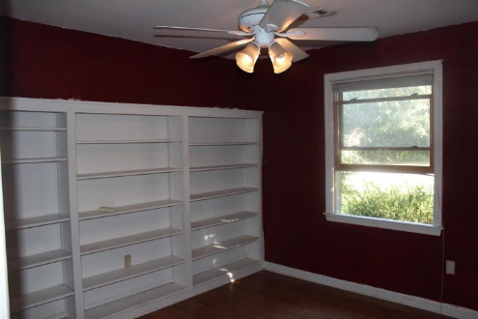
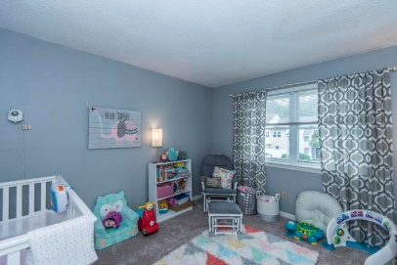
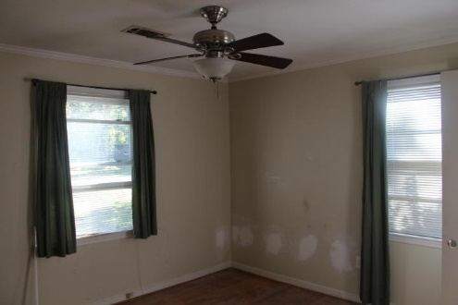
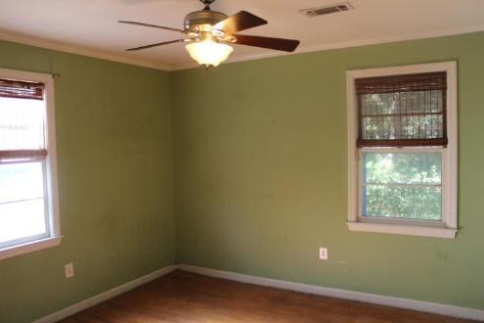
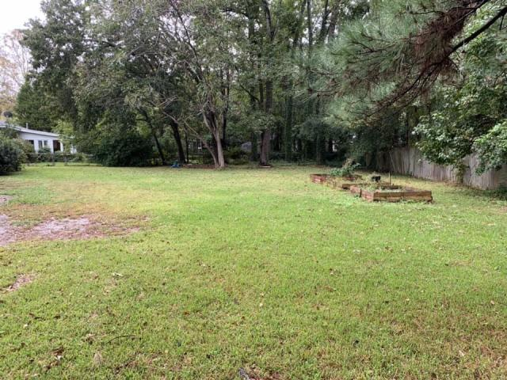


New to the Market!
West Ashley home on large lot
1246 Bamboo Drive
Old Towne Acres
Charleston, SC 29407
MLS# 18029431
Priced to Sell at $250,000
This townhouse is the perfect LOCATION. You are close to Shem Creek, Trader Joe's and Whole Foods.
This townhouse has been freshly painted and just had a new hot water heater installed. The backyard has been regraded and added new sod and a new fence.
Downstairs has Smartcore luxury vinyl waterproof tile and upstairs has new carpet. Home has been inspected and repairs made. Roof was replaced in 2014 and HVAC in 2012.
Welcome to 1246 Bamboo Drive in the lovely Old Towne Acres subdivision of West Ashley! This 3 bedroom, 2 bath home sits on almost a Half Acre and has a brand new roof on it. There are hardwood floors and updated tile in the kitchen! The yard is the private and gives tons of room for whatever you want it for. Great location close to everything including downtown Charleston and Folly Beach.
Del Shaffer
843.408.6821
dshaffer@carolinaoneplus.com

