Slide 1
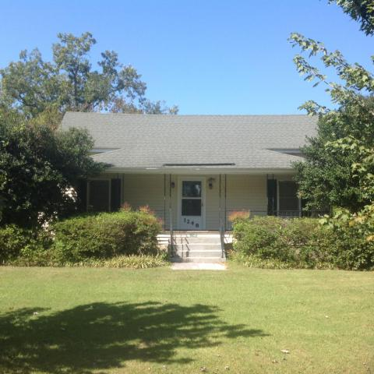
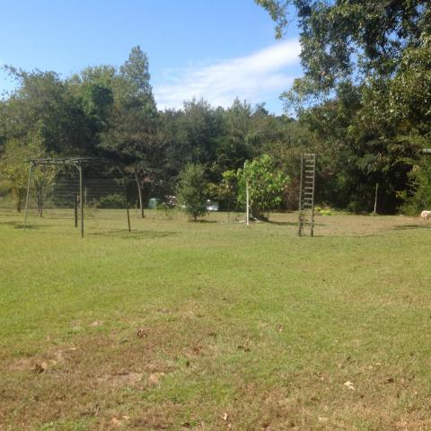
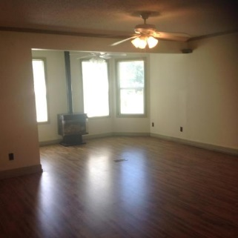
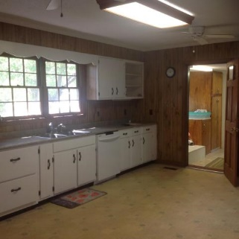
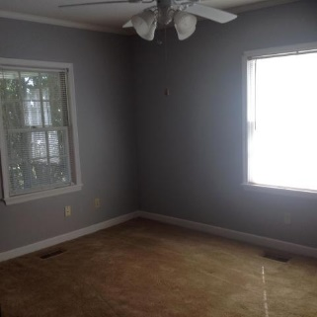
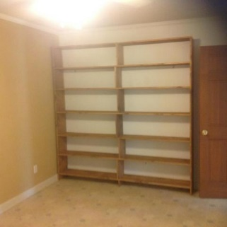
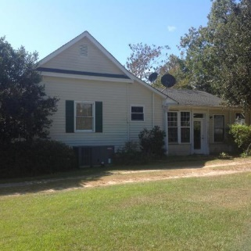
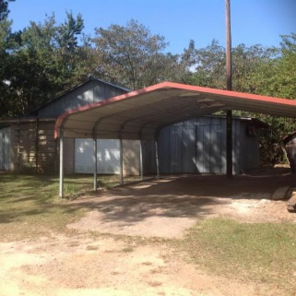
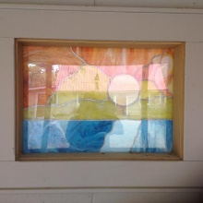

Great 2 Bed/3 Bath House On Over An Acre In Elloree!
1248 Tee Vee Road
Elloree, SC 29047
MLS# 17026936
$159,900
This large 2 bedroom, 3 bathroom home has a large eat in kitchen, home office space, utility room, Sun room and 3 outbuildings (could be use as man cave, workshop are any number of possibilities).Nice front porch to sit outside and look at the mature landscaping! Must see to appreciate!!!
Karen M Brown
Mobile - (843) 709-4029
karenbrown22@gmail.com
Carla C Davis
Mobile - (843) 437-4873
gaweber@tds.net
AgentOwned Premiere Group | 141 A N. Main Street | Summerville, SC 29483

