Slide 1


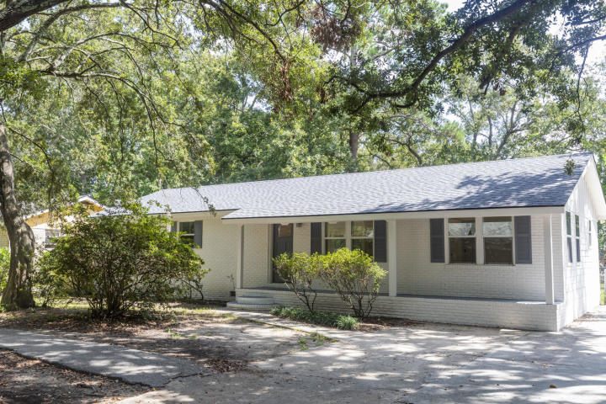
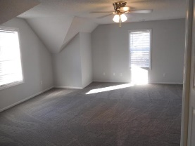
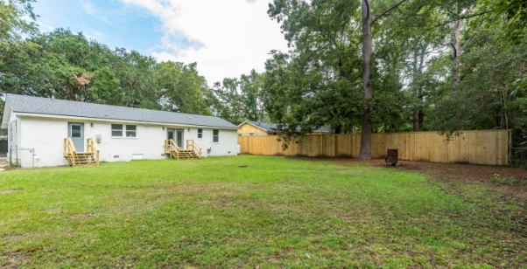
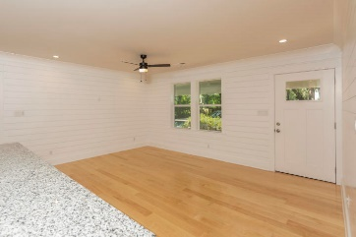
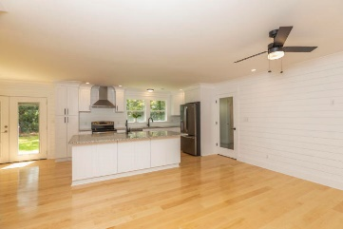
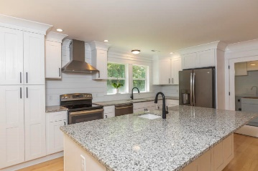
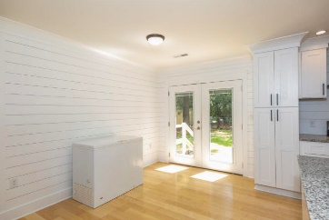
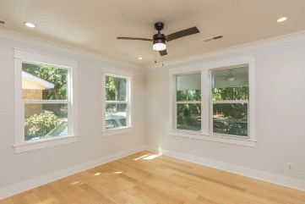
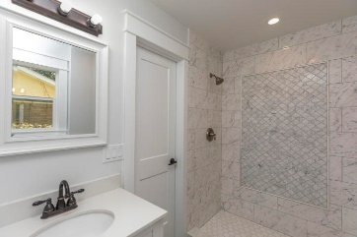
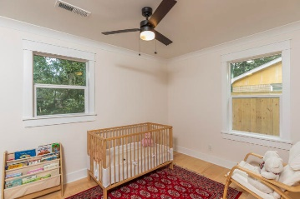
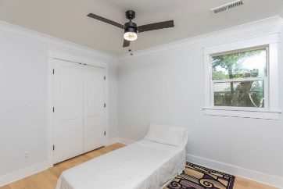
Kim Katich
(843) 754-8060
kimsellschs@gmail.com
Beautiful Home located in the Heart of Mt Pleasant
1249 Mathis Ferry Road
Parish Place
Mount Pleasant, SC 29464
MLS# 20025482
$439,000
Welcome to 1249 Mathis Ferry Rd. This home has been totally renovated and is move-in ready. There is no HOA and no Flood zone. This home sits on almost 1/4 acre with plenty of room to store your boat. Upgrades include new kitchen cabinets, new granite countertops, shiplap in kitchen and living room, cove molding and craftsman style trim throughout the home, and built-in shelves in the closets. There is new custom marble tile in all of the bathrooms, as well as new 5'' maple hardwood floors throughout. Home has been freshly painted inside and out. There are all new solid core interior doors, all new exterior doors, all new windows, new siding, new roof, spray foam insulation and a new Navien tankless water heater. This home is currently under a termite bond. Excellent location, with close proximity to shopping, schools, restaurant's and the beaches. Don't let this one slip away.
Real Estate Advocates LC
7613 Hwy 544 | Myrtle Beach, SC 29588
www.realestateadvocates.com

