Slide 1
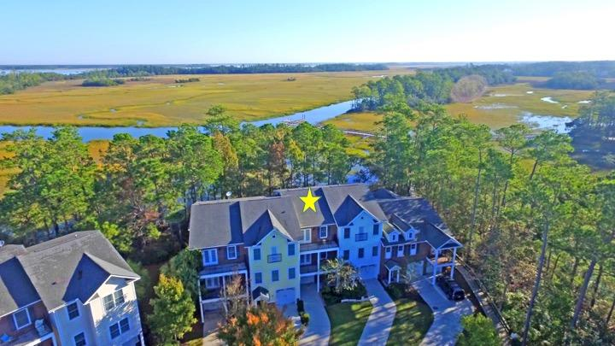
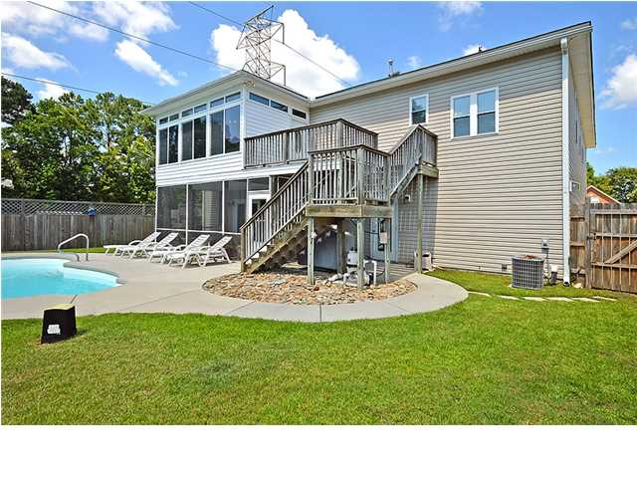
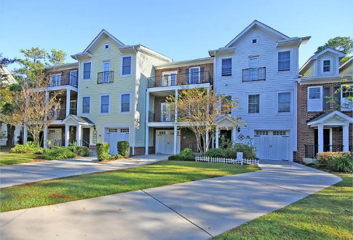
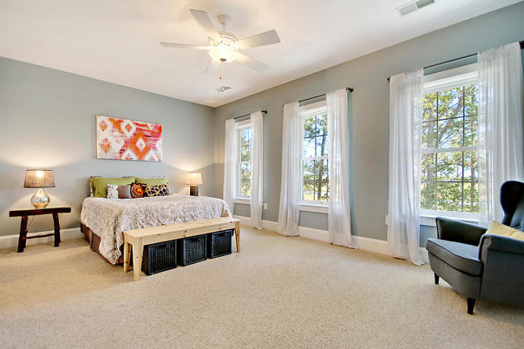
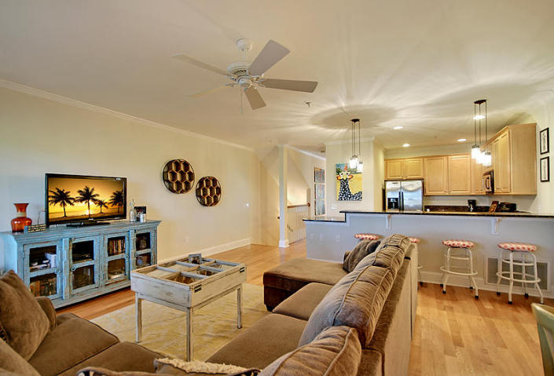
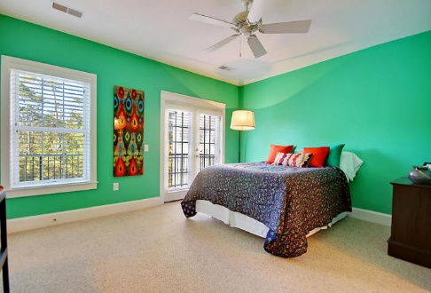
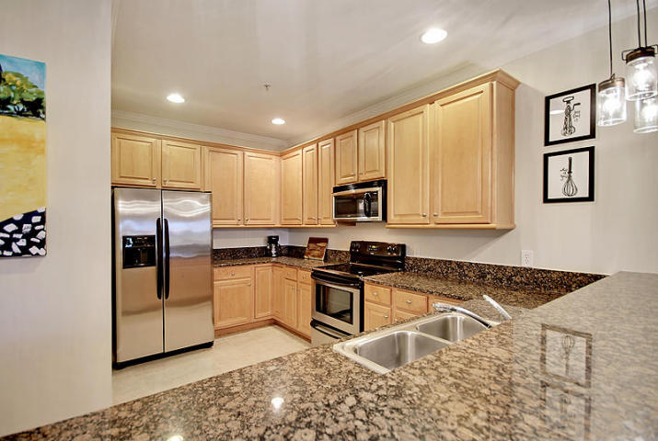
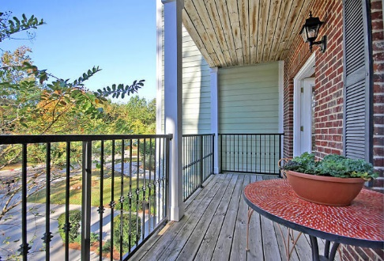
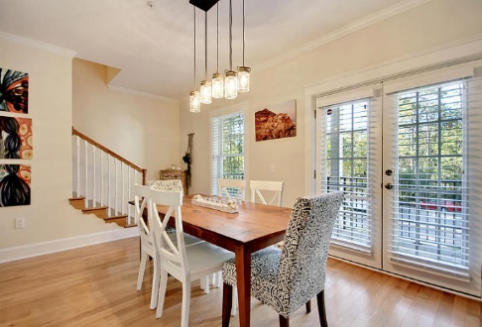
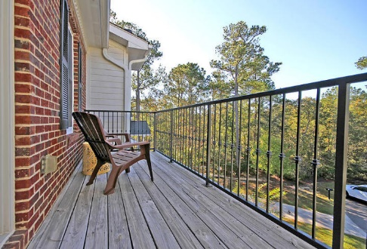
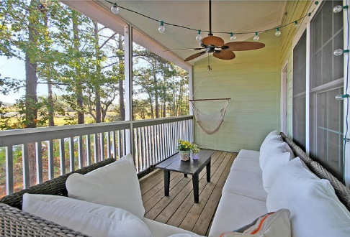


Price Reduced!
Don't Miss Out!
124 Winding Creek Court
Etiwan Pointe ~ Mount Pleasant ~ MLS# 17030110 ~ $347,499
Yes, this home is move in ready, yes, there is an open floor plan with a beautiful granite kitchen, yes, both bedrooms have en-suite full baths BUT the thing that will drop your jaw to the ground the moment you walk in are the gorgeous views of the marsh and Rathall Creek. How about walking in your backyard onto the community dock, launching your kayak off the floating dock and paddling out to the Wando River in no time? Whether you’re relaxing on any one of the three balconies, the screened-in porch or patio, enjoying a fire in the backyard fire pit or kicking back at the community pool, this is more than just a place to call home, its a slice of paradise! You'll love the convenient Mount Pleasant location close to shopping, dining, the beaches and downtown Charleston.
-Hardwood floors
-Baseboard and crown molding
-Freshly painted
Hamilton Horne Hamilton@MattOneillTeam.com (843)708-0584

