Slide 1
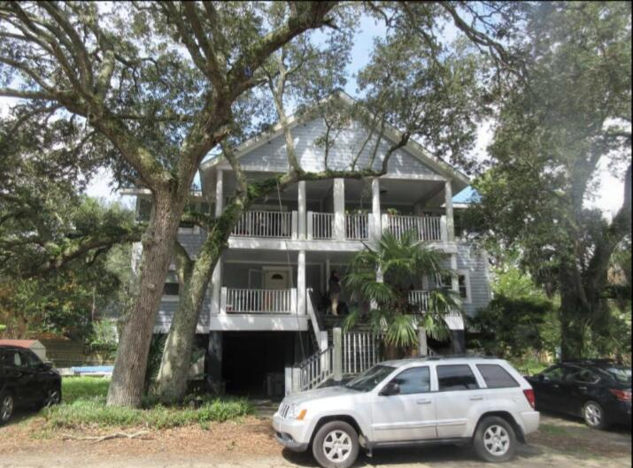
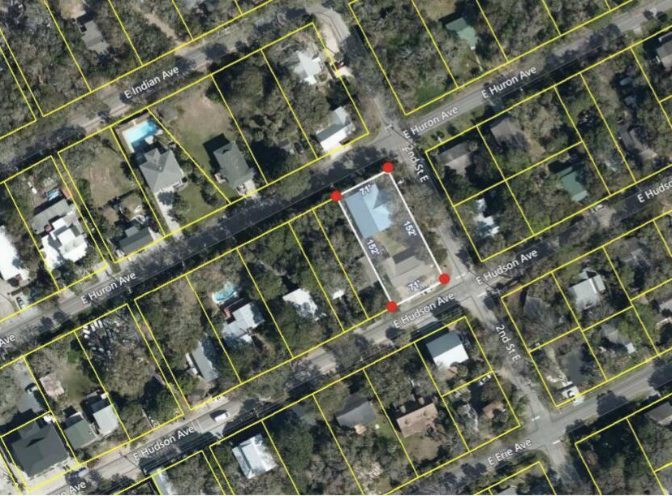
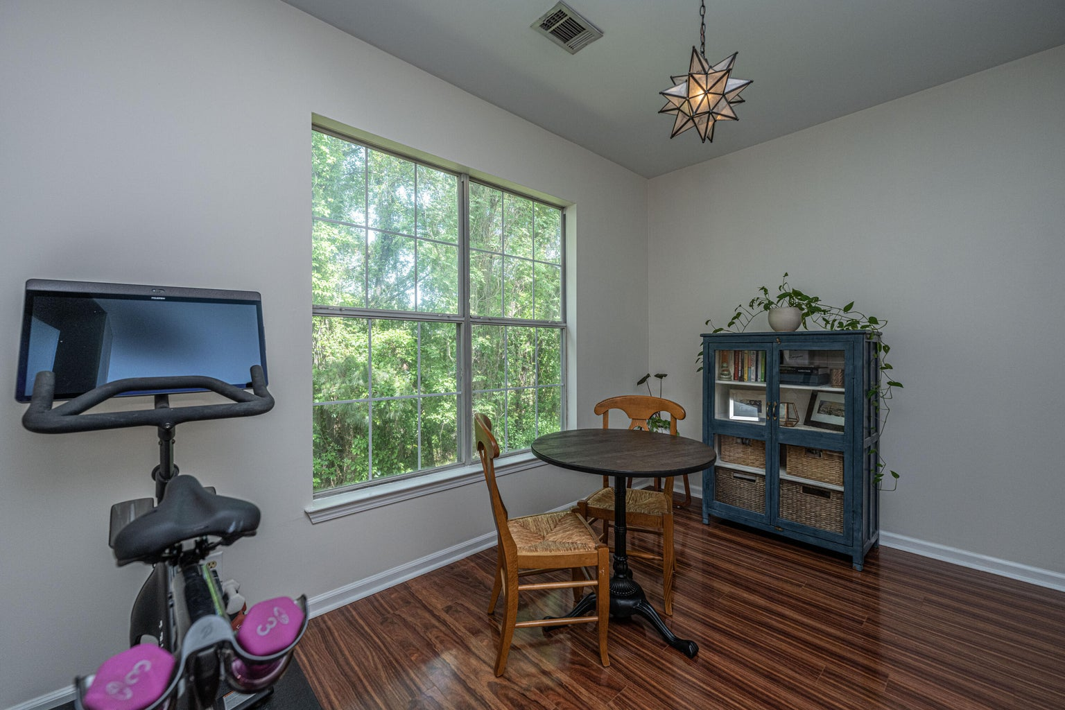
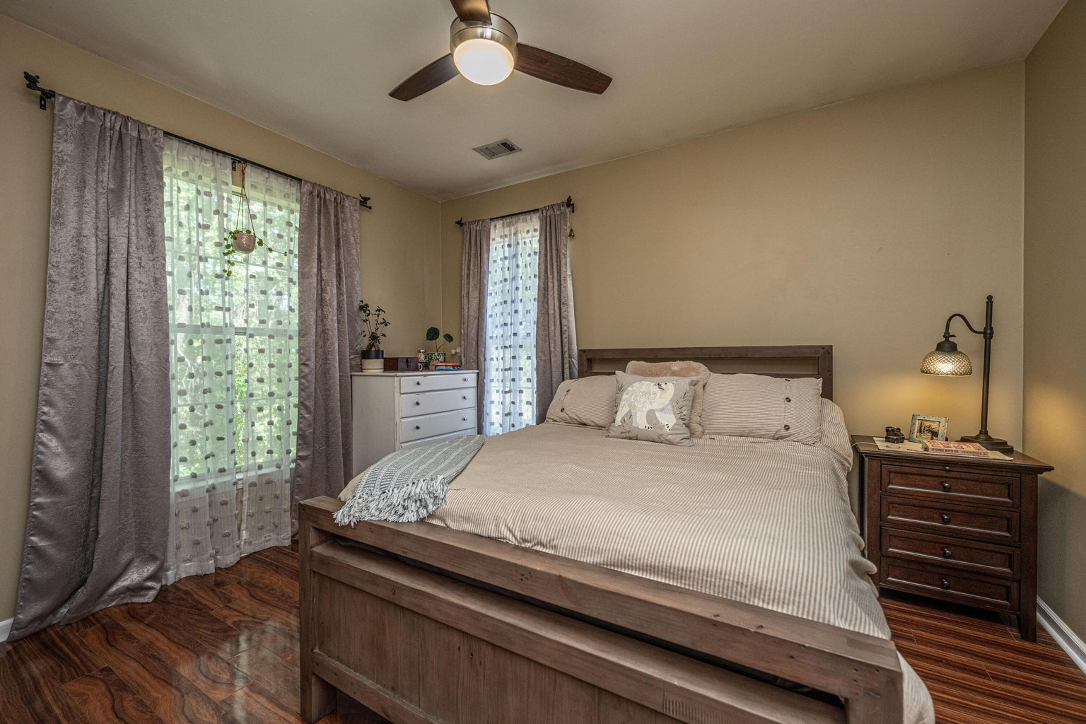
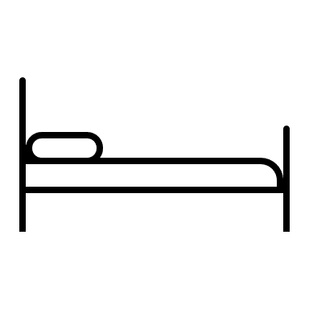


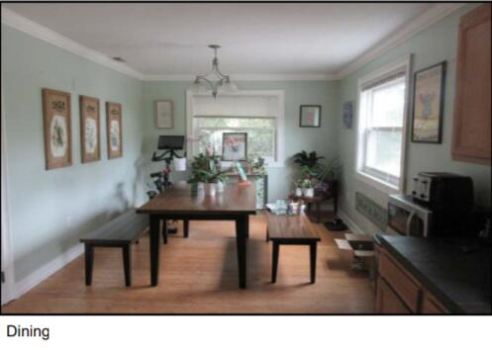
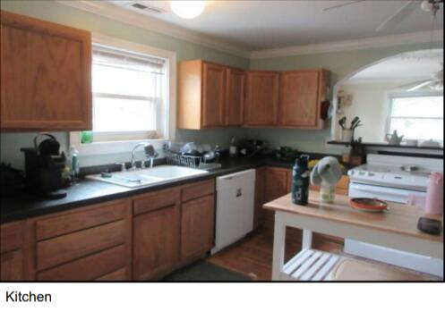
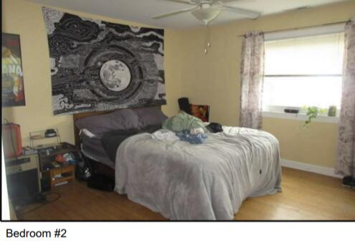
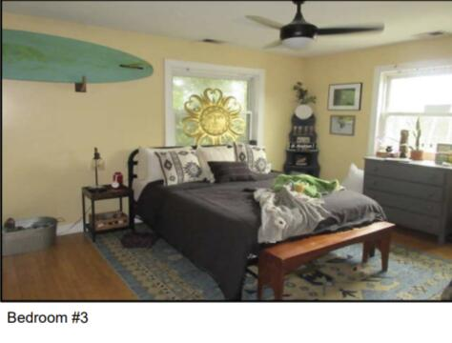
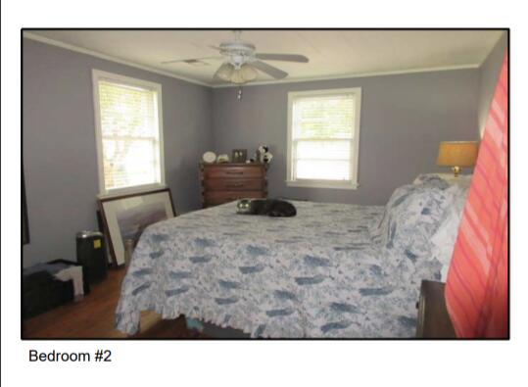
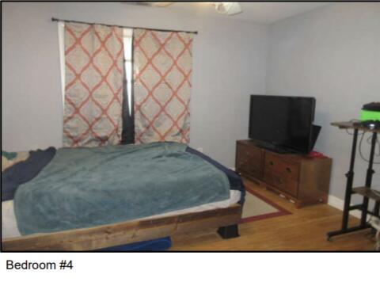
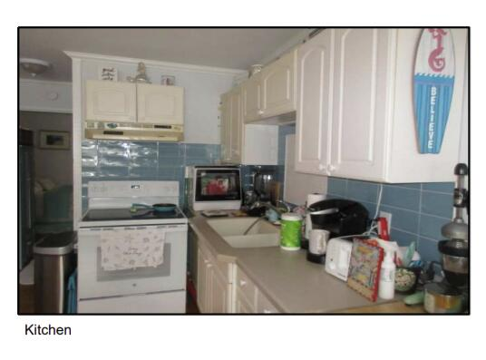
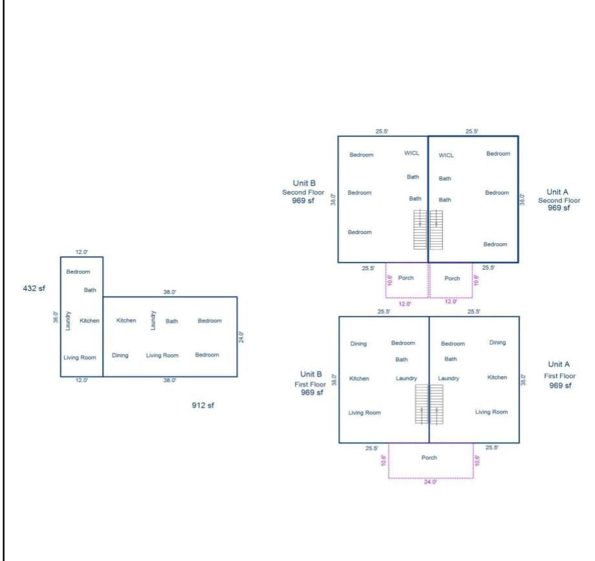

Folly Beach Opportunity
This stunning 5br, 4.5ba low country custom built home by Simonini Home Builders has been meticulously cared for situated on a .60 acre heavily treed lot on large pond in private gated community of Popular Grove. This spacious , two story, 4721 square foot home features master bedroom suite on the first level, full front porch, beautiful heart pine wood flooring, large entry foyer which separates the private study from formal dining room, open gourmet kitchen with Wolf 6 burner gas stove, built in SubZero refrigerator/freezer, dishwasher, microwave oven and large pantry. Half bath/Powder room under stairway and large utility room for washer and dryer and deep sink and built in cabinets off hallway. The smaller den with gas log fireplace opens to kitchen and breakfast room. The larger fireplace opens to kitchen and breakfast room and offers expansive views of the water year-round. The living room with its second gas log fireplace is great for entertaining away from dining areas. The large master bedroom suite is located on the first level and has travertine tile flooring in the master bath, his and hers walk in closets, separate vanities, soaking tub, and a large separate shower. There is a game room with separate stairs over the two-car garage large enough for a pool table. The second level boasts 4 spacious bedrooms and three bathrooms. On the rear of home is a large screened in porch and open deck overlooking firepit and pond. To reduce maintenance the exposed wood decking has been replaced with Trex decking and exposed rail caps with PVC. Yard has irrigation system and 120-gallon buried propane tank. Sellers just replaced roof with 50 year architectural shingles with transferable warranty. The two electric water heaters have been converted to a single LP gas fired tankless water heater. New epoxy coating on floors and newly finished walls now in two car garage. Neighborhood amenities include Privacy gate, Boat Ramp, Dock facilities, Exercise area, Pool, RV/boat storage and walking/jogging trails. Don't forget the fantastic equestrian center for your horses!
124 E Hudson Avenue
Folly Beach, SC 29439 | MLS# 23026239 | $2,700,000
Two blocks off Center Street in the heart of Fun Folly Beach. Shopping, restaurants and more. Easy beach access in walking distance. Park with tennis, playground and restrooms just down the street. Street to street lot. 11 bedrooms, 8 bathrooms. Two structures. Excellent rental income. The two story building is hardi plank siding. See pictures for the floor plan. Sold ''as is, where is''. Selling agent and buyer to verify all information during due diligence period. 121 East Huron Avenue is the address of the 2 story building. One story unit was built in 1955. Flood insurance is transferable. The 2 story duplex is $3150 per side. The 2 bedroom unit is $1800. The one bedroom is $1300. All per month. Total rental income $9400/month. Listing includes 110 and 124 E Hudson.
4
3
1,844
Shirley Gilbert
843-860-5092 sgilbert@carolinaone.com
Amy Waite
843-224-5092
amy.waite@carolinaone.com
Carolina One Real Estate | 717 Folly Road | Charleston, SC 29412

