Slide 1
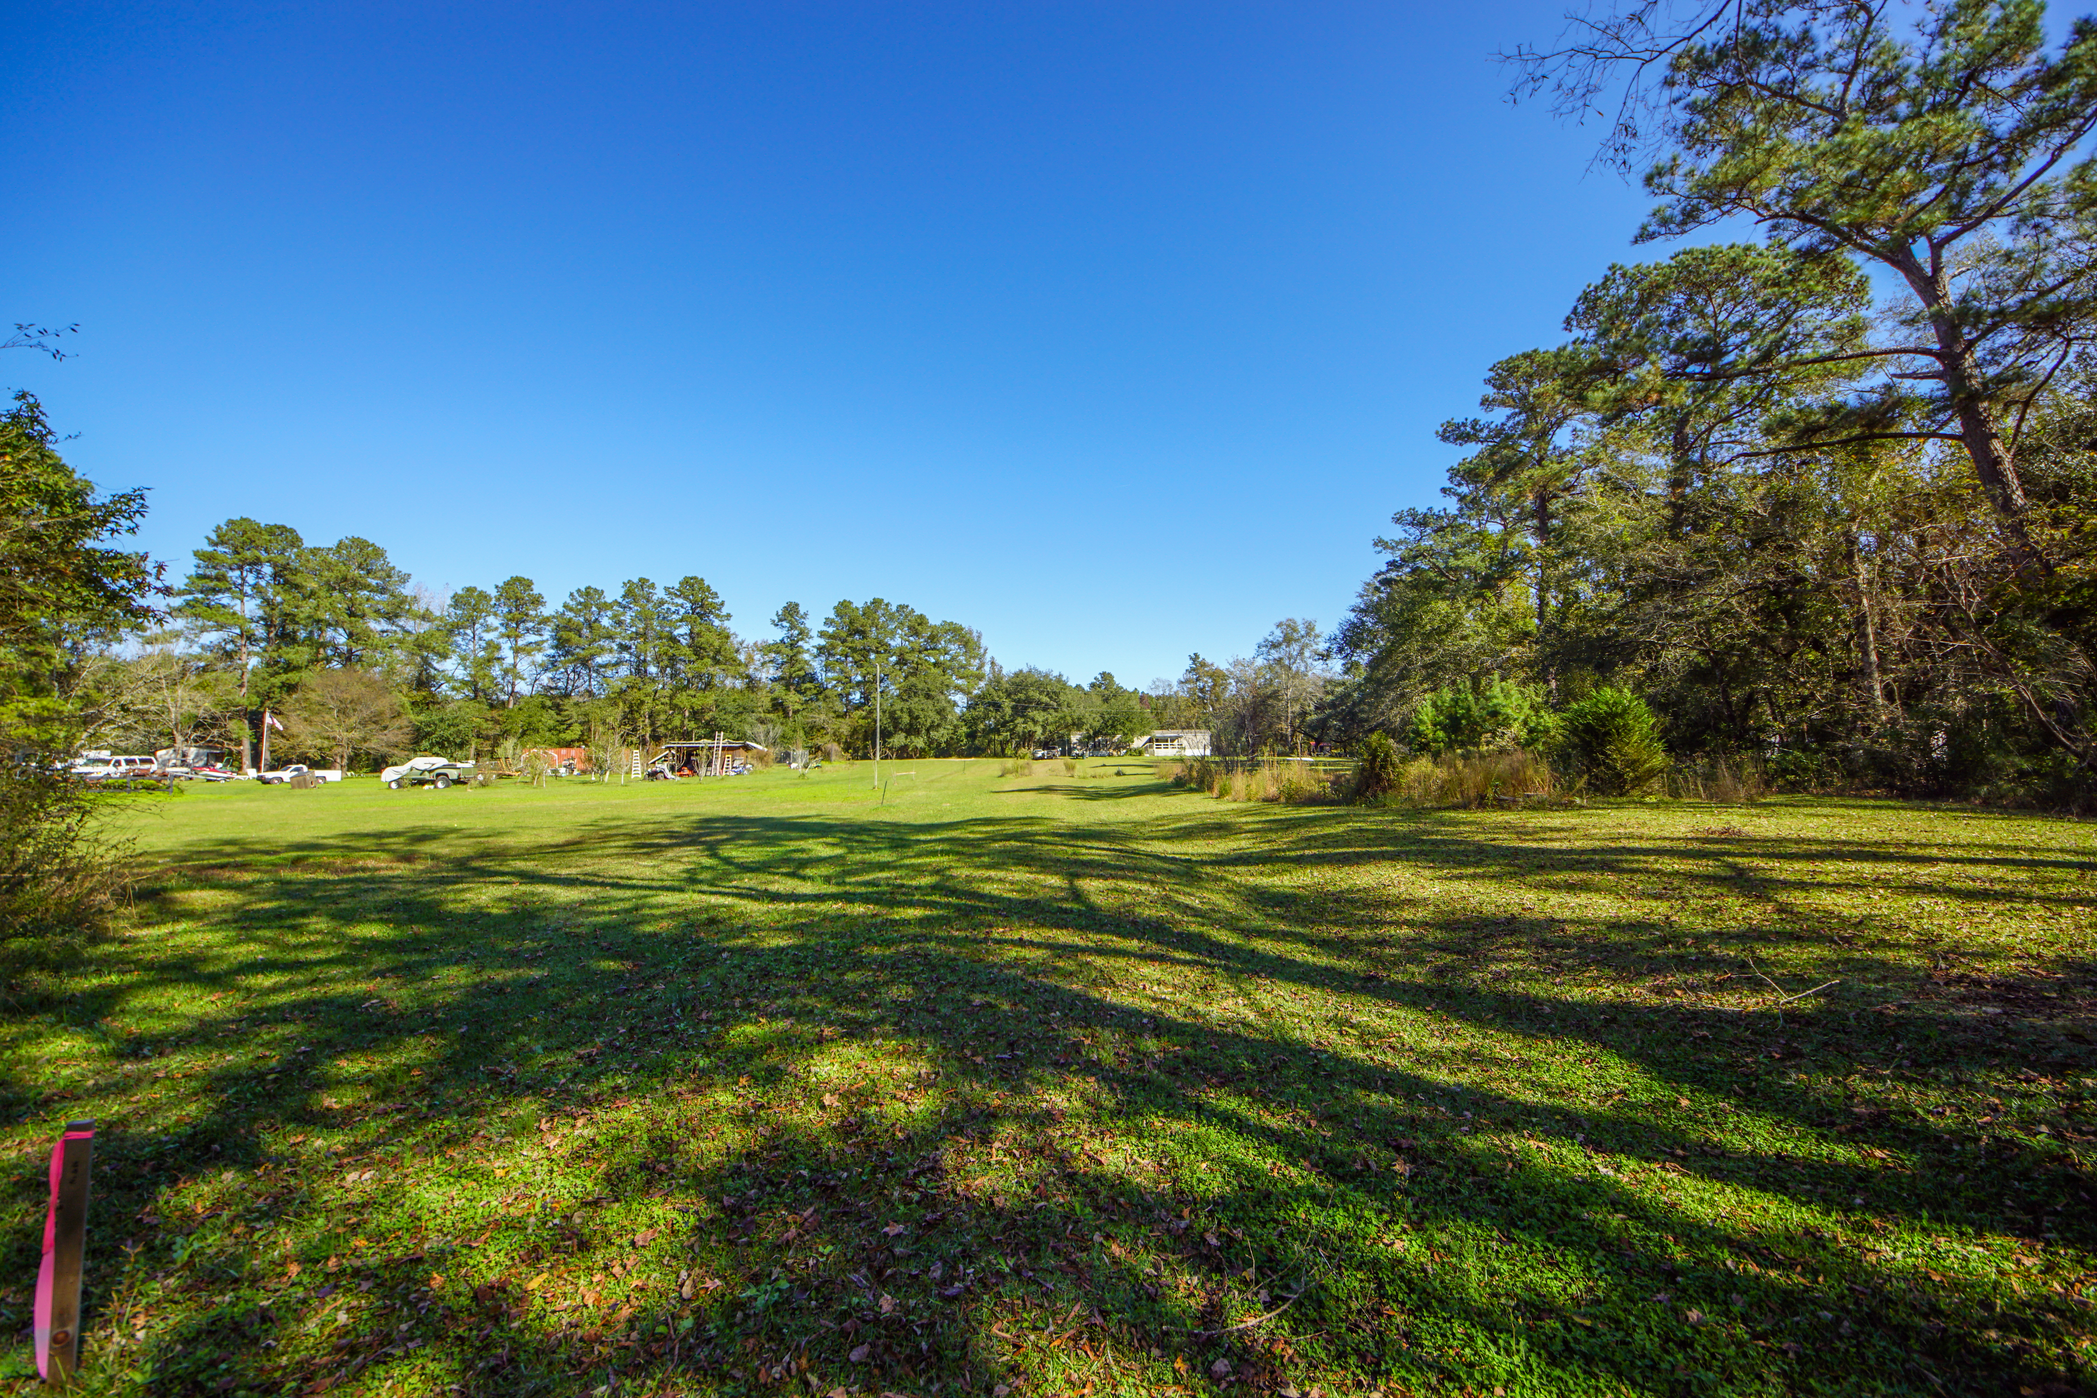
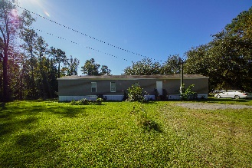
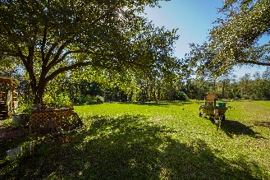
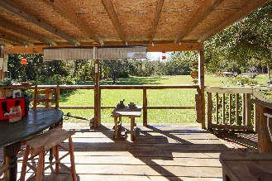
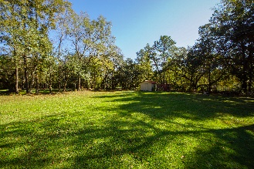
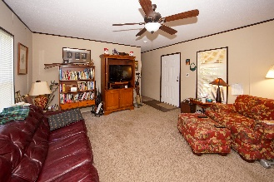
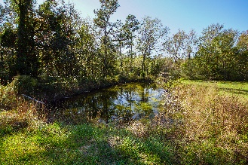
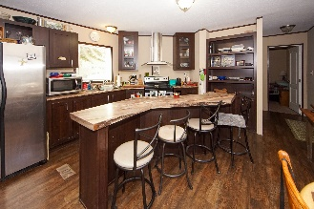
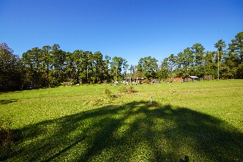
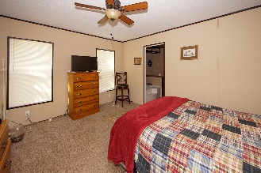
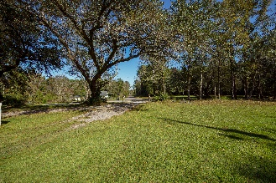
Open House Saturday, December 19th from 1-3
Absolutely Beautiful 2.25 Cleared Acres!
124 Newman Lane
Ridgeville, SC 29472
MLS# 20031905 | $259,000
You'll enjoy the outdoors sitting on your deck amongst the 12 mature oaks overlooking your picturesque property that feels like a country paradise. Riding lawnmower included. Minutes to I-95, 15 mins. to Edisto River and 30 mins. to Lake Marion.... within minutes to Charleston and Summerville and all they have to offer; plenty of restaurants, shopping, and churches. Enjoy the pond on the property that allows for plenty of fishing. The property can accommodate up to 2 horses. Choose to build your dream home or live in the mobile home which is only 6 years old and has an open floor plan with the master B/R on one side and the other 2 on the other side....kitchen has a handy island which makes entertaining a breeze! A must see!!!
Jeanette Turner, ABR | (843) 814-1355 | jeanetteturner100@gmail.com
AgentOwned Charleston Group | 902 Savannah Hwy | Charleston, SC 29407

