Slide 1
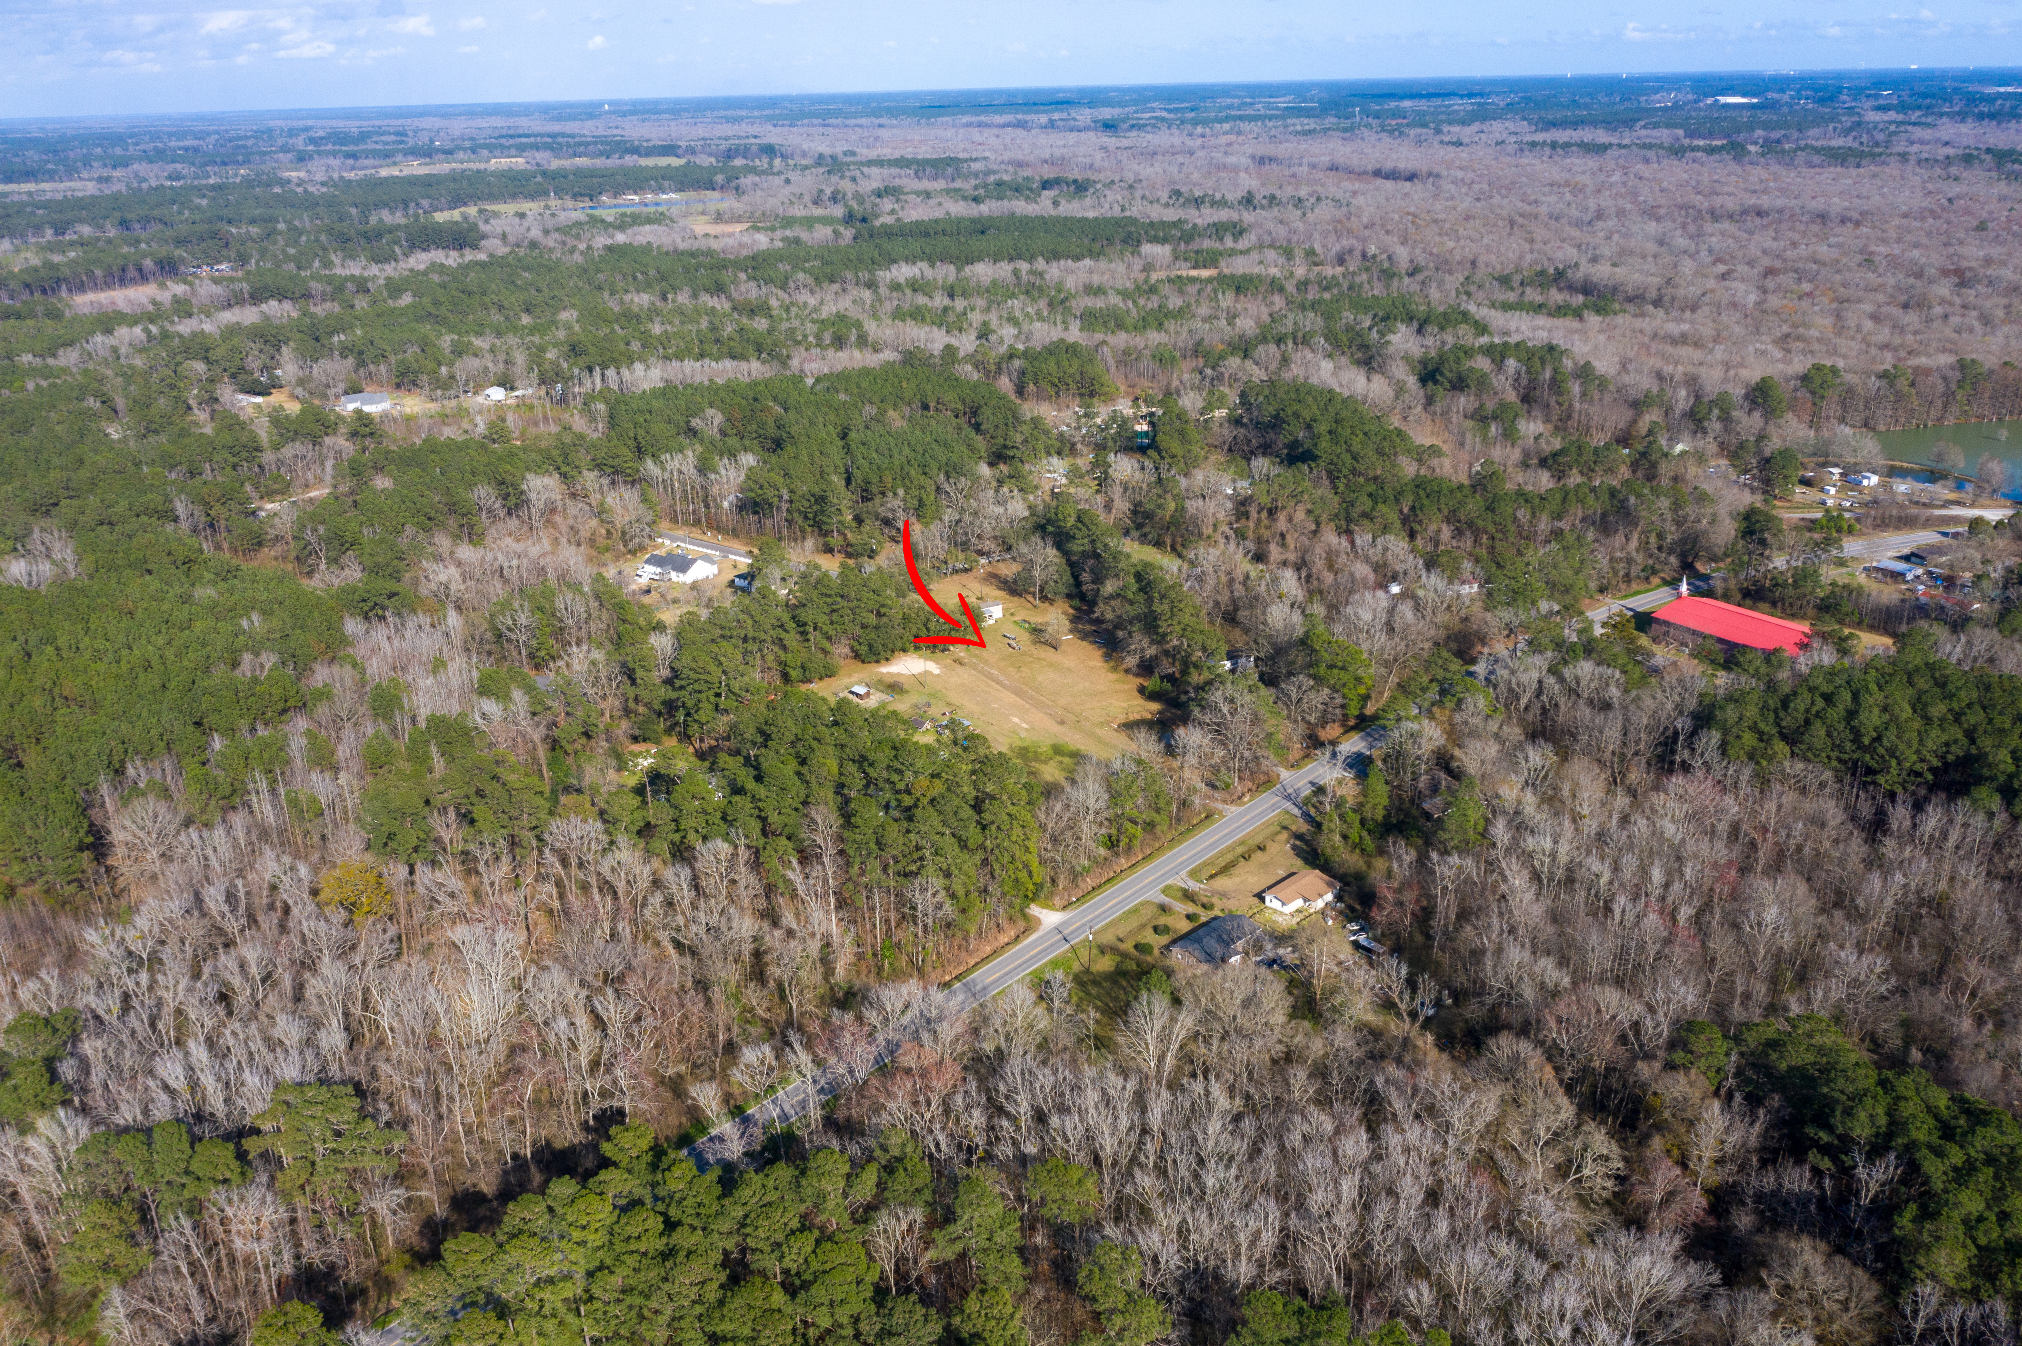
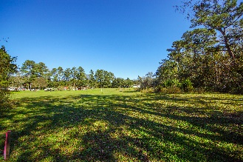
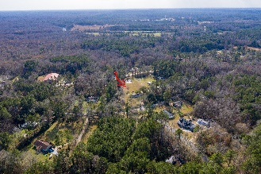
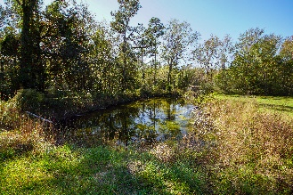
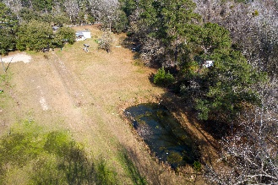
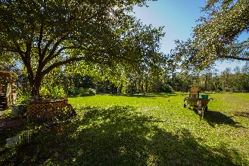
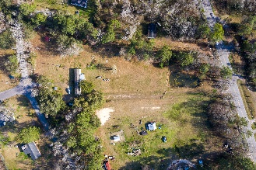
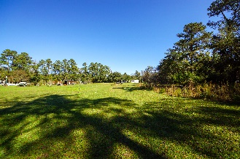
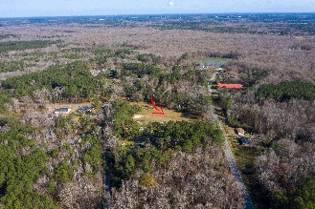
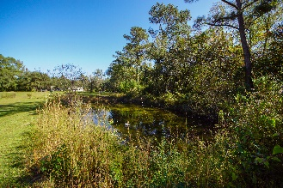
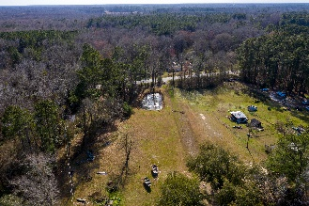
PRICE ADJUSTMENT!!
124 Newman Lane Ridgeville, SC 29472
MLS# 20031905 | $225,000
PRICE CHANGE!!! Beautiful 2.25 cleared acres that you can build your dream home on and look out amongst the 9 mature oaks overlooking your picturesque property.....property that feels like a country paradise. Minutes to I-95, 15 mins. to Edisto River and 30 mins. to Lake Marion.... within minutes to Charleston and Summerville and all they have to offer; plenty of restaurants, shopping, and churches. Enjoy the pond on the property that allows for plenty of fishing. The property can accommodate up to 2 horses. Property is not in a flood zone and price does not include the mobile home on property. Ridgeville is not way out there anymore; it's only minutes away and so convenient to everything you need. This is a must see!!
Jeanette Turner, ABR | (843) 814-1355 | jeanetteturner100@gmail.com
AgentOwned Charleston Group | 902 Savannah Hwy | Charleston, SC 29407

